Slide 1
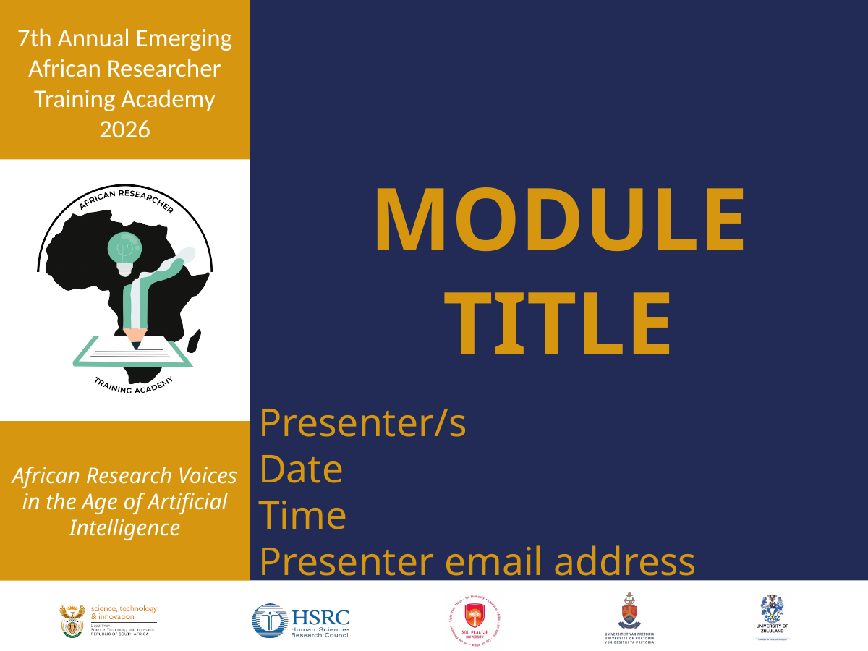
ACADEMIC
COMMUNICATION SKILLS:
SCHOLARLY VOICE
Finding your WritersVoice
Prof. Joleen Steyn Kotze
Chief Research Specialist: Democracy and Citizenship
Human Sciences Research Council
July 2026

Slide 2
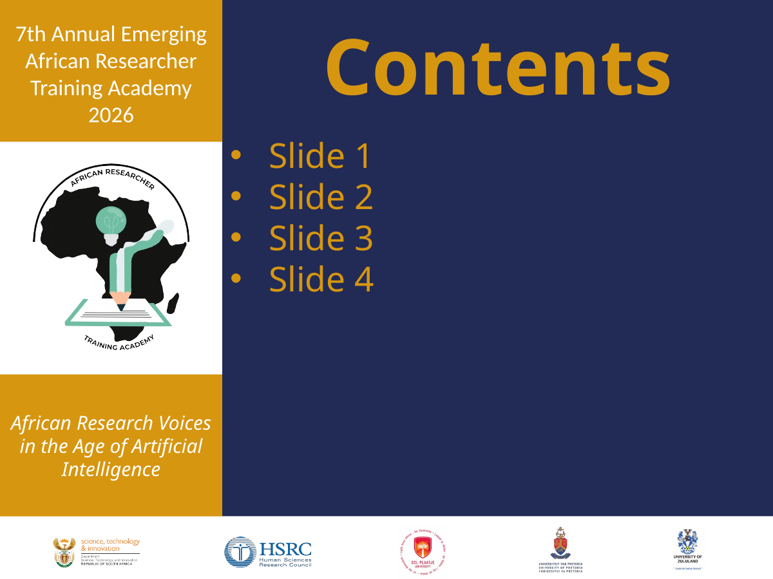
Contents
• Your writing identity
• Getting the “write” balance
• Voice as communication
• Feedback, reflection and revision
• Sustainable routines for scholarly writing

Slide 3
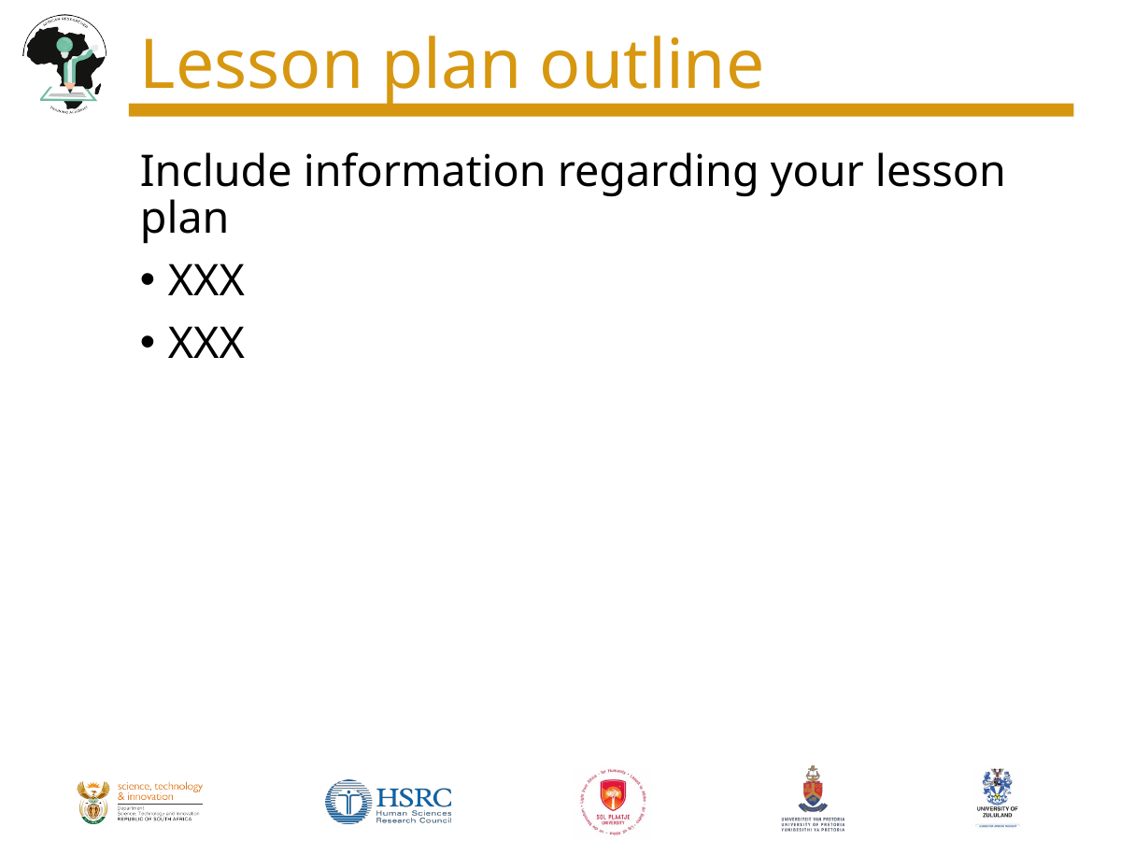
Lesson plan outline
• Opening poll: expectations for the session
• Mini-input: writer identity, voice and values
• Goal-setting exercise: testing writing goals against life realities
• Pair activity: explaining a concept and the colour purple
• Reflection: translating insights into writing habits and annual commitments

Slide 4

Learning outcomes
• Identify the values, experiences and habits that shape your scholarly voice
• Set writing goals that are ambitious, realistic and life-aware
• Practise communicating concepts with clarity, tone and purpose
• Use peer feedback as an opportunity to strengthen your writing
• Design a sustainable routine for meeting your annual writing commitments

Slide 5

PART 1
GETTING THE
“WRITE” BALANCE
Goals, context and writing commitments

Slide 6
Goals, goals and more goals
• SMART goals are useful, but writing happens inside real lives
• A sustainable goal needs awareness of time, energy, care responsibilities and institutional demands
• The key question is not only “what will I write?” but “why does this writing matter?”
• Good goals connect output targets with purpose, values and career direction

Slide 7
Reflection: test your writing goals
What writing goals have you set for 2026?
Write one goal. Then add: why it matters, what may get in the way, and one realistic adjustment.

Slide 8
PART 2
WHO ARE YOU
AS A WRITER?
Identity, values and voice

Slide 9
Who are you as a writer?
• We often ask “who am I?” in life, but rarely ask it about our writing
• Your scholarly voice is shaped by your values, interests, experiences and commitments
• Writing motivation grows when your topic connects to what you care about knowing more deeply
• Without that connection, writing can become a cycle of dread rather than a source of purpose

Slide 10
Voice is how you communicate meaning
• Your voice is not decoration; it is how you make concepts understandable to others
• It shows in your point of view, tone, structure, evidence and choice of words
• A strong voice can still be rigorous, ethical and appropriately academic
• The aim is clarity with confidence, not performance or perfection

Slide 11
Activity: explain a core concept
Choose one concept central to your work
Explain it to yourself first. Notice your key words, tone, examples and assumptions.

Slide 12
Pair activity: explaining home
• Exercise: Explaining “Home” to an Alien
Imagine aliens have arrived on Earth. They understand buildings, shelters and geographical locations, but they cannot understand what humans mean when they say that a place, person or feeling is “home.”
Take five minutes each to explain home to your partner without defining it as “the place where you live.”
You may use a story, memory, sensory detail, metaphor or example.
Your partner listens for your tone, keywords, images, sentence rhythms and what you choose to emphasise.
Switch roles after five minutes.
Discuss:
What did the speaker’s explanation reveal about what they notice and value?
Which words or images felt most distinctive?
Did the voice sound reflective, humorous, analytical, nostalgic, direct or something else?
How would another person’s explanation of “home” differ?
Reflection: A writer’s voice emerges not only through how they write, but through what they notice, remember and choose to make meaningful.

Slide 13
Debrief: what did you notice?
• How did your self-reflection and partner feedback align?
• What did you learn about your tone, vocabulary and examples?
• Where did your explanation become most vivid or persuasive?
• What might this teach you about how you write for scholarly audiences?

Slide 14
PART 3
SUSTAINING
YOUR VOICE
Reflection, routines and next actions

Slide 15
Reflective practice for scholarly writing
• Reflect without judgement: notice how you spend time and what stories you tell yourself
• Link writing goals to the values and priorities that matter in your life and career
• Translate big goals into weekly and daily writing commitments
• Build routines that protect consistency rather than relying only on urgency or inspiration
• Use peer feedback and collaboration to keep writing visible, accountable and supported

Slide 16
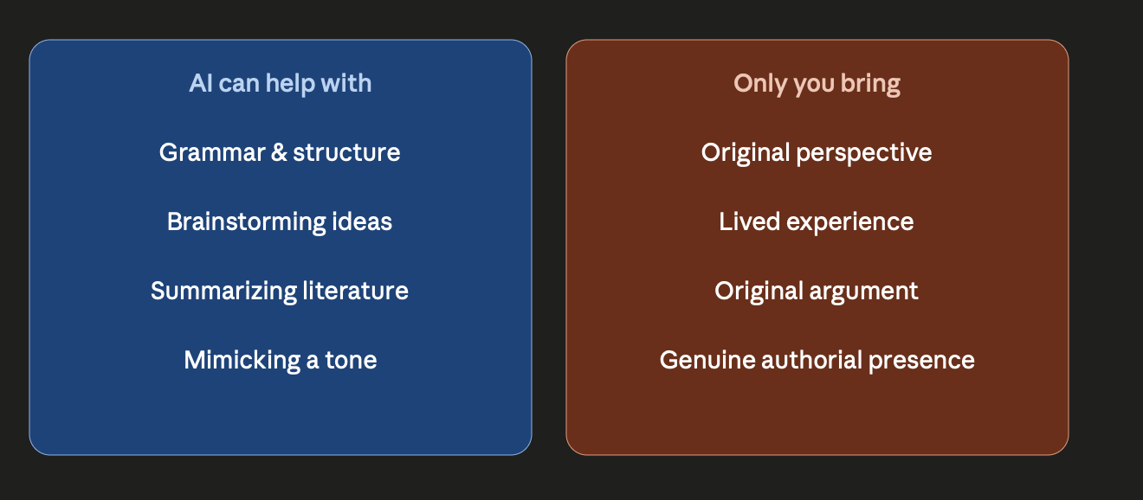

Slide 17
Closing reflection
What is your biggest takeaway?
Write one next action you can take within the next 48 hours to strengthen your scholarly voice.

Slide 18

Thank you
Any questions?
Prof. Joleen Steyn Kotze
Human Sciences Research Council

