Slide 1

7th Annual Emerging African Researcher Training Academy 2026
Principles of Referencing Using a Citation Software
Jacqueline Maseloane
28 July 2026
11h00-13h00
JLNMaseloane@hsrc.ac.za
African Research Voices in the Age of Artificial Intelligence

Slide 2
7th Annual Emerging African Researcher Training Academy 2026
Contents
Defining a bibliographic management tool
Core functionalities of a bibliographic management tool
Benefits of using a bibliographic management tool
Choosing a suitable bibliographic management tool
Common tasks you may want the software to perform
African Research Voices in the Age of Artificial Intelligence

Slide 3
Lesson plan outline
At the end of the presentation, you should have the following basics:
Understand what a bibliographic management tool is
Why using a bibliographic management tool is beneficial for you as a researcher/academic
Gain insight into selecting a suitable bibliographic management tool
Enhance your digital skills

Slide 4

What is a Bibliographic Management Tool?
A software used by researchers and scholars to assist with creating databases of bibliographic citations
To produce bibliographies which can easily be inserted into word processing documents (dissertations, books, papers, etc.)
Citations may either be created within the software itself, or more commonly, downloaded from online bibliographic systems (databases) and the Internet.

Slide 5
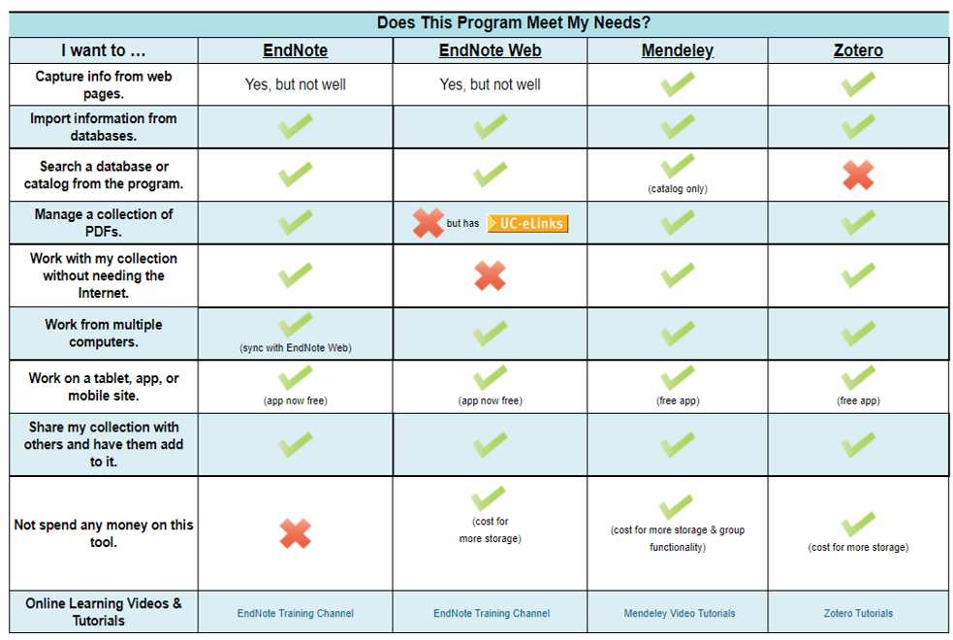
Helping you Choose a Bibliographic Management System

Slide 6
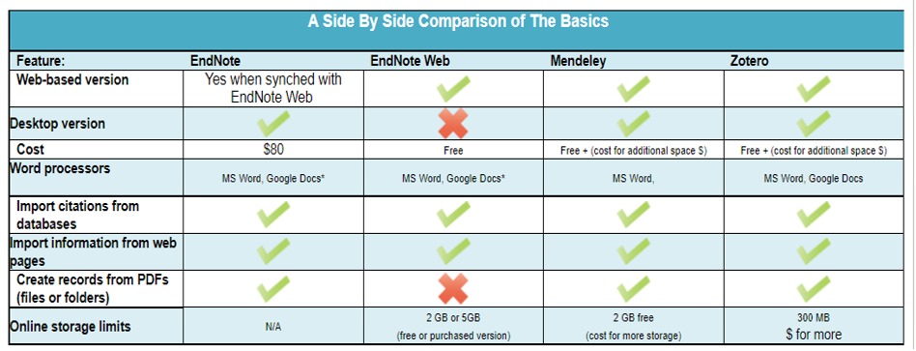
Common Functions You May Want the System to Perform

Slide 7
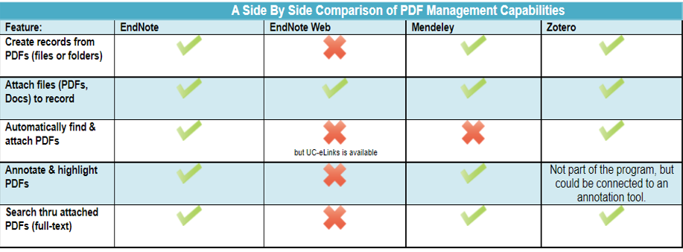
PDF Management Capabilities

Slide 8
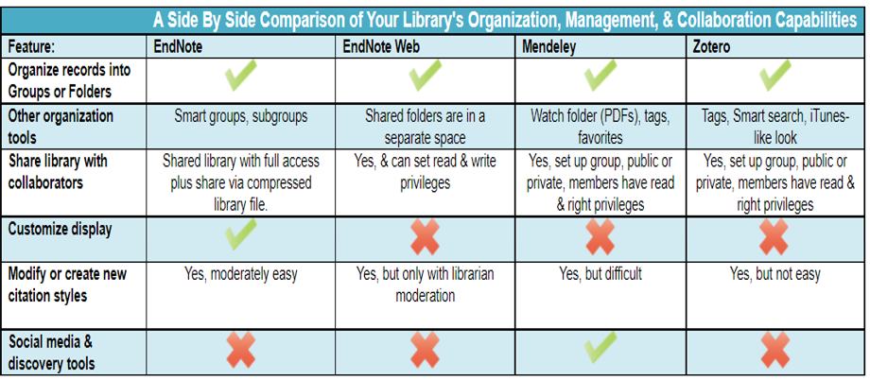
Comparison of Organization, Management and Collaboration Capabilities

Slide 9
References and Help Guides
Mendeley
https://www.mendeley.com/guides
EndNote
https://clarivate.com/webofsciencegroup/support/endnote/
https://www.youtube.com/user/EndNoteTraining
EndNote Web
https://www.youtube.com/watch?v=xRbtGtV0kFg
Zotero
https://www.zotero.org/support/quick_start_guide

Slide 10
7th Annual Emerging African Researcher Training Academy 2026
Thank you
Any questions?
African Research Voices in the Age of Artificial Intelligence

