Slide 1

RESEARCH ETHICS & INTEGRITY
Dr. Mathias Alubafi
Marilyn Couch
27 July 2026.
14:15-16:00
malubafi@hsrc.ac.za macouch@hsrc.ac.za
7th Annual Emerging African Researcher Training Academy 2026
African Research Voices in the Age of Artificial Intelligence

Slide 2
Lesson plan outline
Explain the historical development of research ethics and its relevance to contemporary research.
Describe the role of national legislation and ethical guidelines in research governance.
Identify the ethical opportunities and challenges of using artificial intelligence in research.
Apply the principles of research integrity to support responsible and trustworthy research.

Slide 3
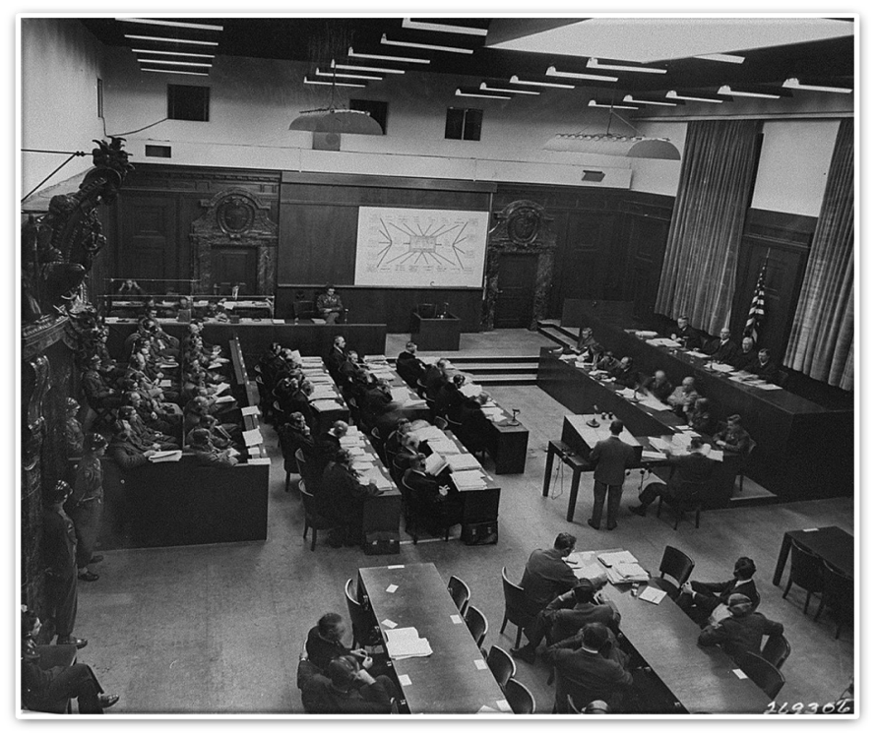
The history of Research Ethics
The Doctors Trial, which took place after World War 2, highlighted the need for ethical considerations in biomedical research.
During this trial, 23 doctors and administrators were charged with crimes against humanity for conducting research without obtaining informed consent from participants.
The judgment from this trial led to the creation of the Nuremberg Code.

Slide 4
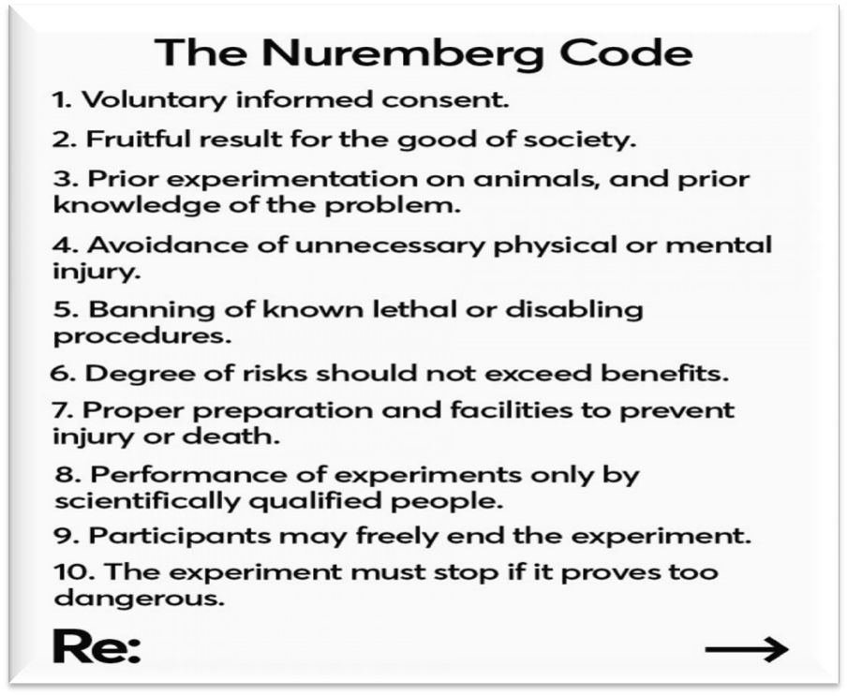
The history of Research Ethics
The first international ethical standard that outlined ten principles to protect human research participants.
The core tenets of the Code were to obtain voluntary consent from research participants and to respect their autonomy.
Some researchers disregarded the Code and continued to engage in inhumane experimentation. As a result, other unethical research practices emerged.

Slide 5
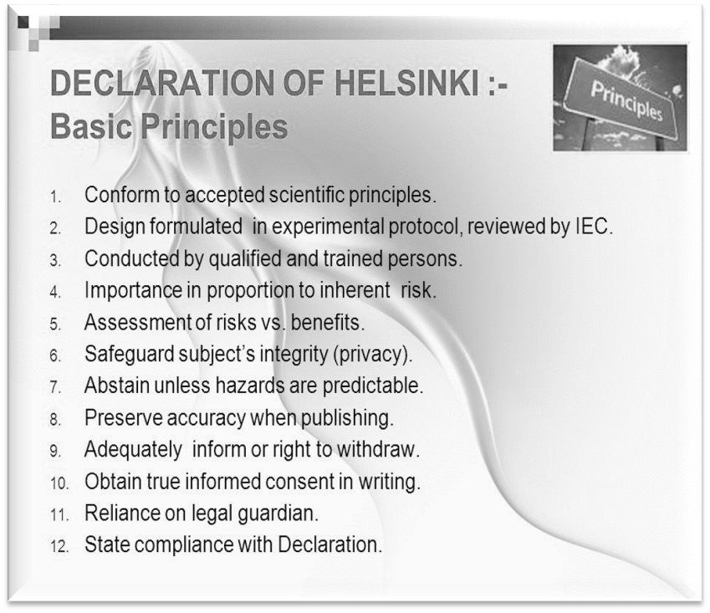
The history of Research Ethics
The World Medical Association developed the "Declaration of Helsinki" in Finland in 1964.
Research should be conducted in a manner that prioritises the interests and rights of research participants.
NB: The declaration proposed that research protocols be submitted to a Research Ethics Committee (REC) prior to the commencement of studies.

Slide 6
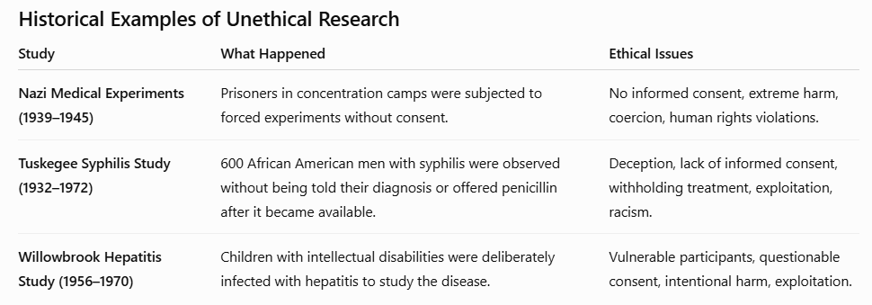
The history of Research Ethics

Slide 7
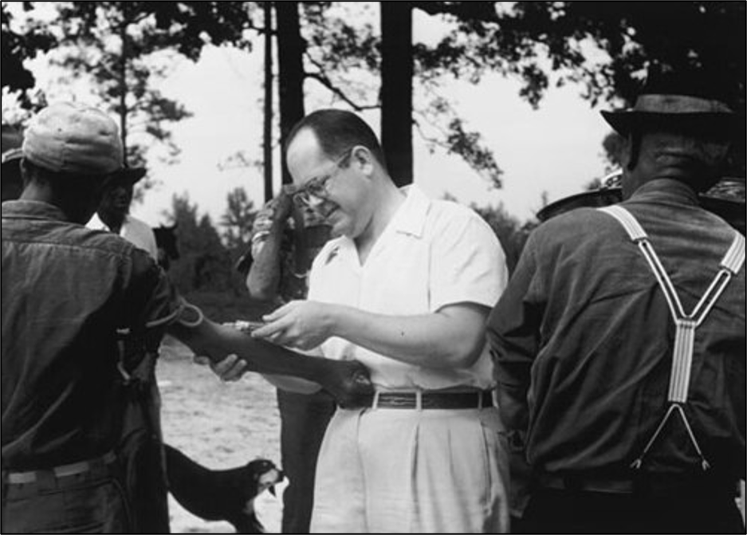
The history of Research Ethics
Prompted the enactment of the National Research Act (NRA) in the United States, which established federal regulations to protect human research participants.
It led to the creation of the National Commission for the Protection of Human Subjects of Biomedical and Behavioral Research (NCPHSBB), tasked with identifying ethical standards to guide human research.
NB: The commission (NCPHSBB) subsequently submitted the Belmont Report in 1979.

Slide 8
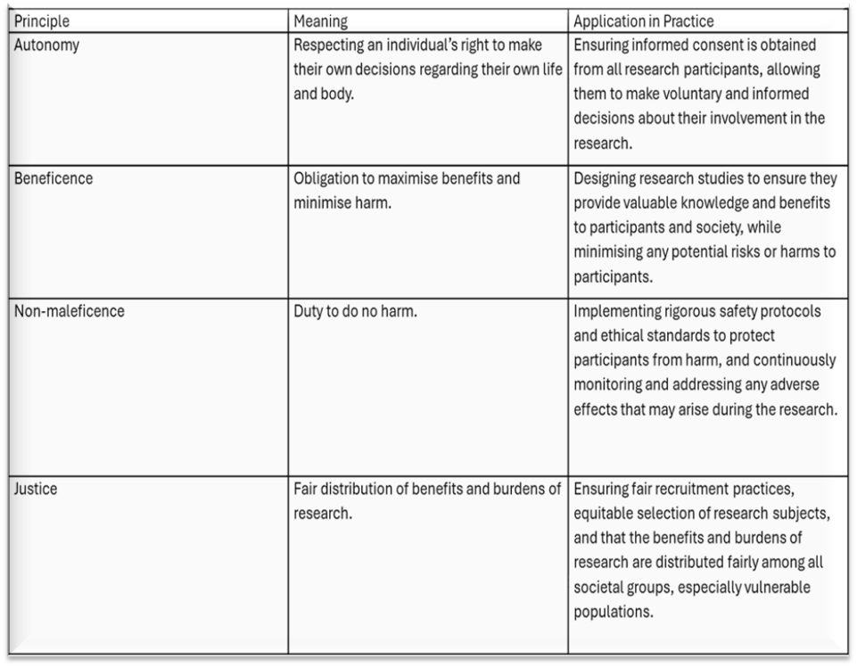
The history of Research Ethics
Belmont Report
Outlines the principles of ethical assessment in research involving human participants, including the evaluation of risks and benefits, the appropriate selection of research participants, and the requirement of informed consent.
Re-emphasised the need for research proposals to be reviewed by ethics committees (RECS).
Grounded in principles of autonomy, beneficence, non-maleficence, and justice.

Slide 9
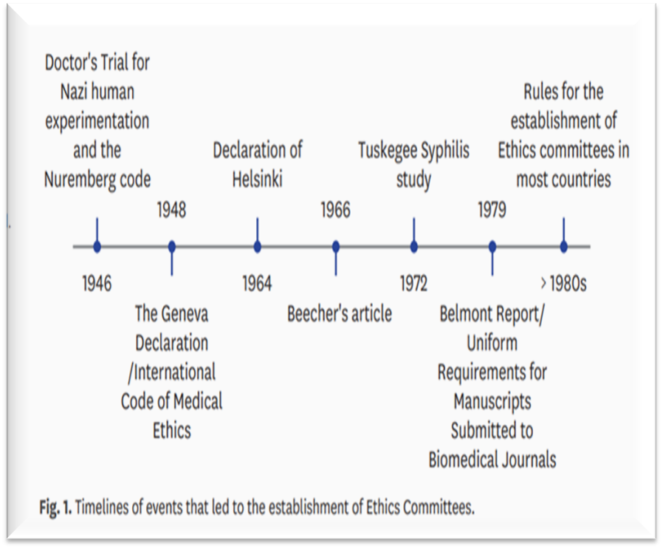

The history of Research Ethics
Since the 1980s, countries such as China, India, and South Korea have adopted and legally mandated the submission of research protocols to research ethics committees.
In South Africa, it is a legal obligation for all health-related research to undergo review by independent ethics committees.

Slide 10
Activity - Poll
Question
Is ethical review by an Independent Research Ethics Committee (REC) a legal requirement for health research in your country?
-yes/no/unsure

Slide 11

National Legislation S A Constitution
South Africa is a democratic state in which human dignity, equality and the advancement of human rights are respected, promoted and protected in terms of the Constitution of SA.
The South African Constitution explicitly protects the freedom of scientific research.
It guarantees this through Chapter 2 (Bill of Rights), Section 16 (1)(d), which states that everyone has the right to freedom of expression, which includes "academic freedom and freedom of scientific research"

Slide 12
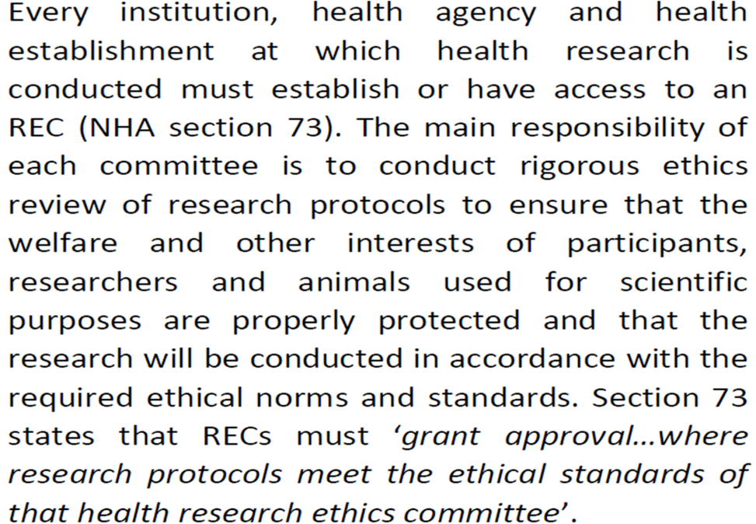
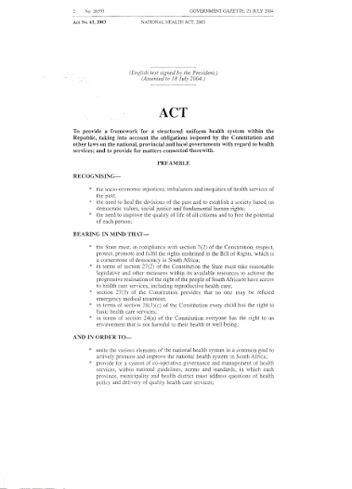
National Health Act 61 of 2003

Slide 13
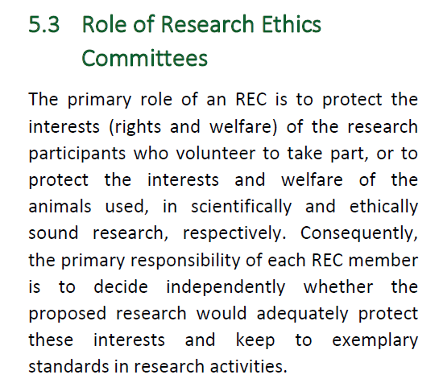
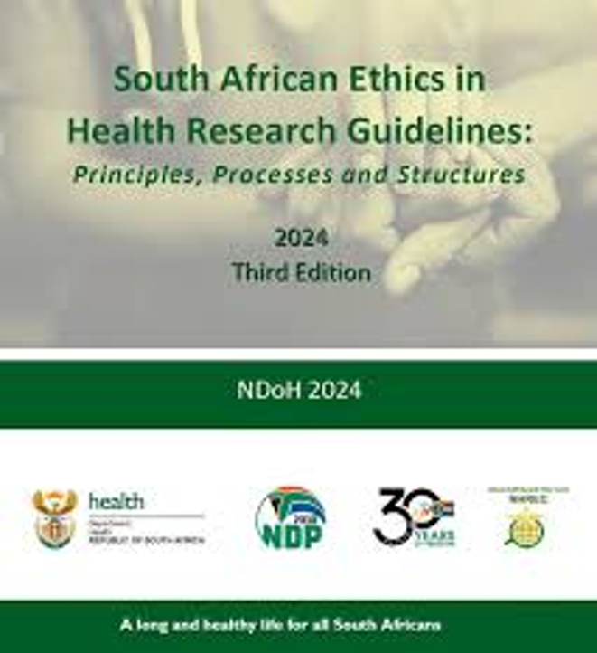
National Research Ethics Guidelines

Slide 14
So, what is Research Ethics??
Research ethics are moral principles that guide researchers to conduct and report research without deception or intention to harm the participants of the study or members of the society as a whole, whether knowingly or unknowingly.
The set of values, standards, and principles used to determine appropriate and acceptable conduct at all stages of the research process.
Principles for guiding decision-making and reconciling conflicting values in research with people and about people.
Concerns the responsibility of researchers to be honest and respectful to all individuals who may be affected by their research activities or research outputs/reports.

Slide 15

Why is Ethics in Research Important
It is a reflection of respect for those who take part in research.
It ensures that no unreasonable, unsafe, or thoughtless demands are made by researchers.
ensures that research outputs are shared in a responsible and ethically sound manner.

Slide 16
7th Annual Emerging African Researcher Training Academy 2026
ETHICS & ARTIFICIAL INTELLIGENCE
African Research Voices in the Age of Artificial Intelligence

Slide 17
Activity- Poll
Which of the following have you used AI for in your research?
Literature searching
Summarising articles
Editing grammar
Brainstorming ideas
Coding qualitative data
Data analysis
Writing sections of a paper
I have never used AI

Slide 18

Artificial Intelligence
Artificial intelligence (AI) can be defined as a machine (mainly a computer) capable of replicating human capabilities like learning, reasoning, and self-correction.
Some categories of AI include generative AI, which are models that generate novel content in response to prompts – e.g., ChatGPT.
Large language models – LLM – which are AI models that understand and generate human-like text by training on large datasets.

Slide 19
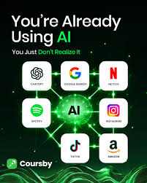
The Application of Artificial Intelligence
AI is mostly applied in the following:
Search engines such as Google
Recommendation systems such as YouTube, Amazon &Netflix – friends recommending content/products to search
Virtual assistance on phone
Chatbots such as ChatGPT

Slide 20
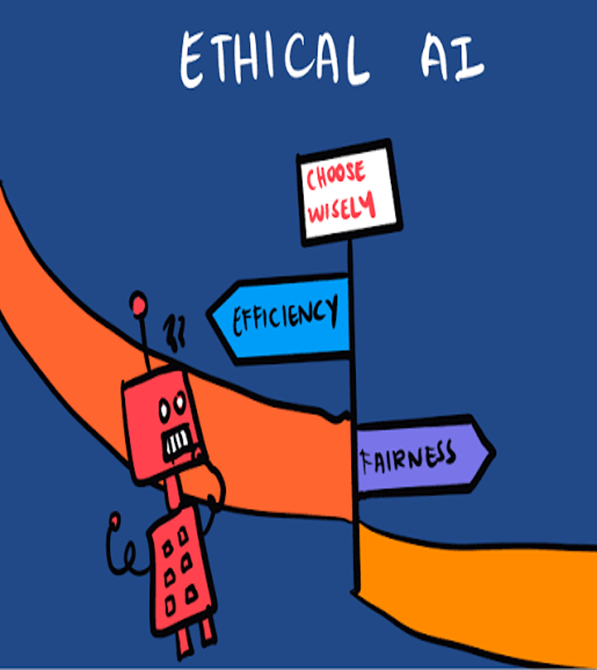
Why the use of Artificial Intelligence
We are told that AI is important because it significantly reduces errors and increases accuracy.
Decisions made by AI are based on previously gathered information and a specific set of algorithms.
When programmed correctly, these errors can be minimized to zero. For example, robotic surgery systems can perform complex surgeries with precision.

Slide 21
Ethical Challenges of Artificial Intelligence
Bias and fairness
AI bias is an important ethical concern. AI is meant to mimic human behaviour, that is to act like humans, think like humans, so it is possible that AI can be bias in the process of mimicking
Bias exist in training data which is coming from human input and this training data is used to train AI models to think like humans and that is why bias can exist in AI models as well
There could be different sources of bias that exist – e.g. confirmation bias – which is bias where AI would tend to produce confirmative answers when you ask a question even when this may not be the case
Authorship
Research suggest that 52% of the internet content is AI generated
Prior to AI ChatGPT, 90% of internet content was generated by humans but in recent years AI has populated the internet occupying more than 50% of internet content and this is bound to increase as the years go by
So the question is, who is the author of this AI content, how authentic is it, and how ethical is it?

Slide 22
Ethical Challenges of Artificial Intelligence
Accountability and transparency
The other ethical issue is ensuring AI accountability and transparency.
We all know that when conducting scientific research, transparency is required to ensure that others can reproduce the results we generate
When it comes to using AI in research, it complicates the steps for transparency and reproductivity. This is because AI models are updating regularly
So imagine that there are two people who are using AI and feeding the same prompt – that is one person now and another after six months (asking same question) – we will get different answers because of the time difference – so which one is correct?
Even when two people ask similar questions to AI at the same time, they may still get different answers because of the prompts they used in asking

Slide 23
Best Practices
Verify Everything Independently: Large language models can produce hallucinations or biased data. Always verify AI-generated claims and citations against credible, primary, peer-reviewed sources.
Maintain Human Accountability: You are fully responsible for the integrity and accuracy of your research. Never let AI substitute for critical thinking, hypothesis generation, or conceptual leaps.
Prioritize Data Privacy: Never input unpublished, sensitive, or confidential data into public AI platforms, as these may train the model on your proprietary information.
Disclose Usage Transparently: Explicitly detail how and where AI assisted your work (e.g., in the methods or acknowledgments sections). Be sure to check the exact AI guideline for researchers provided by your target publisher or funding agency. For example:
Declaration of AI Use: Artificial intelligence-based tools were used solely to assist with
English language editing and formatting. All substantive content, analysis, and interpretations are the authors’ own.

Slide 24
Activity - Discussion
A student uses ChatGPT to help write a literature review.
They ask it to:
summarise journal articles, improve the language, generate research questions, and rewrite paragraphs they have written.
The student does not acknowledge using AI in the thesis because they believe it is "just like Grammarly."
Questions
Is the student's use of AI ethical?
Which uses of AI are acceptable?
At what point does AI become a co-author rather than a writing assistant?
Should AI use always be disclosed?
Who is responsible if the AI produces incorrect information?

Slide 25
7th Annual Emerging African Researcher Training Academy 2026
RESEARCH INTEGRITY
African Research Voices in the Age of Artificial Intelligence

Slide 26
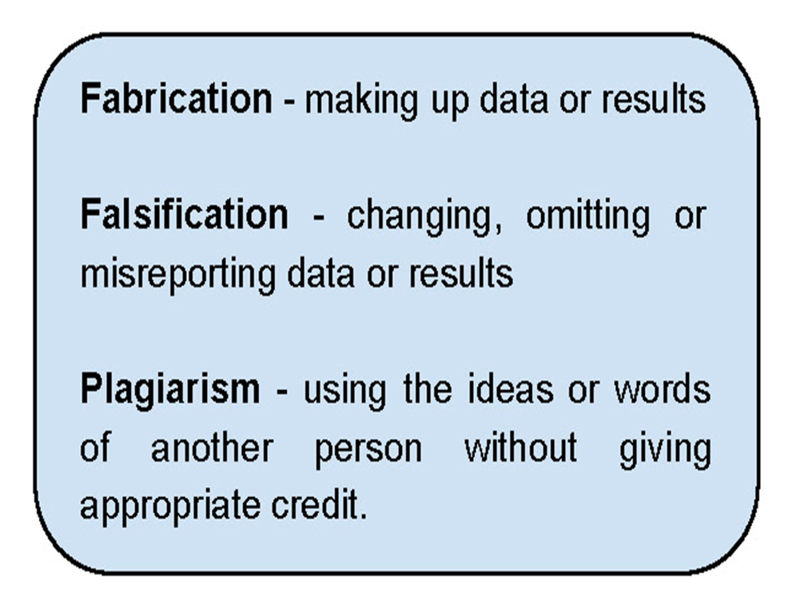
Research Integrity and Misconduct
Research integrity is the active adherence to ethical principles, professional standards, and intellectual honesty in proposing, conducting, and reporting research.
Research misconduct is the violation of ethical and professional standards in proposing, conducting, or reporting research.

Slide 27
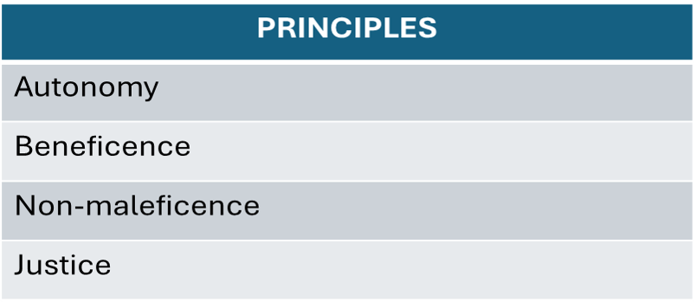
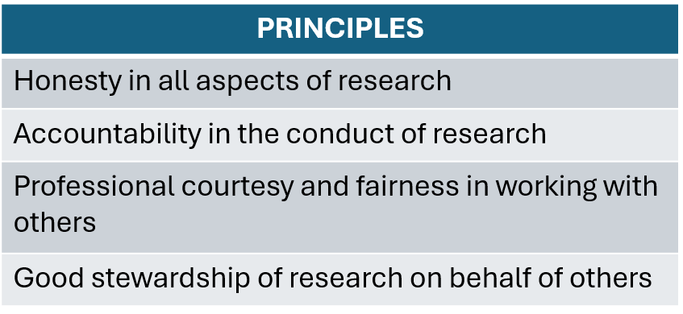
Research Ethics vs Research Integrity
Research Ethics
Research practice viewed from the perspective of moral principles.
(i.e. the protection of the research participants).
Research Integrity
Research practice is viewed from the perspective of professional standards.
(i.e. the conduct of the researcher).

Slide 28

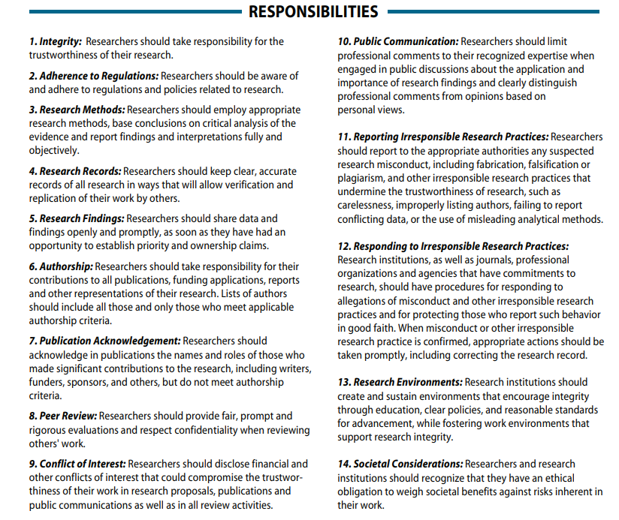

Slide 29

Human Accountability: Researchers must remain fully responsible for the integrity, validity, and accuracy of their work. AI tools may assist with processes but cannot replace critical scholarly thinking or fulfill the moral and legal accountability of authorship.
Transparent Reporting: When AI is used in data analysis, methodology, or content generation, it must be clearly and transparently declared and documented.
Cross-Sector Collaboration Integrity: Researchers must safeguard the independence of their research, manage biases, and ensure that AI-driven tools do not obscure the human role in knowledge production.

Slide 30

Activity - Poll
Activity
1. Explain what took place in the video
POLL:
Q1: Was this a research ethics or research integrity breach?
Q2: What type of breach - data fabrication, falsification, or plagiarism?
Discuss: What are the potential consequences of research misconduct for the broader scientific community?
https://youtu.be/j_6U-2LG5Q8?si=--2zBStyVyB3o8VT

Slide 31
Lesson outcomes
Explain the historical development of research ethics and its influence on contemporary research practice.
Describe the role of national legislation and ethical guidelines in the governance of research.
Identify key ethical opportunities and challenges associated with the use of artificial intelligence in research.
Apply the principles of research integrity to promote responsible and trustworthy research practices.

Slide 32
7th Annual Emerging African Researcher Training Academy 2026
Thank you
Any questions?
African Research Voices in the Age of Artificial Intelligence

