Slide 1

7th Annual Emerging African Researcher Training Academy 2026
LITERATURE REVIEW
Dr Jaqueline Harvey
28 July 2026
09:00-10:30
jharvey@hsrc.ac.za
African Research Voices in the Age of Artificial Intelligence

Slide 2
7th Annual Emerging African Researcher Training Academy 2026
CONTENTS
Understanding the literature review
Overview of the process
Searching for literature
Reading, analysing, and organizing
Synthesizing and writing
Using AI
African Research Voices in the Age of Artificial Intelligence

Slide 3
Learning objectives
Understand what a literature review is and its purpose
Know how to undertake the three steps of writing a literature review
Be exposed to information synthesis
Know a few tips and tricks in making these processes easier

Slide 4
Do not edit
How to change the design
How do you generally feel towards literature review?
The Slido app must be installed on every computer you’re presenting from

Slide 5
Role in research process
Identify initial topic, RQs, and outcomes
Conduct literature search
Write literature review
Develop specific aims and RQs
Interpret outcomes, discuss conclusions and limitations, generate future RQs
Choose appropriate research design
Collect and analyse outcome data
Identify methods and outcome measures

Slide 6
What is a literature review to you?
What do you think the purpose of the literature review is?
Mic on
Notes:
“The Great Wave off Kanagawa”

Slide 7
Types of literature reviews
Part of larger work
Project proposal
Independent project
Journal article
Thesis
Dissertation
Selective
Comprehensive
Reading report
Review article
Stand-alone work

Slide 8

Four main components
Evaluates and critiques source texts
Makes connections between source texts
Identifies theories and previous research
Illustrates gaps in previous research
Notes:
It has the following four key components: 1) evaluates and critiques source texts, 2) makes connections between source texts (synthesizes, compares, contrasts), 3) identifies theories and previous research which have influenced your research topic and methodology, and 4) illustrates the gaps in previous research.
And it does so to demonstrate your knowledge of the subject area and where you fit in as well as motivate for your choices, such as your research design and how your work will fill the gap.

Slide 9
Overview of process
Three steps, guided by your topic and RQs:
This is a recursive rather than a linear process
SEARCH
READ, ANALYSE, AND ORGANISE
SYNTHESIZE AND WRITE

Slide 10
7th Annual Emerging African Researcher Training Academy 2026
SEARCH
African Research Voices in the Age of Artificial Intelligence

Slide 11

Notes:
“The Great Wave off Kanagawa”

Slide 12
Searching for literature (briefly)
Developing a search strategy is an iterative process
Identify keywords based on preliminary reading
Search for relevant sources
  Use Boolean operators (AND, OR, NOT)
  Read abstracts
  Check bibliographies for more sources
  Note seminal and recuring citations

Slide 13
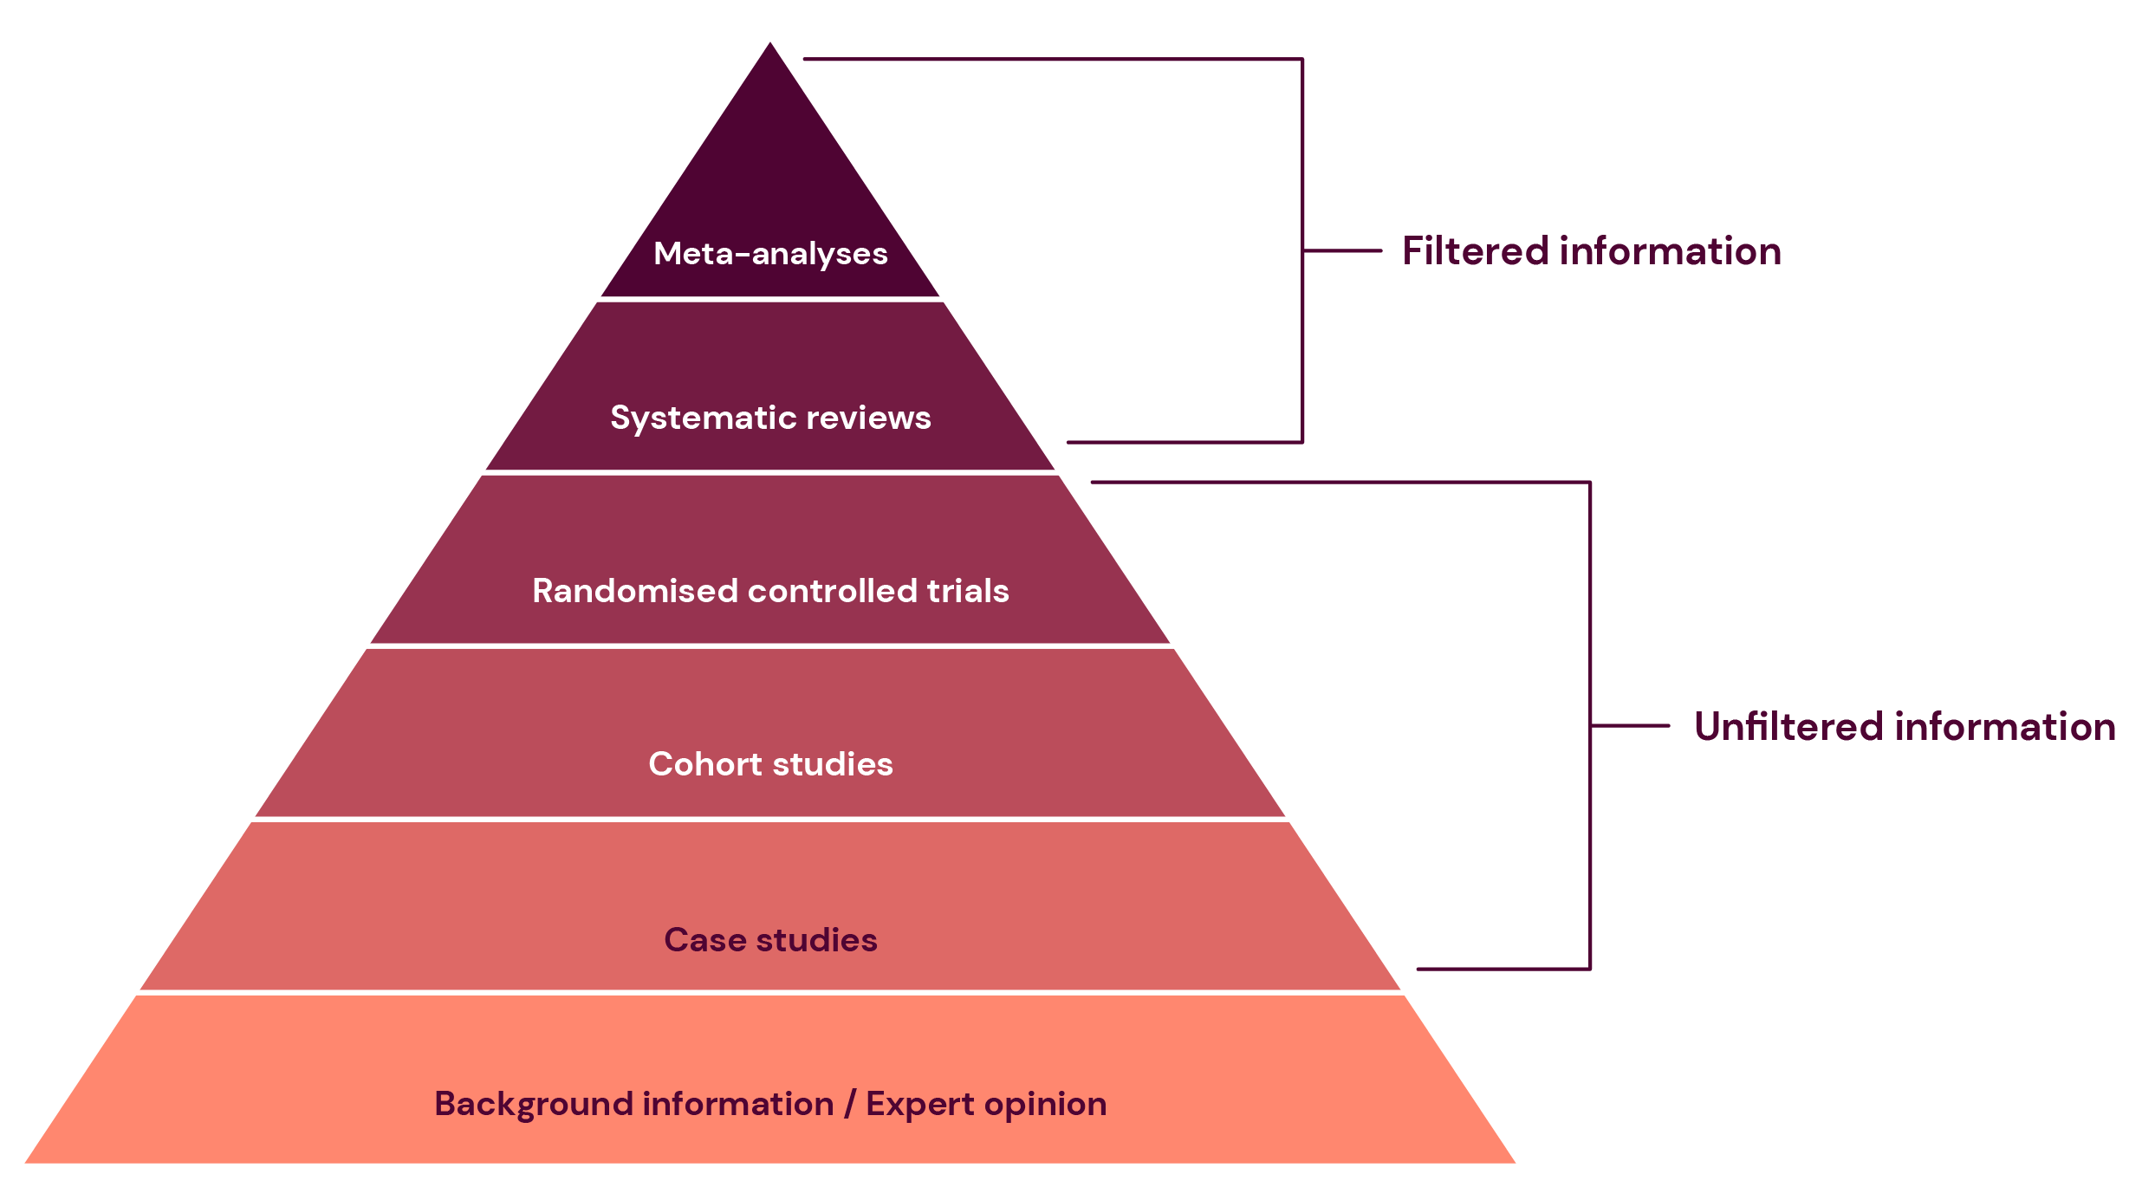
Pyramid of evidence

Slide 14
7th Annual Emerging African Researcher Training Academy 2026
READ, ANALYSE, AND ORGANISE
African Research Voices in the Age of Artificial Intelligence

Slide 15
Read and analyse
Read the abstract
Read the introduction
Read the method with a close, critical eye
Evaluate the results
Take the discussion with a grain of salt
Notes:
Step 1: Decide whether to read the abstract in detail
Step 2: The introduction explains why the study is important and provides a review and evaluation of relevant literature. Important references will be repeated across scholarly works.
Step 3: Focus on the participants, the measures, and the procedures. What was the theoretical approach?
Step 4: Do the conclusions seem logical? How valid are the results? Can you detect any bias on the part of the researcher?
Step 5: How does the work contribute to the discipline’s understanding of the problem? What problems has the author avoided or ignored?

Slide 16
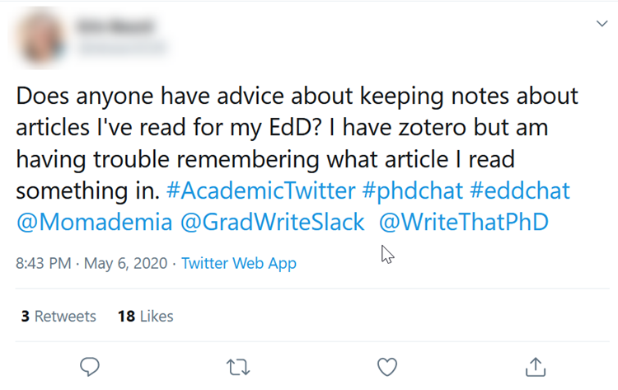
Organise
Organise the literature you have selected (e.g., note-taking)
Consider an annotated bibliography or Excel synthesis matrix
Develop a visual diagram
Use a reference management software
E.g., Zotero, Mendeley, Endnote, etc.

Slide 17
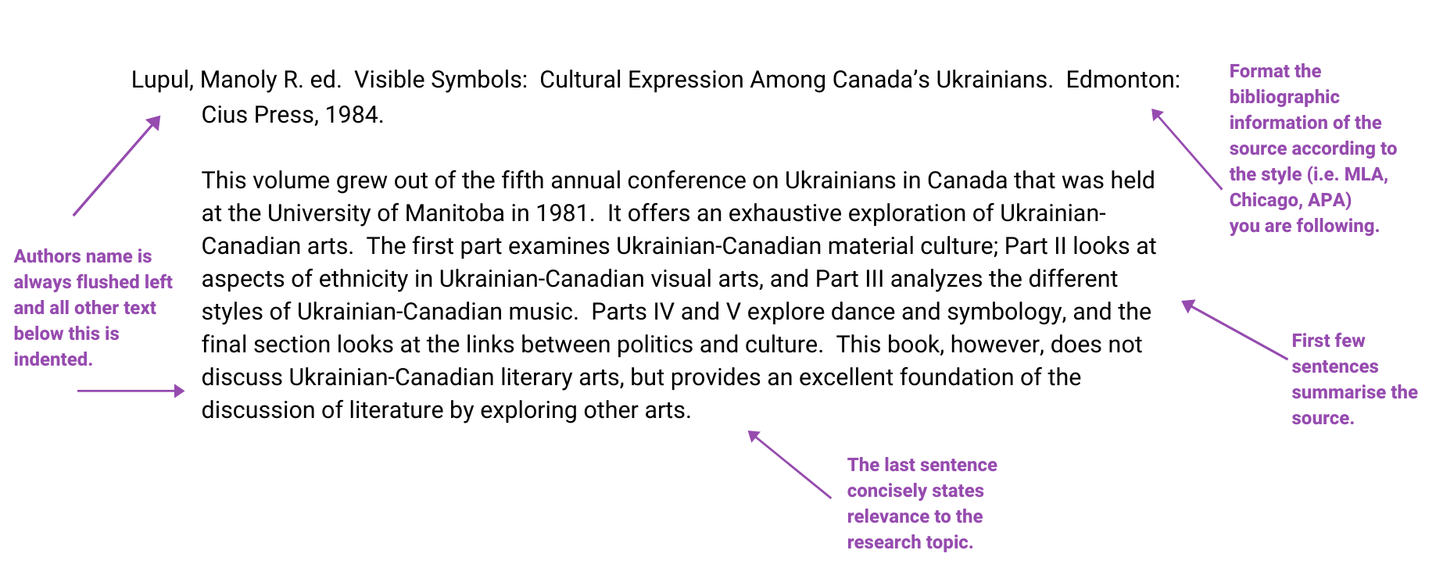
Annotated bibliography example

Slide 18
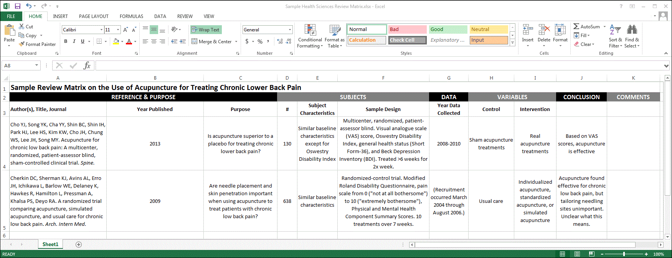
Excel synthesis matrix example

Slide 19
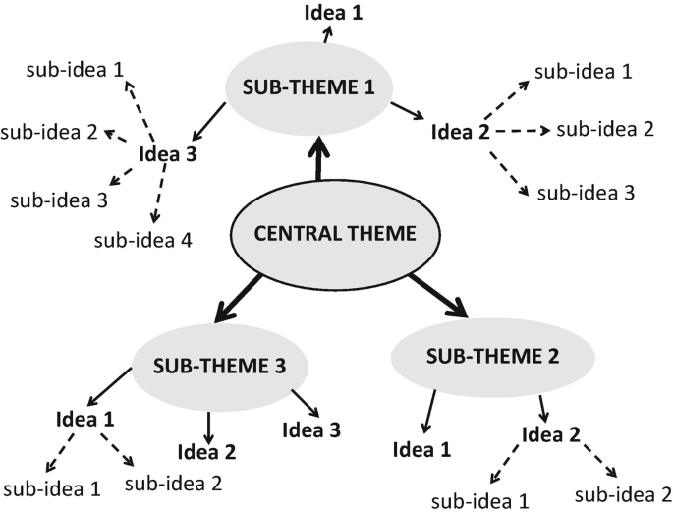
Visual diagram example

Slide 20
7th Annual Emerging African Researcher Training Academy 2026
SYNTHESIZE AND WRITE
African Research Voices in the Age of Artificial Intelligence

Slide 21
Synthesize…
Key themes
Pivotal publications and trends in the literature over time
Debates and disagreements
  Where do sources disagree?
  What the strengths and weaknesses of the debates?
What evidence is lacking, inconclusive, or limited?
Research gaps
  What is missing from the literature?
  Are there weaknesses that need to be addressed?

Slide 22
… and write
Introduction
Establishing purpose
Overview of topic, aim of review, and structure
Body
Analysing the literature
Summarise and synthesise, bringing in your critical evaluation and analysis
Conclusion
Summarising key findings
Relate conclusion to purpose, aims, and objectives
Write in well-structured paragraphs using topic sentences, concluding sentences, and transition words
Summarise key points, particularly key gaps
Outline areas for future research

Slide 23
Keep drafting
Start with an overview and decide on organising principles
  Use headings for the different sections of the review
Clear paragraph structure
  Topic sentence (signposting)
  Discussion of topic (use transition words for signposting)
  Closing sentence
Thematic and grammatical links
  Logical progression from one paragraph to the next
  Demonstrate links in your language
Summarise your review/highlight ‘gap’ in research

Slide 24
Word choice
Author is neutral | Author implies | Author argues | Author disagrees | Author agrees
comments | analyses | contends | disparages | admits
describes | assesses | defends | bemoans | concedes
illustrates | concludes | holds | complains | concurs
notes | finds | maintains | deplores | grants
observes | predicts | insists | laments | agrees
points out | speculates | disputes | warns | states

Slide 25
Finally, your literature review should answer
Current knowledge
What questions have existing publications addressed?
What issues have been neglected?
Conceptual frameworks
What theories provide a framework for the research you are reviewing?
What variables or processes are cited as explanatory or causal?
Linking your study intent
How will your project contribute to ongoing discussion in the area reviewed?
What are the main conclusions of existing research?
What are the main disagreements?
What are the most important problems and gaps that require addition research?

Slide 26
7th Annual Emerging African Researcher Training Academy 2026
FINAL EXERCISES
African Research Voices in the Age of Artificial Intelligence

Slide 27
Sample paragraph 1
Language of instruction plays a significant role in students’ academic performance. The positive association between language of instruction and achievement has been identified in several studies (e.g., Fakeye & Ogunsiji, 2009; Ghenghesh, 2015; Komba & Bosco, 2015; Phiri et al., 2013). For example, in Tanzania, Komba et al. (2012) explored if there was a correlation between students’ abilities in written English language proficiency and their academic performance. The authors found a significant positive relationship between students’ abilities in the English Writing Skills Test (EWST) and their University GPAs (r = .314, p <.01). However, the results from the study by Wilson and Komba (2012) were somewhat contradictory. Wilson and Komba (2012) identified a significant positive correlation between English language proficiency and students’ academic achievement in English (r = .293, p = .005), but not General Studies (r = .096, p = .372). Further investigation is required to resolve these conflicting results and explore how language of instruction impacts student academic achievement.

Slide 28
Sample paragraph 1 answer
Language of instruction plays a significant role in students’ academic performance. The positive association between language of instruction and achievement has been identified in several studies (e.g., Fakeye & Ogunsiji, 2009; Ghenghesh, 2015; Komba & Bosco, 2015; Phiri et al., 2013). For example, in Tanzania, Komba et al. (2012) explored if there was a correlation between students’ abilities in written English language proficiency and their academic performance. The authors found a significant positive relationship between students’ abilities in the English Writing Skills Test (EWST) and their University GPAs (r = .314, p <.01). However, the results from the study by Wilson and Komba (2012) were somewhat contradictory. Wilson and Komba (2012) identified a significant positive correlation between English language proficiency and students’ academic achievement in English (r = .293, p = .005), but not General Studies (r = .096, p = .372). Further investigation is required to resolve these conflicting results and explore how language of instruction impacts student academic achievement.

Slide 29
Sample paragraph 2
David Mosse (2000) writes about a rural development project in Eastern India. In this project (the Western Indian Rainfed Farming Project), an NGO aimed to use participatory methods to include the views of the community within the running and management of the project. Mosse says that this did not fully work, as the project coordinators already had their own ideas about the goods and services they would provide villagers with.
Another example of participatory development in India is described by Jenkins and Goetz (1999). They discuss the role of the MKSS, which fights for the right to information about government programmes in Rajasthan. Here, the NGO works by publicizing the account of government development programmes, and holding public meetings where the actions of government officials can be criticised.

Slide 30
7th Annual Emerging African Researcher Training Academy 2026
USING AI
African Research Voices in the Age of Artificial Intelligence

Slide 31
Is AI beneficial in literature review writing?
AI can help refine RQs, identify gaps in the literature, and streamline the screening and data extraction process, reducing the time and effort needed.
However, AI cannot replace human interpretation and creativity.
It is the role of the researcher to evaluate, synthesise, and develop—this is irreplaceable.

Slide 32
What is “allowed” and what is not
Routine tasks, e.g., improving grammar, revising sentence structure, or assisting with literature searches
Some tasks if a declaration is provided, e.g., correcting code, generating tables or figures, reducing word count, or checking on analyses
AI-generated content. Authors must disclose when AI-generated content is used, providing specific details such as the AI tool’s name, version, and the prompt used. AI tools cannot be listed as co-authors or take responsibility for the content.
Laher S. Using AI in academic writing: what’s allowed and what’s not. South African Journal of Psychology. 2025;55(2):155-158. doi:10.1177/00812463251338244

Slide 33
Why do you want to use AI to draft literature reviews?
How do you think it should be used?
Mic on
Notes:
“The Great Wave off Kanagawa”

Slide 34
Example 1: Connected Papers
A visual tool to help researchers find and explore papers relevant to their field of work.
Analyses papers from Semantic Scholar to create a graph and then selects the most relevant papers.

Slide 35
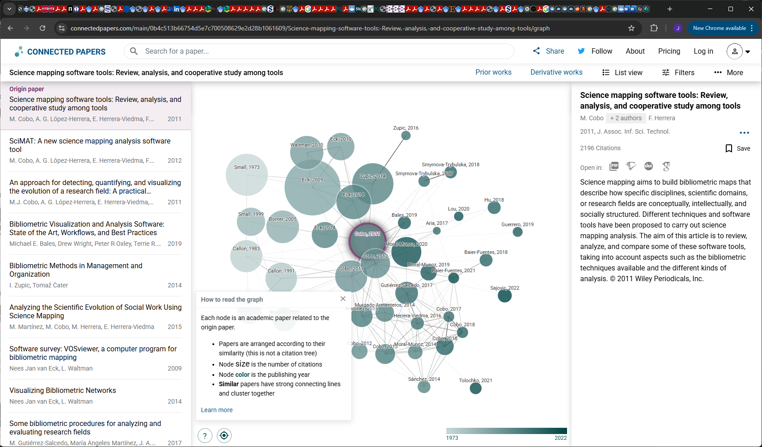
Notes:
“The Great Wave off Kanagawa”

Slide 36
Example 2: Research Rabbit
Free research platform to discover and visualise relevant literature and authors, create alerts for newly published papers and share collections with colleagues.
Build your own collection: Add a few papers (seed papers) and it will recommend further papers.
Visualise networks of papers and co-authorships
Share and collaborate
Integrated with Zotero

Slide 37
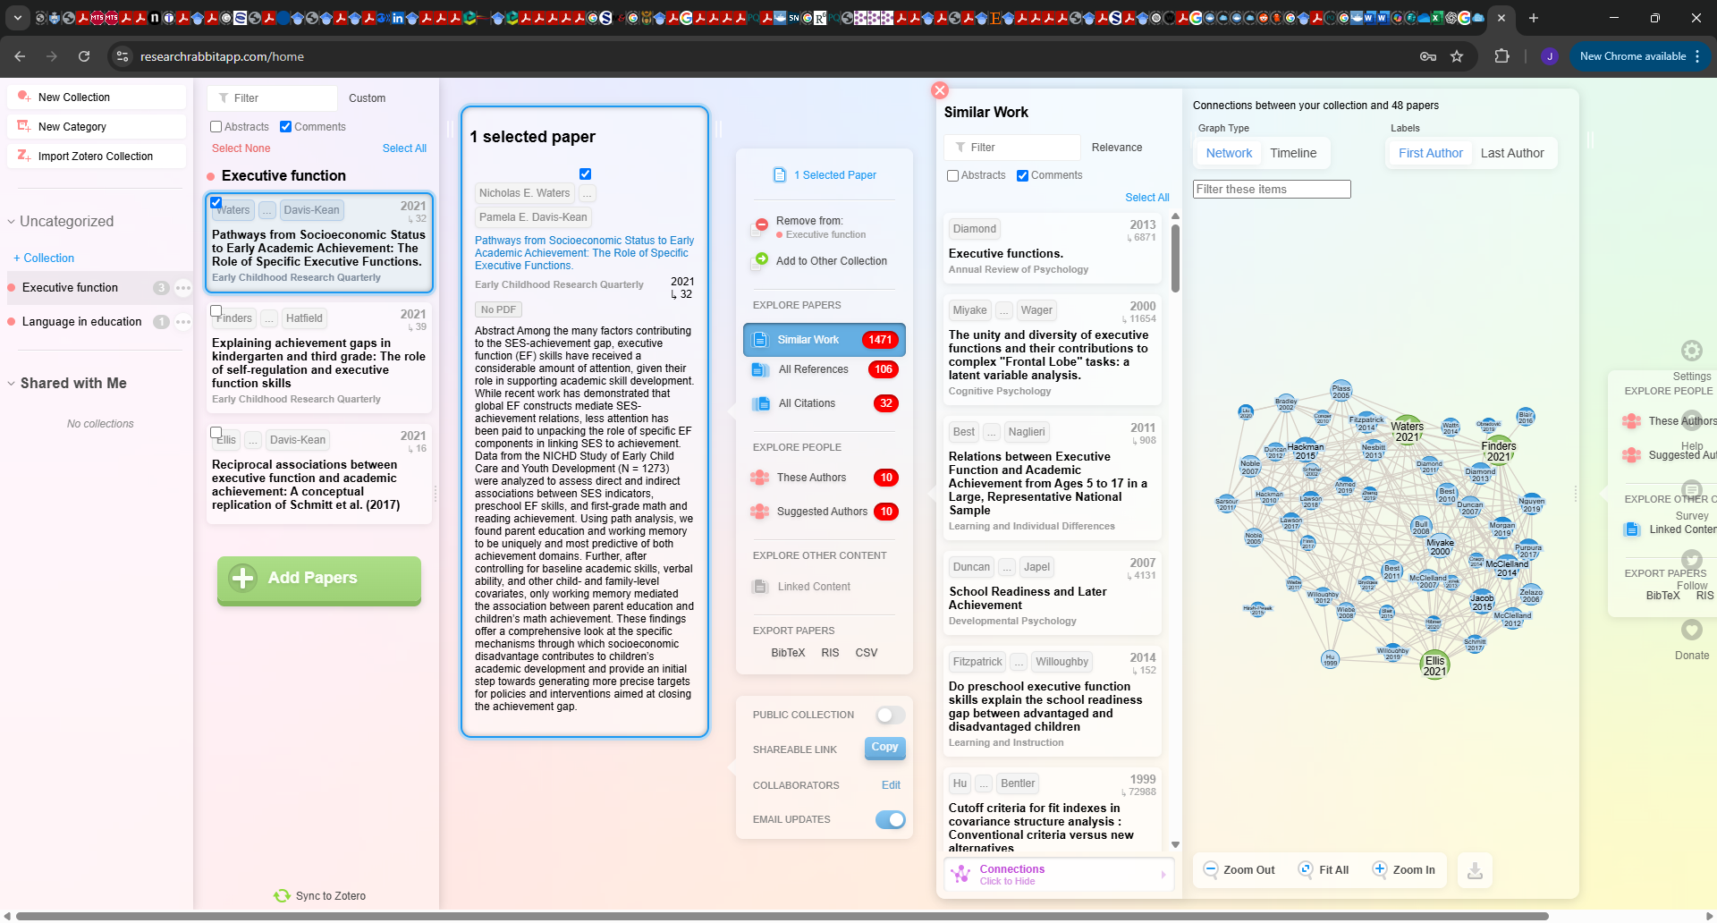
Notes:
“The Great Wave off Kanagawa”

Slide 38
7th Annual Emerging African Researcher Training Academy 2026
THANK YOU
African Research Voices in the Age of Artificial Intelligence

