Slide 1
Module 8
Unlocking Research Funds: Mastering the Art of Finding Grants and Writing Winning Research Proposals
Presenters: Ms Shirin Motala, Dr Bongiwe Mncwango,
Dr Stewart Ngandu, Ms Nkateko Chauke & Ms Nondumiso Masuku
Human Sciences Research Council
28 July 2026 | 9:00 – 13:00

Slide 2
1. Introduction
2. Where to look for research funding
3. Types of funding opportunities
4. Evaluating a Call for Proposals: eligibility, alignment and institutional capacity
Break (10:30–11:00)
5. Developing a Funding Proposal
6. Budgeting Development & Justification
7. Packaging Proposals
8. Q & A
9. Wrap-up: key takeaways and resources
Module Outline

Slide 3

🔍Find grant opportunities
Evaluate grant opportunities that align with your research goals, expertise, and institutional capabilities.
📋Interpret a funder's scope of work and the criteria your proposal must meet.
🧩Structure the key components of a winning proposal.
💰Develop a budget aligned to the proposal's scope of work.
📬Package and submit a complete grant proposal.
Module Learning Outcomes

Slide 4

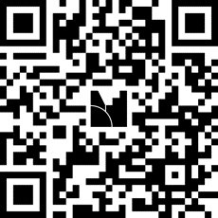
7th Annual Emerging African Researcher Training Academy 2026
Interactive exercise
Let's hear from you!
Use your phone or laptop to participate.
Please answer:
1. How would you rate your experience in grant writing?
2. What challenges, if any, have you experienced in securing research grants?
Option 1 Click on the link https://www.menti.com/al49trarpfvf
Option 2 Visit menti.com and enter code 1556 6413
Option 3 Scan the QR code on the screen
We'll discuss the results together before moving on.
African Research Voices in the Age of Artificial Intelligence

Slide 5
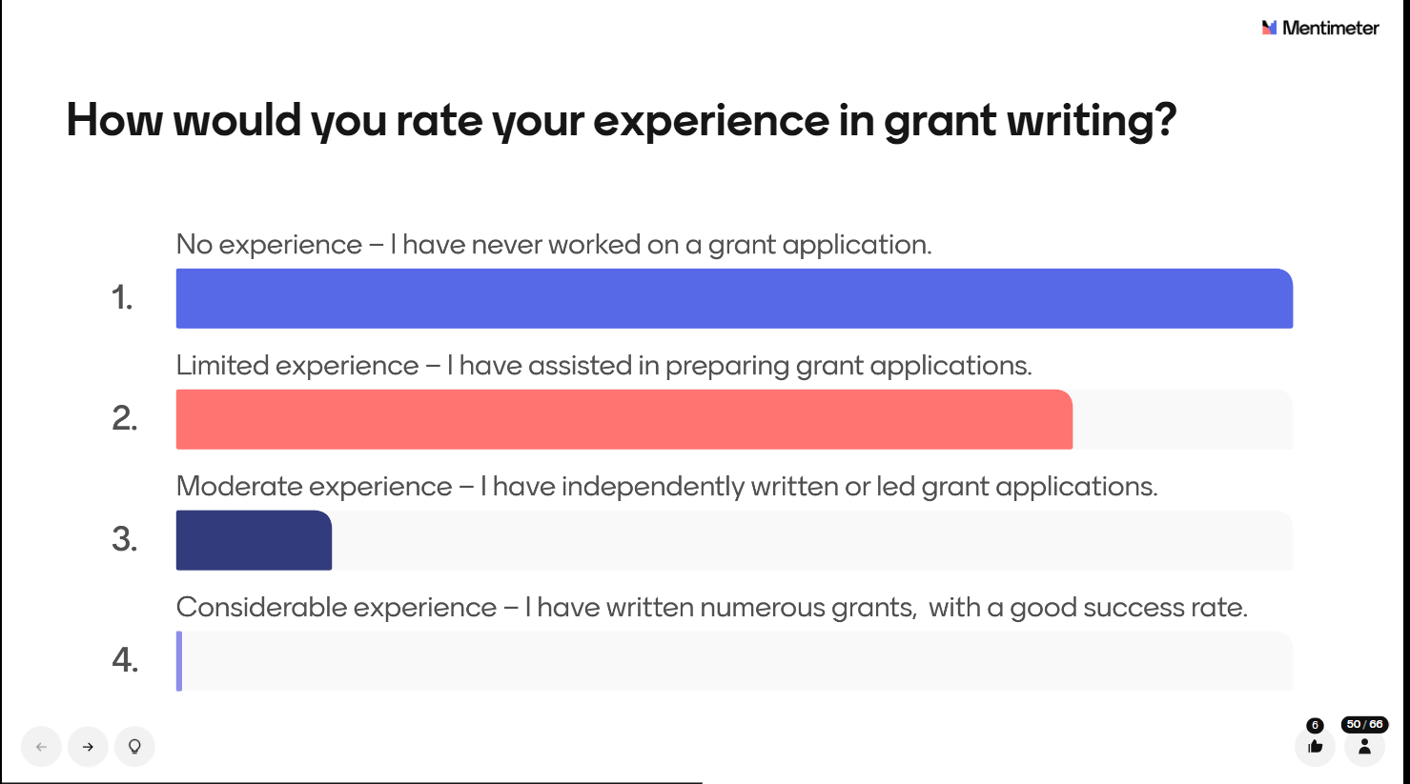
7th Annual Emerging African Researcher Training Academy 2026
Menti Exercise Results
L
African Research Voices in the Age of Artificial Intelligence

Slide 6
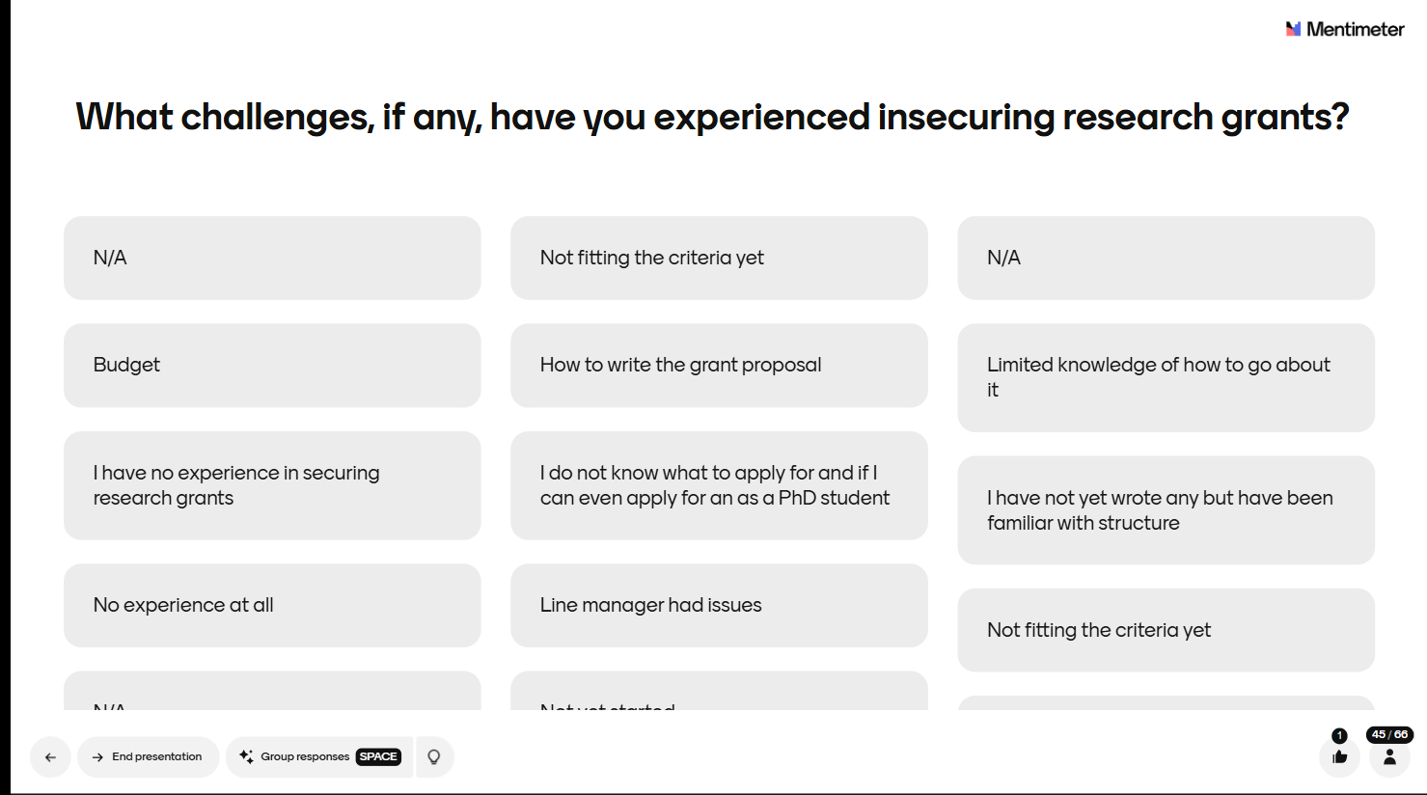
7th Annual Emerging African Researcher Training Academy 2026
Menti Exercise Results
African Research Voices in the Age of Artificial Intelligence

Slide 7
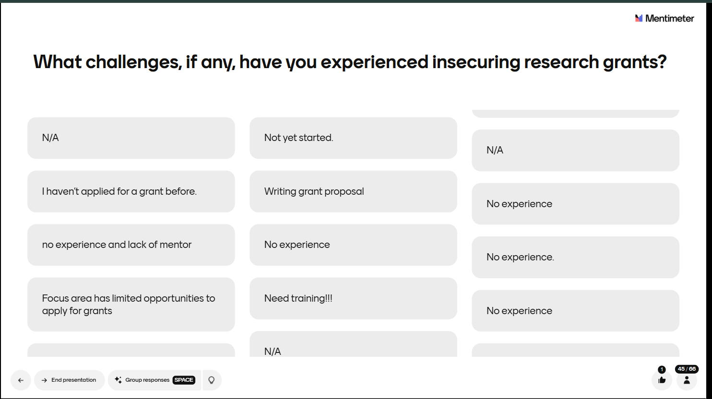
7th Annual Emerging African Researcher Training Academy 2026
Menti Exercise Results
African Research Voices in the Age of Artificial Intelligence

Slide 8
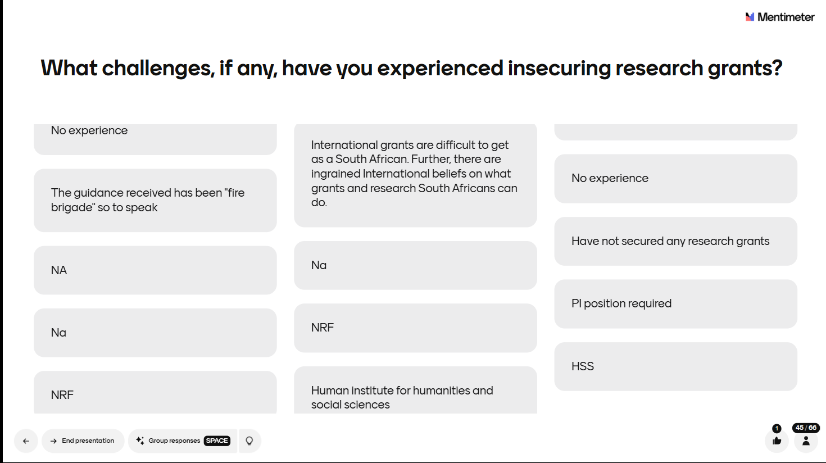
7th Annual Emerging African Researcher Training Academy 2026
Menti Exercise Results
African Research Voices in the Age of Artificial Intelligence

Slide 9

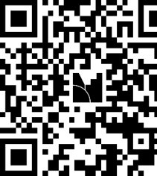

Finding Research Grant
Opportunities
Let's hear from you!
Use your phone or laptop to participate.
Please answer:
1. Where do you search for research funding opportunities?
2. What other unique ways have you used to find research funding opportunities?
Option 1 Click on the link https://www.menti.com/alwwuz6isgp2
Option 2 Visit menti.com and enter code 5595 4023
Option 3 Scan the QR code on the screen

Slide 10
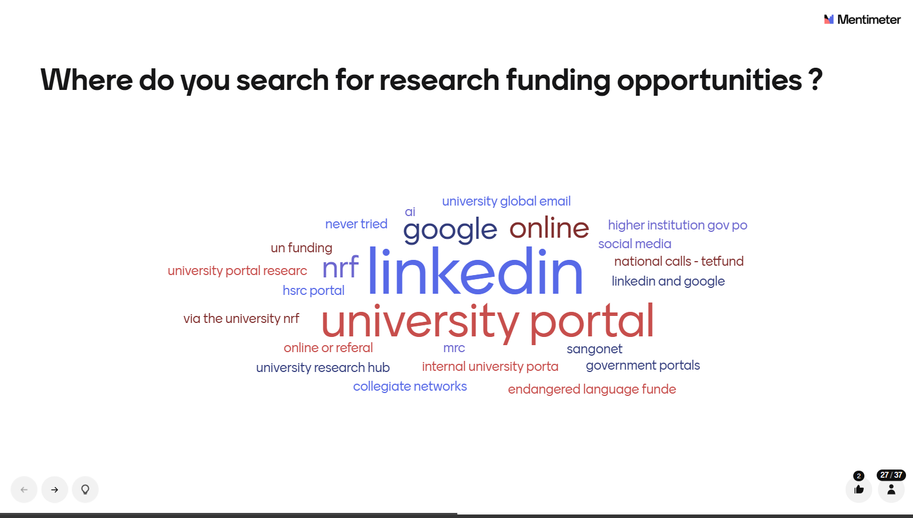
Menti Exercise Results

Slide 11
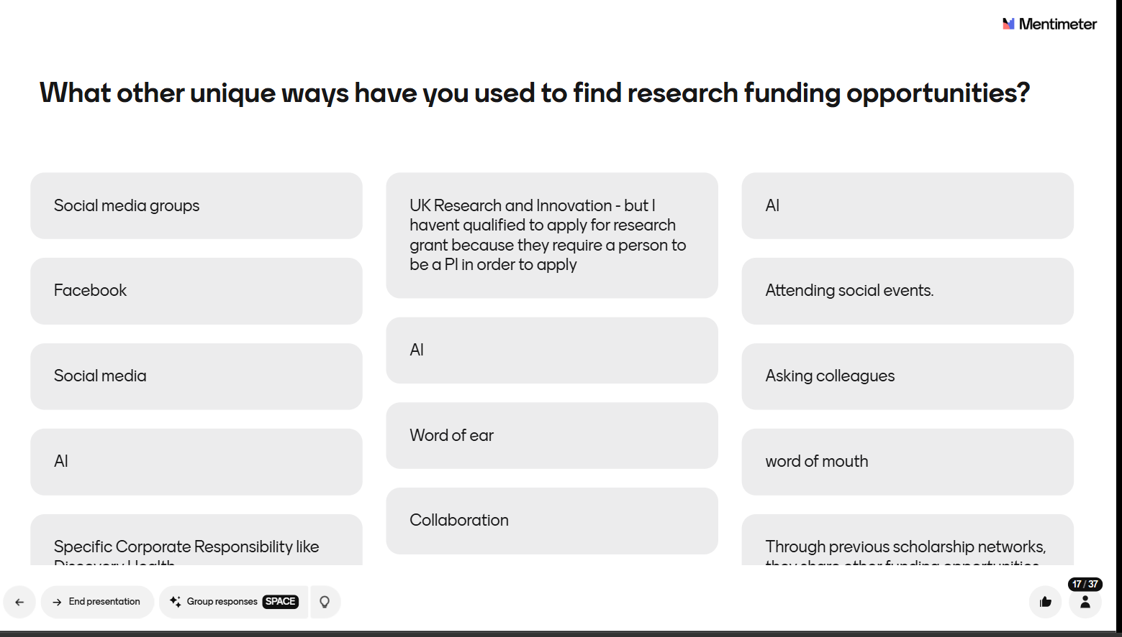
Menti Exercise Results

Slide 12
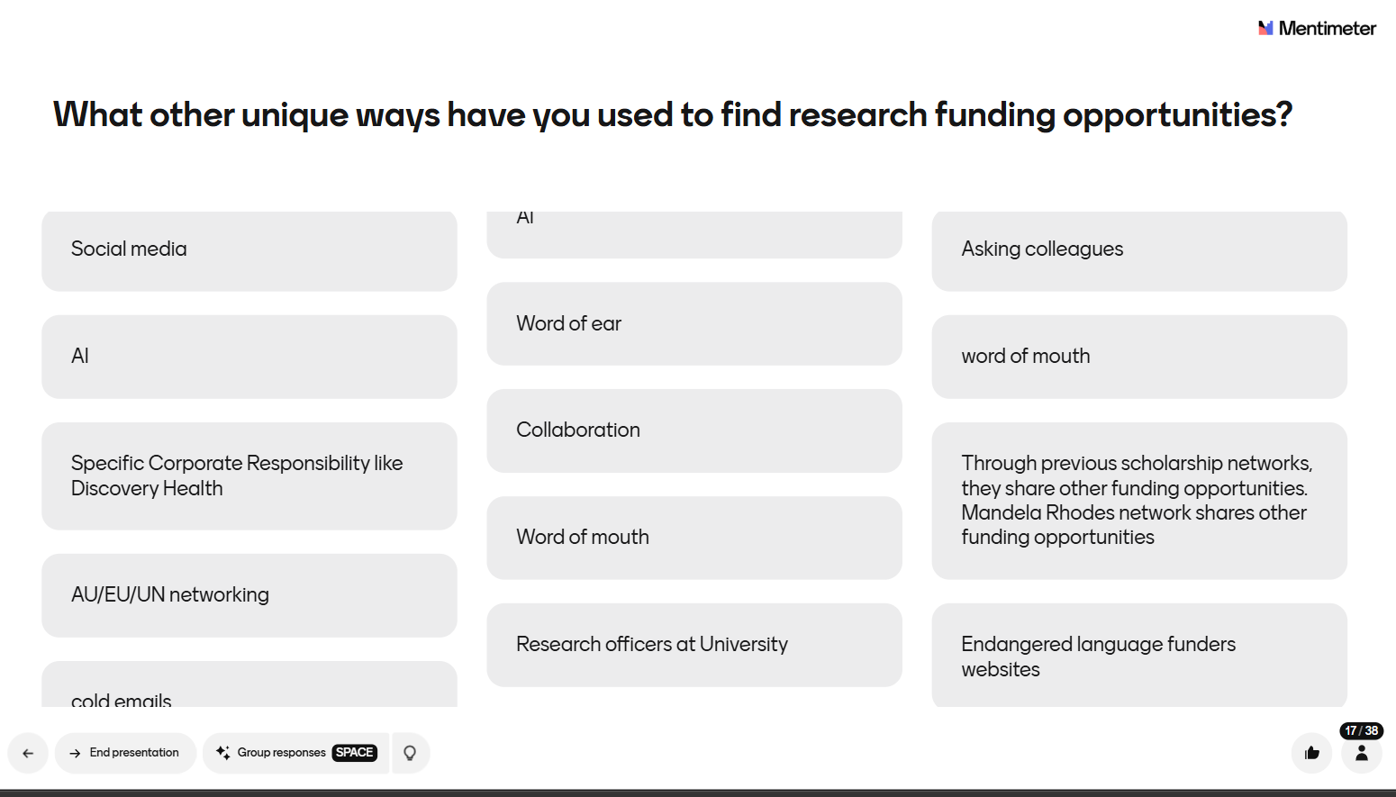
Menti Exercise Results

Slide 13
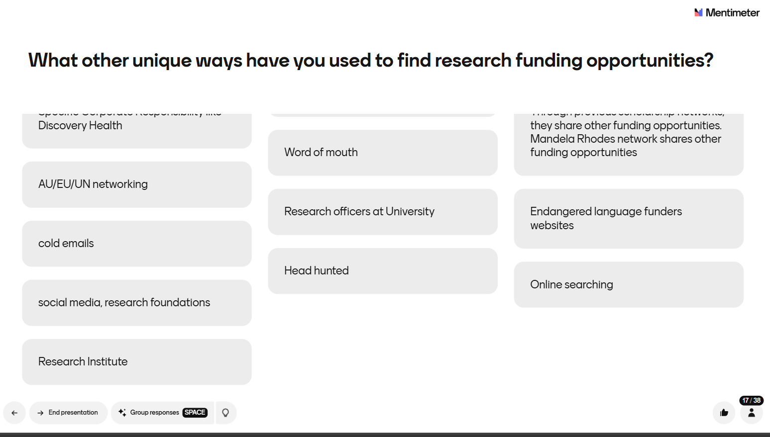
Menti Exercise Results

Slide 14




Types of Research Grant Opportunities
Many types of funding opportunities exist — the focus here is on research grant opportunities.
Tenders/Request for Proposal (RFP)
A formal invitation issued by a government body or large corporation asking service providers to submit bids to provide research services — follows government procurement policy. Tenders strictly follow government procurement policy, whereas RFP may or may not follow procurement rules
Request for Quotation (RFQ)
A request for a detailed price to conduct a study. It is used when funder wants to compare prices, delivery timelines and the supplier's ability to provide the required service.
Expression of Interest (EOI)
An early call inviting interested parties to indicate intent to submit a full proposal. It includes submission of a concept note.
Panelist / Expert Call
Invites experts to indicate their qualifications, interest and charge rate to serve on a panel.

Slide 15







Where to look for funding opportunities
Platforms listing research calls - Euraxess, eTenders, FundsforNGos
University research grant offices
Donor / institutional website – Spencer foundation
Business development officers
Referral via professional networks
Media advertisements
LIVE DISCUSSION
What are other unique ways you have found research grant opportunities? Share your views in the chat.

Slide 16
Who are typical research funders?
Share your responses in the chat
Notes:
Ask attendees to answer on the chat

Slide 17







Who are typical research funders?
Public Sector
Government dept and entities
Private Sector
Non-Profit Entities
Foundations and Trust
Regional Institutions
International donors and development agencies
International Institutions
Int'l Govt Agencies
FCDO (UK), EU, embassies

Slide 18
What is a research grant call?
7th Annual Emerging African Researcher Training Academy 2026
Also referred to as a funding call, call for proposals/expression of interest, or research opportunity) is an announcement by a funding institution inviting researchers or institutions to submit proposals for financial support to conduct research on a specific theme/issue.
A call typically outlines:
What is the focus of the call?
What research is required to be undertaken
Who can apply? (institutions, expertise)
What is the available funding?
Application requirements?
Criteria for evaluating your proposal
African Research Voices in the Age of Artificial Intelligence

Slide 19
Examples of Funding Sources
NB: This is not a comprehensive list and many of the listed institutions are South African and may only fund SA work
Public Sector - Government Depts, Parastatals, National Research Foundation
Private Sector - Corporate Social Investment, research aligned to business interest (CSI)-Standard Bank Foundation, Zenex Foundation, Alan and Jill Gray Foundation
Non-profit entities (NGOs) - e.g. Shintsha Amakhaya
Philanthropy organisations – e.g. Nelson Mandela Foundation, DG Murray Trust, Trevor Noah Foundation,
Regional Institutions (Africa-wide)– e.g. Southern African Development Community (SADC), African Union Agencies, African Economic Research Consortium, African Population and Health Research Center (APHRC), DigiFI Africa / J-PAL Africa, ESSA (Education Sub-Saharan Africa)
International foundations/donors – e.g. Mastercard, International Development Research Centre, Wellcome Trust
International institutions - e.g. United Nations Agencies, World Bank, ILO
International Government Agencies – e.g. UK Foreign Commonwealth Development Office (FCDO, UK), European Union (EU), Government Embassies
Notes:
Do not read all the points

Slide 20

Evaluating Terms of Reference (ToR)/Calls for Proposal
Notes:
Now that we know where and how to find different calls for proposals, it is important to spend some time evaluation the ToRs. It is pointless to move ahead and invest time and other resources in developing a proposal before engaging closely with the ToRs.
Systematically evaluate ToRs using a structured framework Make informed GO/NO-GO decisions before investing time in proposals Identify red flags and competitive advantages in funding calls Apply evaluation criteria to real-world ToR examples.

Slide 21
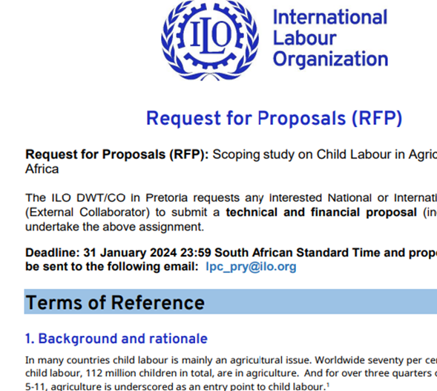
Understanding Terms of Reference
Live Discussion
In the chat share what your understanding of primary purpose of a Terms of Reference (TOR)

Slide 22
Why Funders Issue Terms Of Reference
Funding entities issue ToRs to strategically select partners who can deliver quality results while minimising risk and maximising value
ToRs create a competitive, structured process that ensures fair evaluation and optimal resource allocation.
Why ToRs are Non-Negotiable for Tender Success
  Strategic Alignment: ToRs reveal the funder's true priorities and pain points-
  Enable you to tailor your approach to their specific needs.
  Compliance Assurance: Missing ToR requirements = automatic disqualification.
  Ensure you meet ALL eligibility and technical criteria.
  Competitive Advantage: Understanding evaluation criteria helps you craft winning responses.
  Allows strategic resource allocation to high-scoring sections.
  Resource Optimisation: Prevents wasting time on unsuitable opportunities.
  Enables accurate budgeting and timeline planning.

Slide 23
Terms Of Reference (ToR)- Your Project Blueprint
What Are ToRs?
Terms of Reference (ToR) define the complete project framework: requirements, expectations, scope, and deliverables for a study. They serve as your project blueprint — establishing objectives, roles, responsibilities, evaluation criteria, and available resources.
Parameters of a Good ToR
Project rationale: Why the study is needed and for whom — context & stakeholders
Clear objectives: What the study intends to accomplish — measurable outcomes
Methodology requirements: How the work should be conducted — approach & methods
Team specifications: Who should be involved and their qualifications — expertise & roles
Timeline & milestones: When key deliverables are expected — schedule & deadlines
Resource parameters: Budget and support available — funding & resources

Slide 24
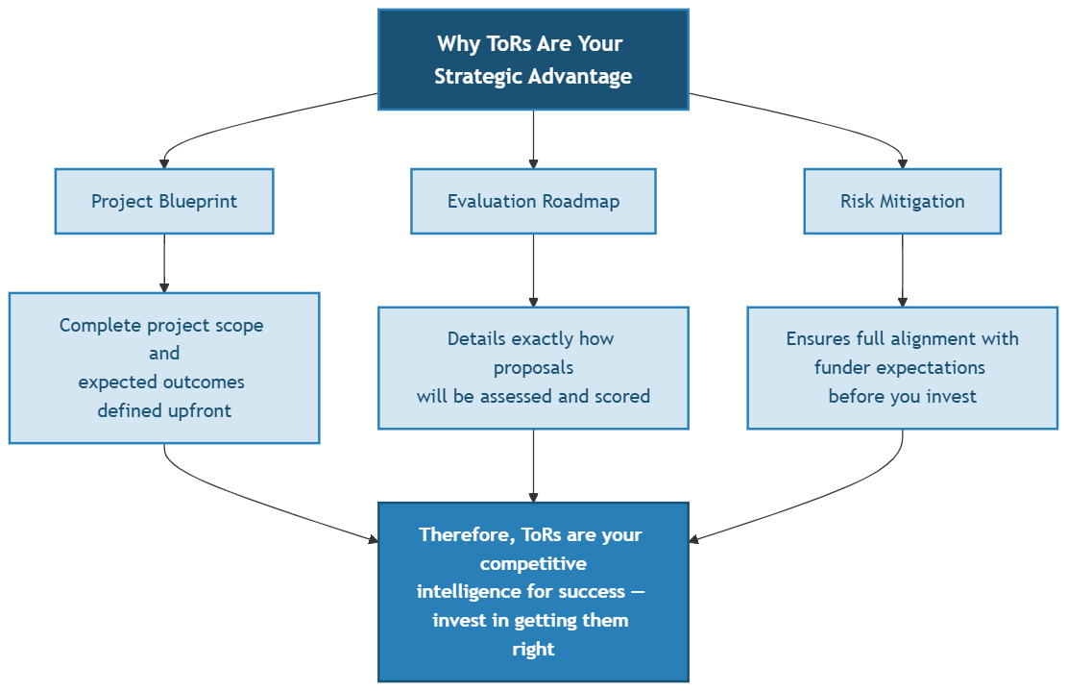
ToRs – Strategic Advantage

Slide 25
Eligibility criteria and institutional capacity considerations
Go/No Go Framework for informing your decision to pursue the opportunity ToR
Key questions to consider | Yes | No
Is there a fit between the donor and your institutional priorities?
Is there an existing relationship with the client?
Do you meet their minimum criteria?
Is there sufficient time to write the proposal?
Who are you competing against?
What is motivating the call for proposals?
Do you have the right resources? (personnel, equipment, infrastructure)
Can you effectively meet their evaluation criteria?
Do the project timelines align with your capacity
❌ WITHOUT ToR Analysis: Wasted time, poor alignment, rejection
✅ WITH ToR Mastery: Strategic targeting, competitive advantage, success

Slide 26
Unpacking the eligibility criteria and institutional capacity considerations: A Checklist
Before you start preparing the proposal, Ask these critical questions:
If ANY critical requirement is unmet
Consider alternatives.
If you can demonstrate strong alignment.
Proceed strategically
📋Eligibility Verification
✅ Research Alignment: Does your research expertise match the focus area of the Call?
✅ Institutional Status: Is your institution eligible? (e.g., universities only, emerging researchers, specific geographic regions)
✅ Career Stage Requirements: Do you meet experience thresholds? (e.g., PhD + 5 years, early-career researchers, senior scholars only)
⏱️ Feasibility Assessment
✅ Timeline Reality Check: Can you deliver quality work within their timeframe? (e.g., 18-month study with 6-month interim report)
✅ Budget Constraints: Does the funding cover your actual costs? (Note: salary caps, indirect cost limitations)
✅ Team Expertise: Do you have the required specialists? (e.g., statistician, local partners, evaluation expert, subject expert, specific methodological expertise)
✅ Supporting Documentation
CVs, institutional letters, reference letters, ethics clearance, budget justifications
Notes:
Eligibility verification
Does your research interest align with the call?
Is the institution eligible to submit? BEE Status – only level 1 can apply
What is the duration of the study? Can the work be done in that period? 1st Draft Report in 3 months
What is the budget ceiling?
What will they fund/not fund? No time-billing
Do you have the right expertise in the team? PI Economist min 10 years experience
What qualifications or experience must the PI have? e.g. 3 publications in that field
When to submit? Is it doable? Due in 6 days
What format for drafting the proposal?
What platform for submitting proposal? Physical Submission to Limpopo
Does it need Delegated Authority (DA) approval? E.g. NRF (stipulated timeframes)
What supporting information is needed? Certified copies of CV’s
Relevant Experience – Proof of completing at least 3 such studies

Slide 27
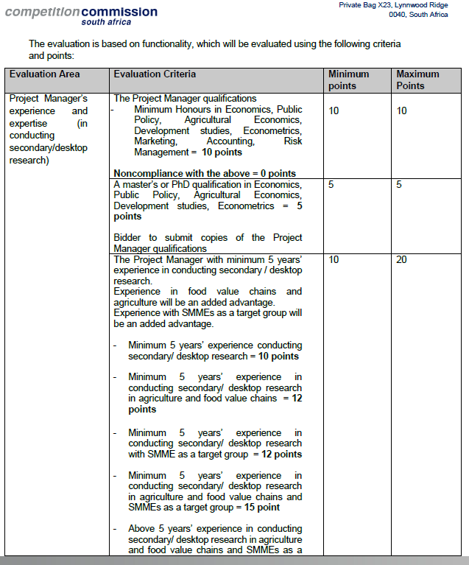
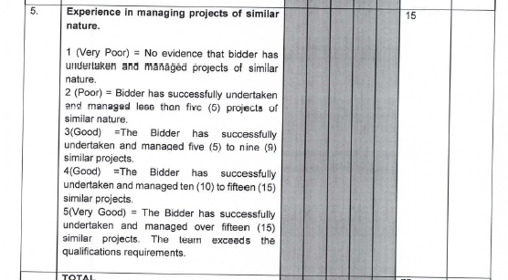
Evaluation Criteria as outlined in TORs (e.g. 1)

Slide 28
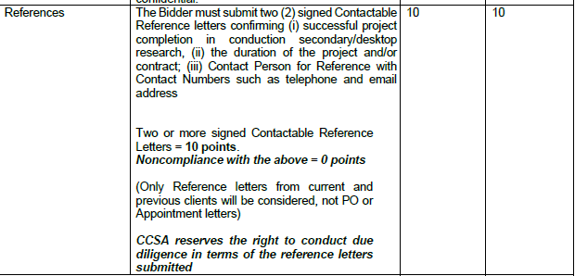
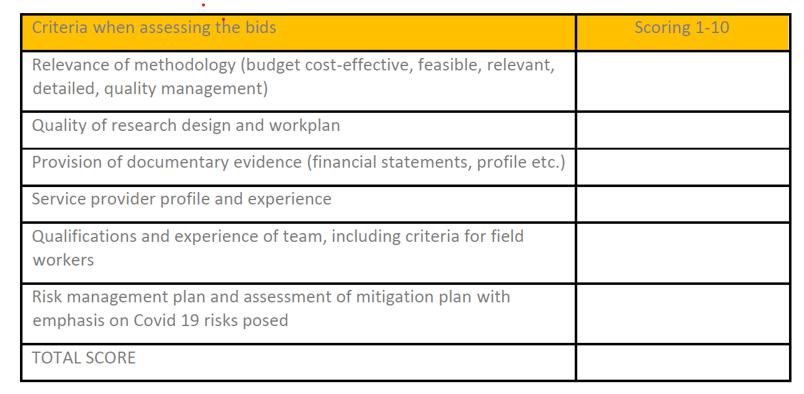
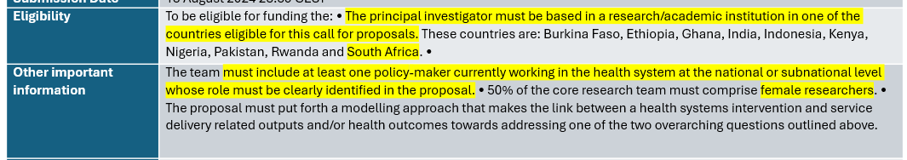
Evaluation Criteria (cont.)

Slide 29
Evaluating the ToR: Group Exercise (15 min)
You are assessing whether to pursue a funding opportunity. The opportunity is from the ILO Mozambique. Assume you will be submitting it for this country assignment. Your task is to systematically evaluate the ToR to determine eligibility and make a well-informed strategic decision. Consider your own expertise, research interests, and your institution’s capacity. Reflect on whether you meet the eligibility criteria and whether the opportunity aligns with your skills, resources, and strategic goals.
Phase 1: Individual Assessment (3 minutes). Read the TOR and complete a Quick Eligibility Scorecard:
1=Very Weak; 2=Weak; 3=Moderate; 4=Strong; 5=Very Strong
Research alignment (1-5 scale): Does your expertise match the ToR focus area?
Institutional capacity (1-5 scale): Can your institution meet all requirements?
Timeline feasibility (1-5 scale): Is the project timeline realistic for quality delivery
Resource availability (1-5 scale): Do you have access to required resources/team expertise?
Total Score: ___/20
(don’t need to share your scores if you don’t want to)
Is it GO AHEAD or NO-GO?
Phase 2: Small Group Analysis (9 minutes) In your group compare scores and discuss:
What made you say GO or NO-GO?
What, if any, critical information was missing from the ToR?
What would make this opportunity more attractive?
What are the biggest risks you identified?
What would give you an edge over other applicants?
Notes:
Scoring Guide:
5 = Excellent fit/Very confident
4 = Good fit/Confident
3 = Moderate fit/Some concerns
2 = Poor fit/Major concerns
1 = No fit/Cannot meet requirements
Decision Threshold:
16-20: Strong GO - Proceed with confidence 12-15: Conditional GO - Address concerns first 8-11: Weak opportunity - Proceed with caution Below 8: NO-GO - Consider alternatives

Slide 30
1. What was the single most important factor that shaped your GO/NO-GO decision?
2. Which aspect of the ToR was hardest to assess, and what missing information would you need to make a confident decision?
REPORT BACK IN PLENARY
(NOT GROUPS- INDIVIDUALS TO REFLECT)

Slide 31




What Donors & Funders Report About Proposal Quality
Evidence from grant review processes on why proposals fail
80%
67%
>50%
of proposals immediately rejected
cite misalignment as #1 mistake
declined for process errors, not ideas
W.K. Kellogg Foundation reported that 80% of applications crossing its proposals-processing office are rejected on first review.
In a survey of 71 funded grant writers, 67% named failure to align with the funder's theory of change as the most common error in rejected applications.
Research from leading funders shows more than half of unsuccessful applications are declined due to process missteps rather than the strength of the idea.
Chronicle of Philanthropy
FundRobin Survey, 2026
Grants.com, 2026
Common Funder Complaints in Review Reports
Proposals do not align with the funder's stated priorities or theory of change — applicants write to their own mission, not the call
Funding for Good; FundRobin; Council on Foundations
Applicants fail to follow basic guidelines: page limits, required formats, eligibility criteria, and submission instructions
Chronicle of Philanthropy (Kellogg Foundation); Grants Plus
Weak or absent methodology: no clear research questions, vague objectives, or no evaluation framework addressing the TOR scope
DFAT Research Selection Committee; AusAID Selection Criteria
No evidence of local partnerships, relevant experience in the proposed area, or capacity to deliver the work as specified
DFAT Africa RSC Feedback; Exponent Philanthropy
Notes:
SLIDE 1 REFERENCES:
1. Chronicle of Philanthropy — 'Grant Makers Reveal the Most Common Reasons Grant Proposals Get Rejected': https://www.philanthropy.com/news/grant-makers-reveal-the-most-common-reasons-grant-proposals-get-rejected/
2. FundRobin (2026) — Survey of 71 funded grant writers: https://www.fundrobin.com/articles/thought-leadership/grant-application-mistakes-rejection-fix/
3. Grants.com (2026) — 'Top Grant Application Mistakes to Avoid in 2026': https://grants.com/top-grant-application-mistakes-to-avoid-in-2026-the-essential-checklist-for-funding-success/
4. Funding for Good — 'Rejected: What to Do if Your Grant Proposal is Denied': https://fundingforgood.org/rejected-what-to-do-if-your-grant-proposal-is-denied/
5. DFAT — 'General feedback from the Research Selection Committees': https://www.dfat.gov.au/aid/topics/development-issues/research/Pages/general-feedback-from-the-research-selection-committees
6. Grants Plus — 'Top Reasons Grant Proposals are Rejected': https://grantsplus.com/insights/blog/partner-plan/top-reasons-grant-proposals-are-rejected-and-how-to-improve-your-odds/
7. Exponent Philanthropy — 'How to Simplify Grant Applications': https://exponentphilanthropy.org/blog/how-to-simplify-grant-applications-and-reports-for-nonprofits/

Slide 32



What This Tells Us: Reading the TOR Is a Core Skill
Concrete examples of how misreading a call leads to rejection
TOR Requirement vs. Common Applicant Error
Key Takeaways for Researchers
Eligibility: registered non-profit with 3 years' audited financials
New organisation applies without financials, hoping the idea alone will carry it
1
Read every word of the TOR
GrantWatch
Funders design calls deliberately. Each criterion filters for fit. Treating the brief as a suggestion is the single most common reason for desk-rejection.
Scope: proposals must address maternal health in two named provinces
Applicant proposes a national programme across all sectors, ignoring the geographic focus
2
Self-assess eligibility honestly
Kellogg Foundation / Chronicle
If you don't meet a mandatory criterion, don't apply. The Kellogg Foundation rejects 80% at first pass — most for basic ineligibility or misalignment.
Methodology: include a mixed-methods evaluation plan with a baseline
3
Mirror the TOR structure in your response
Proposal lists activities but no evaluation framework, no theory of change
Address each section the call asks for, in the order it asks for it. Reviewers reading 250 proposals won't search for your answer.
DFAT RSC; AusAID criteria
Budget ceiling: ZAR 2 million over 18 months
Demonstrate, don't assert
4
Applicant submits a ZAR 8 million budget hoping for negotiation
67% of rejected proposals fail on alignment. Show exactly how your work maps to the funder's theory of change — with evidence, not claims.
Funding for Good
Format: 10-page narrative, 12pt font, PDF only
5
Obey the format requirements
Submits 18 pages in Word with 10pt font, assuming content overrides format
Page limits, font sizes, required documents — these are screening criteria, not suggestions. Non-compliant proposals are eliminated without review.
Chronicle of Philanthropy
Notes:
SLIDE 2 REFERENCES (same sources as Slide 1, applied as illustrative examples):
1. Chronicle of Philanthropy — Kellogg Foundation 80% rejection rate: https://www.philanthropy.com/news/grant-makers-reveal-the-most-common-reasons-grant-proposals-get-rejected/
2. GrantWatch — 'Why Are Grant Proposals Rejected?': https://www.grantwatch.com/grantnews/why-are-grant-proposals-rejected/
3. FundRobin (2026) — 67% misalignment finding: https://www.fundrobin.com/articles/thought-leadership/grant-application-mistakes-rejection-fix/
4. Funding for Good — Rejected proposal guidance: https://fundingforgood.org/rejected-what-to-do-if-your-grant-proposal-is-denied/
5. DFAT — Research Selection Committee feedback on Africa proposals: https://www.dfat.gov.au/aid/topics/development-issues/research/Pages/general-feedback-from-the-research-selection-committees
6. AusAID — Research proposal selection criteria: https://www.dfat.gov.au/sites/default/files/selection-criteria-research.doc
7. Australian Research Council — Discovery Projects 2022 Selection Report (51 ineligible applications): https://www.arc.gov.au/funding-research/funding-outcome/selection-outcome-reports/selection-report-discovery-projects-2022
8. Grants.com (2026) — >50% declined for process errors: https://grants.com/top-grant-application-mistakes-to-avoid-in-2026-the-essential-checklist-for-funding-success/
9. Grants Plus — Top reasons proposals rejected: https://grantsplus.com/insights/blog/partner-plan/top-reasons-grant-proposals-are-rejected-and-how-to-improve-your-odds/
10. Exponent Philanthropy — Simplifying grant processes: https://exponentphilanthropy.org/blog/how-to-simplify-grant-applications-and-reports-for-nonprofits/

Slide 33
Developing a Funding Proposal
﻿Best Practices and Common Pitfalls for Each Proposal Section

Slide 34
TEA BREAK
BACK AT 11:00
UNLOCKING RESEARCH FUNDS

Slide 35
Introduction: The Funding Imperative
In research, great ideas are essential, but funded ideas are transformative.
Funding is the key that unlocks research independence, leadership, and impact.
The Opportunity - The NRF alone invested over R1.1 billion in research and innovation last year.
The Challenge - How do you persuade funders that your project is the one to back?
Today's Goal - To demystify the process and provide practical skills for writing winning proposals.
Our Aim - To help you turn your compelling research vision into a funded reality.

Slide 36
Agenda - From Blank Page to Winning Proposal
Our Goal: To master the art of writing a compelling research proposal that is clear, feasible, and directly aligned with a funder's priorities.
Part 1: The Anatomy of a Proposal: A deep dive into the core sections, from the Abstract and Problem Statement to the Budget and Dissemination Plan.
Part 2: Strategic Writing: We will cover the best practices and, crucially, the common pitfalls to avoid in each section of your proposal.

Slide 37
The Anatomy of a Winning Proposal: The Golden Rules of Grant Writing
The single most important rule: Answer the question the funder is asking.
Think of the Call for Proposals as your exam paper, not just a suggestion box for your ideas.
Every call is designed to meet the funder's specific strategic goals, priorities, and mission.
The most common mistake is writing the proposal you want to write, instead of the one the funder has asked for.
Your proposal must explicitly mirror the call’s language, structure, and evaluation criteria.
Perfect alignment makes your proposal easy for reviewers to understand, score highly, and ultimately, to fund.
What is the key difference between a traditional academic proposal and a funding proposal?
Research funding proposals tend to be more stringent and require a higher degree of specificity than academic proposals.
Why is specificity important in a funding proposal?
Notes:
This presentation speaks more to grant funding that is based on a call for proposals. However, the process of developing the proposal is the same for a non-call-based submission. There are more call-based than non-call-based.
Competition for funding
The funder requires an audit trail, and you can’t have one if the proposal is not specific about what will be achieved.

Slide 38
The Anatomy of a Winning Proposal: The ABSTRACT: Your Project's First Impression
What It Is:
A powerful, self-contained summary of your entire project, typically 250-300 words.
It is often the first, and sometimes the ONLY, section a reviewer reads in detail.
Its job is to grab their attention and communicate the entire value of your project concisely. It must encapsulate four key elements:
  The research PROBLEM or gap.
  The main OBJECTIVE or research question.
  The METHODOLOGY you will use.
  The anticipated SIGNIFICANCE and IMPACT.
Best Practices:
  Be Specific & Confident - Use clear, declarative language. Instead of "I hope to look into...", write "This study will determine...".
  Stay Jargon-Free - Write for an intelligent, NON-SPECIALIST REVIEWER. Avoid acronyms or overly technical terms that would require a deep dive into your specific field.
  Mirror the Proposal - The abstract must be a perfect miniature of your full proposal. Every key component you mention in the abstract must be explained in detail later.

Slide 39
The Anatomy of a Winning Proposal: Abstract - Avoiding Common Pitfalls
Common Pitfall 1: Vagueness & Grandiosity
This is the most frequent mistake made by early-career researchers. The abstract makes big promises with no specific details, using buzzwords instead of substance. This confuses reviewers and undermines your credibility.
Weak Example:
  "This research will investigate the economic challenges facing entrepreneurs in South Africa. It will utilise innovative, mixed-methodologies to create a paradigm shift in understanding the informal sector and will provide groundbreaking solutions for poverty."
Why it's weak: Which challenges? Which entrepreneurs? What specific methods? What paradigm? It is all promise and no concrete plan.
Common Pitfall 2: Mismatch & Missing Funder Requirements
The abstract introduces ideas not found in the main proposal, or it omits key components required by the funder. This signals carelessness.
Practical Tip: Always check the funder's guidelines.
The U.S. National Science Foundation requires separate statements on "Intellectual Merit" and "Broader Impacts" within the abstract.
The South African NRF will look for alignment with national priorities or evidence of human capacity development (student training). Ignoring these is a fatal flaw.

Slide 40
The Anatomy of a Winning Proposal: From Weak to Winning Abstract
﻿The key is to replace vague statements with concrete, verifiable information.
Vague & Weak | Specific & Strong
"investigate economic challenges" | "determine the extent to which mobile money enhances financial resilience of spaza shops in Soweto"
"innovative methodologies" | "a quantitative survey of 300 owners and 30 in-depth qualitative interviews"
"solutions for poverty" | "evidence base for policy recommendations targeting financial inclusion"
Key Takeaway: Your abstract is your project's elevator pitch. Make every single word count.

Slide 41
The INTRODUCTION: Setting the Stage & Stating the Problem
What It Is:
This section sets the stage for your entire proposal. It introduces the research topic, provides essential context, and must achieve three critical goals:
Establish the significance of the topic (why it matters).
Clearly define the Problem Statement – the specific gap in knowledge or practice your research will address.
Present the central research questions that will guide your study.
Best Practices:
Be Precise - The problem statement is the heart of your proposal. Pinpoint the exact issue in one or two clear, unambiguous sentences.
Be Persuasive - Provide just enough background to convince the reviewer that this problem is important and that your research is timely.
Be Coherent - Ensure your research questions and objectives flow logically from the problem you have identified. Everything must connect.

Slide 42
The Anatomy of a Winning Proposal: Successful Approaches Problem Statement
The Funnel Approach: Start with the broad context, narrow down to identify a specific gap in the literature or practice, and then present your focused problem statement.
Example using the Funnel Approach:
Broad Context
The informal economy is a cornerstone of employment in South Africa, with millions depending on small, township-based enterprises. While the national adoption of mobile money has been rapid, offering potential for financial inclusion, a critical gap exists in our understanding of its tangible effects at the micro-enterprise level.
The Gap
Specifically, prior research has focused on mobile money for person-to-person transfers, largely overlooking its role in the operational resilience of small businesses facing economic volatility.
The Precise Problem Statement
Therefore, the central problem this research addresses is the unexamined relationship between mobile money adoption and the financial resilience of spaza shops in Gauteng.

Slide 43
The Anatomy of a Winning Proposal: Introduction - Avoiding Common Pitfalls
The Unfocused Problem
The introduction rambles around a broad topic without identifying a specific, researchable problem. A frequent mistake is stating a general societal ill instead of a knowledge gap.
Weak Example
  "Poverty and unemployment are major problems in South Africa's townships. Many people run small businesses to survive, but it is very difficult for them. This research wants to look at the economy in these areas and help find solutions for these struggling entrepreneurs."
Why it's weak
"Poverty exists" is a condition, not a research problem. It's too broad, lacks a clear focus, and doesn't define a gap that can be investigated.
Exaggeration & Inconsistency
Making exaggerated claims that your research will "solve" a major social issue or "completely transform" a field. This sounds naive to reviewers. Another critical error is promising to answer questions in the introduction that your methodology section doesn't actually address.

Slide 44
The Anatomy of a Winning Proposal: From Weak to Winning Introduction& Problem
Vague & Weak (The "Societal Ill" Approach) | Specific & Strong (The "Research Gap" Approach)
"Poverty and unemployment are major problems..." | "A critical gap exists in our understanding of [mobile money's] tangible effects at the micro-enterprise level."
"This research wants to look at the economy..." | "The central problem this research addresses is the unexamined relationship between mobile money adoption and financial resilience..."
"help find solutions for struggling entrepreneurs" | "This will provide an evidence base for policy recommendations targeting financial inclusion."
Key Takeaway: Your introduction must convince the reviewer that there is a specific, important, and researchable problem, and that your study is perfectly designed to address it.

Slide 45
The Anatomy of a Winning Proposal: The LITERATURE REVIEW - Building on the Shoulders of Giants
What It Is?
A literature review is not just a summary of articles. In a funding proposal, it is a TIGHTLY WRITTEN critical synthesis of only the most RELEVANT existing scholarship that constructs a compelling argument for why your research is necessary. Its purpose is to:
Situate your project within the current body of knowledge that is aligned to the salient aspects of the call.
Demonstrate your familiarity with the field's key debates and findings.
Provide a rationale for your chosen approach and convince funders that your work is original and not duplicative.
Best Practices:
Be Focused & Selective: Do not include everything ever written.
  Select key works (theories, empirical studies) that directly relate to your specific research questions.
Be Critical & Analytical: Do not just report what others have said.
  Synthesise, compare, and critique to identify patterns, contradictions, and debates.
Be Current: Show awareness of recent findings from the last few years, as well as the foundational, seminal works in your field.

Slide 46
The Anatomy of a Winning Proposal: The Literature Review – Success & Pitfalls
SUCCESSFUL APPROACHES
Organise Thematically, Not Chronologically: Structure your review around central themes or debates, which is far more effective than a study-by-study synopsis.
Example (Post-Apartheid Urban Planning): Instead of listing authors who wrote about cities, structure your argument with thematic sections:
  The Enduring Legacy of Apartheid Spatial Planning in cities like Johannesburg.
  Policy Interventions Since 1994 (e.g., RDP, Breaking New Ground).
  Contemporary Debates on Gentrification vs. Inclusive Development in areas like Woodstock (Cape Town) and Maboneng (Johannesburg).
  The Identified Gap from the literature: A lack of research on the socio-cultural impact of urban regeneration on long-term residents.
Remember, a lot of funding calls for research arise from a recognised gap in the literature.
COMMON PITFALLS
The "Unconnected Laundry List": The most common error. Simply stringing together summaries of studies ("Author A found this. Author B found that.") without analysing or connecting them to your own research question.
Ignoring Key Works or Debates: Omitting seminal studies or conflicting viewpoints makes your review seem one-sided or, worse, poorly researched.
No Explicit "Gap": Failing to conclude the review with a clear statement of what is still unknown and, crucially, how your study will address that specific gap.

Slide 47
The Anatomy of a Winning Proposal: The Literature Review - From Weak to Winning
Topic: Vaccine hesitancy in rural South Africa.
Weak Approach (The "Laundry List") | Strong Approach (The "Critical Synthesis")
Just a list of facts Cooper (2021) found that complex social phenomenon is linked to vaccine hesitancy. A study by the HSRC (2022) showed low trust in government healthcare in the Eastern Cape. DFRLab (2020) looked at historical distrust from the apartheid era. | Synthesis While national studies point to complex social phenomenon as a key driver of vaccine hesitancy (Cooper, 2021), a focus on digital sources overlooks deep-seated issues of institutional trust. Research highlights particularly low confidence in government healthcare in rural provinces like the Eastern Cape (HSRC, 2022), often rooted in historical inequities (DFRLab, 2020). The Gap Therefore, a critical gap remains in understanding how local community health workers can effectively bridge this trust deficit at a grassroots level, an approach this study will investigate."
Key Takeaway: A strong literature review is an argument. It must lead the reviewer step-by-step to the inescapable conclusion that your research is the logical and necessary next step.

Slide 48
The Anatomy of a Winning Proposal: The METHODOLOGY: Your Blueprint for Discovery
What is it?
This is the cornerstone of your proposal. It is the detailed, step-by-step blueprint that explains exactly how you will conduct your research. It must describe:
Your overall RESEARCH DESIGN (e.g., qualitative, quantitative, mixed-methods).
Your specific DATA COLLECTION METHODS (e.g., surveys, interviews, archival research).
Your SAMPLING STRATEGY (Who, How Many, How They Will Be Selected).
Your DATA ANALYSIS PLAN (How you will make sense of the data).
The goal is to prove to the funder that your project is feasible, rigorous, and scientifically sound.
Best Practices
Be Detailed & Specific - provide enough information for another researcher to understand your process. Avoid ambiguity.
Justify Your Choices - for every choice—your design, your sample size, your methods—explain why it is the most appropriate way to answer your research questions.
Ensure Alignment - explicitly link each research objective to a specific method. Show the reviewer precisely how you will answer each question you posed in the introduction.

Slide 49
The Anatomy of a Winning Proposal: The Methodology: Successful Approach
Clearly link methods to objectives and justify the 'why'.
Example (Mixed-Methods Study on Land Reform in Limpopo):
A mixed-methods sequential explanatory design is chosen for this research. This approach is justified as it allows us to first identify broad statistical patterns and then explore the rich, lived experiences behind them.
Clearly delineated quantitative and qualitative components.
Phase 1 (Quantitative)
A structured survey will be administered to 400 beneficiary households across two major land reform projects in the Limpopo province to quantitatively assess economic outcomes (income changes, crop yield, market access).
Phase 2 (Qualitative)
Drawing from the survey data, 20 households demonstrating high and low economic success will be purposefully selected for in-depth, semi-structured interviews. This phase will explore the 'why' behind the quantitative results, focusing on factors like community dynamics, gender relations, and access to state support services.

Slide 50
The Anatomy of a Winning Proposal: The Methodology: Pitfalls & From Weak to Winning
Common Pitfalls
Vagueness or Superficiality: Using statements like "we will use qualitative methods" with no further detail. This is a major red flag that suggests a lack of clear planning.
Method-Objective Mismatch: Proposing a method that cannot possibly answer your research question (e.g., using a small, non-representative focus group to make claims about the entire country).
Ignoring Contextual Relevance: This is a critical pitfall noted by the NRF. Using survey instruments, theories, or models designed in Europe or North America without first validating their relevance and appropriateness for a diverse South African context (e.g., accounting for language, cultural nuances, or socio-economic realities).
From Weak to Winning
Topic: Effectiveness of Community Policing Forums (CPFs) in Pretoria.
Weak Approach (Vague & Unjustified)
We will do interviews with CPF members and the police in Pretoria. We will also look at crime statistics to see if the CPFs are working.
(No detail on design, sampling, analysis, or 'why')
Strong Approach (Specific & Justified)
(Design) This study employs a comparative case study design to assess CPF effectiveness in two contrasting Pretoria policing precincts: a high-income area (e.g., Brooklyn) and a township area (e.g., Soshanguve).
(Analysis) We will conduct 15 semi-structured interviews per site with CPF leaders, residents, and local SAPS officers (total n=30), selected via purposive and snowball sampling.
(Sampling) Interview transcripts will be analysed using thematic analysis in ATLAS.ti.
(Triangulation) This data will be triangulated with official crime statistics for the two precincts from the last five years to compare reported crime trends with community perceptions of safety.

Slide 51
The Anatomy of a Winning Proposal: The DISSEMINATION & IMPACT PLAN - Maximising Your Research's Impact
WHAT IT IS
This is your strategy for sharing research findings with relevant audiences. It goes beyond academic tradition to include:
Academic Channels - Peer-reviewed journals and conference presentations.
Non-Academic & Public Outreach - Policy briefs for government, workshops for stakeholders, community presentations, and media engagement.
It demonstrates how your research will create tangible impact and may be referred to as "KNOWLEDGE TRANSLATION" or "KNOWLEDGE MOBILISATION" by development-focused funders.
BEST PRACTICES
Tailor the Format to the Audience - A journal article is for academics; a policy brief is for government; a community workshop is for local stakeholders.
Be Specific and Concrete - Name your target journals, conferences, government departments, or community organisations.
Integrate into the Project - Your dissemination activities must appear in your timeline and be accounted for in your budget (e.g., costs for open-access fees or printing reports).
SUCCESSFUL APPROACHES
Develop a multi-channel plan that connects specific outputs to your project's goals and key audiences.
Example (Research on urban food security in Tshwane):
Academic Impact - "Submit one peer-reviewed article to Agrekon on the economics of urban farming. Present findings at the annual conference of the Society of South African Geographers."
Policy Impact - "Develop a policy brief on supporting urban agriculture for the City of Tshwane's Department of Agriculture and Rural Development and the national Department of Social Development."
Community Impact - "Co-host practical workshops with community gardening groups in Mamelodi on sustainable soil and water use. Create a visual guide on accessing municipal support, translated into Sepedi."

Slide 52
The Anatomy of a Winning Proposal: The Dissemination Plan– Success & Pitfalls
Common Pitfalls
The Generic Statement - Simply stating "Findings will be published and presented at conferences." Reviewers see this as insufficient and a sign of poor planning.
Ignoring the Funder's Mission - Focusing only on academic outputs when applying to a funder like the NRF, which values societal impact, or a development agency that requires a clear plan to influence policy.
The Unrealistic Plan - Promising an overwhelming number of outputs (e.g., five top-tier journal articles from a one-year grant) that reviewers will immediately identify as infeasible.
Forgetting it Exists - Overlooking the dissemination section entirely, a critical mistake as many funders explicitly evaluate your plan to use the research results.
From Weak to Winning
Topic: Documenting the intangible cultural heritage (oral histories) of a community in Marabastad, Pretoria.
Weak Approach (Generic & Vague)
"We will write papers about our findings and share them with interested parties. We will also make our research available online."
Strong Approach (Targeted & Impact-Oriented)
Outputs for Academic Audience - "One article in the South African Historical Journal on memory and place. Anonymised transcripts to be deposited in a university digital archive, as per our Data Management Plan.
Outputs for Community Audience - "Create a community-owned digital archive of the stories. Host a public 'story-sharing day' event for participants and their families at a local venue.
Outputs for Public Engagement - "Collaborate with the Ditsong National Museum of Cultural History on a temporary exhibit or a public lecture."

Slide 53
The Anatomy of a Winning Proposal: The TIMELINES: Your Project's Roadmap to Completion
What It Is?
The timeline, or work plan, is a visual schedule that outlines the sequence and duration of every activity in your project. It is your roadmap from start to finish. Its purpose is to demonstrate to funders that your project is:
  Well-planned - You have thought through all the necessary steps.
  Manageable - The workload is broken down into logical phases.
  Feasible - Your goals can realistically be achieved within the funder's specified timeframe.
Best Practices:
Use a Visual Format: A simple table or a Gantt chart is the industry standard. It is far clearer and more professional than a paragraph of text.
Be Realistic Do not underestimate how long tasks take. Build in buffer time for common delays, such as participant recruitment or administrative processes.
Align with Your Proposal - Your timeline must be a perfect mirror of your methodology (every task included) and your budget (costs align with the timing of activities).
Include Milestones - Clearly mark key deliverables or progress points (e.g., "Ethics Approval Obtained," "Data Collection Complete," "Draft Report Submitted").

Slide 54
The Anatomy of a Winning Proposal: The Timeline - Common Pitfalls
COMMON PITFALLS
The "Miracle" Timeline: Proposing a wildly unrealistic amount of work in too short a time. Reviewers are experienced and will immediately spot an over-ambitious plan.
Forgetting the Bureaucracy: A classic early-career researcher error is failing to allocate 2-4 months for the university ethics approval process. A plan to start collecting data in week one is not credible.
The Vague Block: Using overly broad labels like "Year 1: Fieldwork" or "Year 2: Writing" without breaking these down into specific, sequential tasks.
Illogical Sequencing: Scheduling tasks in an impossible order, for example, planning data analysis to begin before the data has been collected and cleaned.
FROM WEAK TO WINNING
Topic: A two-year study on the impact of load shedding on secondary school learner performance in the Eastern Cape.
Weak Approach (Vague & Unrealistic)
"In the first year, I will get ethics approval and do my fieldwork in schools. In the second year, I will analyse the data and write up my papers and finish the project."
STRONG APPROACH (PHASED & SPECIFIC)
Phase 1: Setup & Approvals (Months 1-4): Finalise survey instruments; Submit ethics application; Obtain approval from the provincial Department of Basic Education. Possible deliverable/s: Study instruments etc.
Phase 2: Data Collection (Months 5-15): Conduct baseline and follow-up surveys with learners and teachers across four school terms; Collect school-level matric pass rate data. Possible deliverable/s: Dataset.
Phase 3: Analysis & Writing (Months 16-22): Quantitative analysis of survey data; Thematic analysis of teacher interviews. Possible deliverables: Draft two journal articles.
Phase 4: Dissemination (Months 23-24): Present findings at the South African Education Research Association (SAERA) conference; Develop and share a policy brief with the Department of Basic Education. Possible deliverable/s: Conference paper, policy brief, etc.
List all relevant and acceptable deliverables for each phase that will appear in your Gantt Chart.

Slide 55
The Anatomy of a Winning Proposal: The Timeline: Gantt Chart
A Gantt chart provides a clear, at-a-glance overview of the project flow, dependencies, and key milestones.
Example: Gantt Chart for a 12-Month Project on Water Access in a Karoo Town
Activity | Q1 (M 1-3) | Q2 (M 4-6) | Q3 (M 7-9) | Q4 (M 10-12)
Literature Review & Instrument Design | ██████
Deliverables/Milestone: Ethics Submitted | ✓
Ethics Approval Period | ██████
Deliverables/Milestone: Approval REC'd |  | ✓
Fieldwork & Data Collection |  | ██████ | ██████
Data Analysis |  |  | ██████ | ██████
Writing & Dissemination |  |  |  | ██████
Deliverables/Milestone: Submitted Research Report |  |  |  | ✓
Project deliverables are one of the end-all’s and be-all’s of funded research, and they should be carefully identified. There should be a clear link between your research activities and each deliverable.
Critically, in most cases, some funds will only be released upon receipt of a project deliverable.

Slide 56
Required Proposal Structure & Unique Requirements of Different Funders

Slide 57
﻿Required Proposal Structure & Unique Requirements: IDRC
Structure
  Cover page and summary;
  Problem statement & background;
  Research questions/objectives;
  Literature/context review;
  Methodology/Work plan.
Expected results & outcomes
  Monitoring & Evaluation plan;
  Communications/Knowledge translation plan;
  Team capacity;
  Ethical considerations;
  Timeline;
  Budget (using IDRC template).
Unique
Strong focus on development impact – must show how research will influence policy/practice and benefit target groups. Gender analysis is required (project should ideally be gender-responsive or transformative). Must include indicators for monitoring progress. Open access dissemination is mandated (plan for open publications). Risk assessment and sustainability (post-project) section needed.

Slide 58
﻿Required Proposal Structure & Unique Requirements: EU – Horizon Europe
Structure
Strict template divided into 3 sections –
Excellence (objectives, relevance to call, state-of-art, concept & methodology);
Impact (expected outcomes and impacts, measures to maximise impact: dissemination, exploitation, communication);
Quality and Efficiency of Implementation (project structure, work packages, timeline/Gantt chart, deliverables, consortium roles, resources).
Separate forms for abstract, ethics issues, and partner info.
Unique
Must follow EU-defined headings and page limits (e.g., 45 pages).
Emphasis on alignment with EU policy goals and defined Impact Pathways. Requires a credible impact plan with target stakeholders and a dissemination/exploitation strategy beyond academia.
Consortium description and team excellence are critical (usually multi-country partnerships). Cross-cutting issues (gender dimension in research, SSH integration, open science practices) must be addressed explicitly. Evaluation is criterion-based (Excellence/Impact/Implementation each scored) – proposals are written almost like responding to an exam rubric.

Slide 59
﻿Required Proposal Structure & Unique Requirements: UN Agency (e.g., UNDP)
Structure
  Executive Summary;
  Background/Problem analysis (context and needs);
  Project Objectives (goal and specific objectives);
  Methodology/Description of Activities (what will be done to meet objectives);
  Work Plan/Timeline; Organization Capacity (experience of applicant);
  Monitoring & Evaluation plan (indicators);
  Sustainability and Exit Strategy; Budget (often with detailed template); Attachments (org documents, letters).
Unique
Very outcome-oriented and formatted like a development project proposal. Must demonstrate how project addresses a UN development priority or SDG. Community involvement and gender mainstreaming are typically required sections.
Proposals often capped at ~10-15 pages. Needs clear explanation of how results will be sustained after funding (since UNDP wants lasting impact).
Often requires risk assessment (including environmental/social risks) and mitigation measures. The language is less about theoretical contribution and more about solving a problem and delivering results to beneficiaries. Co-funding or partnerships may be encouraged.

Slide 60
﻿Required Proposal Structure & Unique Requirements: NRF (South Africa)
Structure
  Project Title & Abstract;
  Research Problem statement and motivation;
  Literature Review (current knowledge, gap);
  Research Questions/Hypotheses;
  Objectives (main and sub-objectives);
  Research Design and Methodology (detailed methods, data sources, analytical approach);
  Expected Outcomes and Significance (contribution to field and/or SA national priorities);
  Ethical considerations (if applicable);
  Timeline/Milestones;
  References. Budget with justification via NRF online system.
Unique
Evaluators look for realistic, well-defined objectives and a tight alignment between aims, literature, and methods. Must clearly articulate expected outputs (e.g., papers, student theses) and how these outcomes will be achieved within timeframe. Importance of capacity building – proposals often must state how many students or postdocs will be involved/trained. Alignment with national strategic goals or social relevance is a plus (e.g., how research benefits South Africa or addresses local challenges). Typically requires the PI’s and team’s track record (CVs) in the application. NRF also enforces formatting (e.g., section word limits) and may reject if sections like “Expected Outcomes” or “References” are missing.

Slide 61
Link to quiz
https://questionpro.eu/t/AB3u1wtZB3wIGB

Slide 62
The Anatomy of a Winning Proposal: Answers to the Quiz
1. Question: What is the primary function of the 'Introduction and Problem Statement' section in a research proposal?
Correct Answer (C): To establish a compelling context, identify a specific gap in current knowledge, and pose the central research question.
2. Question: A common pitfall in the 'Literature Review' section is creating an 'unconnected laundry list'. What does this mean?
Correct Answer (B): The review summarises a series of studies one after another without analysing them or connecting them to the proposed research question.
3. Question: In the 'Methodology' section, what is the most crucial element to include besides describing your methods?
Correct Answer (B): A detailed justification for why the chosen methods are the most appropriate for answering your specific research questions.
4. Question: Which of the following is a common but critical error early-career researchers make when creating a 'Timeline (Work Plan)'?
Correct Answer (D): Failing to allocate the necessary 2-4 months for the university's ethics approval process before starting data collection.
5. Question: What is the primary weakness of a 'Dissemination Plan' that only states: 'Findings will be published in a journal and presented at a conference'?
Correct Answer (A): It focuses on academic audiences and ignores other key stakeholders like policymakers or the community.
6. Question: When writing the 'Abstract', you should avoid vagueness. Which of the following is the BEST example of a specific and effective statement for an abstract?
Correct Answer (B): This study determines how access to municipal water services affects the daily routines of female-headed households in Khayelitsha.

Slide 63
Roles and Responsibilities in Proposal Development

Slide 64
Roles and Responsibilities in Proposal Development
Multiple role players may be involved in proposal development. It depends on your institutional protocols for grant raising (business development) and donor requirements
Researcher or Research Team – self-select or appointed by seniors in the institution, responsible for proposal development.
  ToR may require a researcher with PHD to be the lead, consortium members, equity considerations (gender, youth etc.)
Fundraising/Business Development Officials – identifying opportunities, assessing relevance and appropriateness, supporting the team with preparation of bids, packaging and submission
Finance personnel – draft and finalise budgets (according to regulations) and facilitate budget approvals
Approvers – Senior officials who sign off on the proposal – check for alignment, quality, capacity to deliver, budget sufficiency (Chief Executive Officers (CEO), Senior Leadership, Chief Financial Officer (CFO)).
  National Research Foundation (NRF) requires a designated Senior Research Administrator (RA) to be the key contact person, to approve the proposal before submission (e.g. Deputy CEO).
Legal/Compliance Assessors: Legal Officer, Compliance/Risk Manager – assess risks, ensure compliance. (e.g. United Nation Agencies (environmental impact,
Ethical Reviewers Protection of research subjects, ethical considerations (research with vulnerable groups)

Slide 65
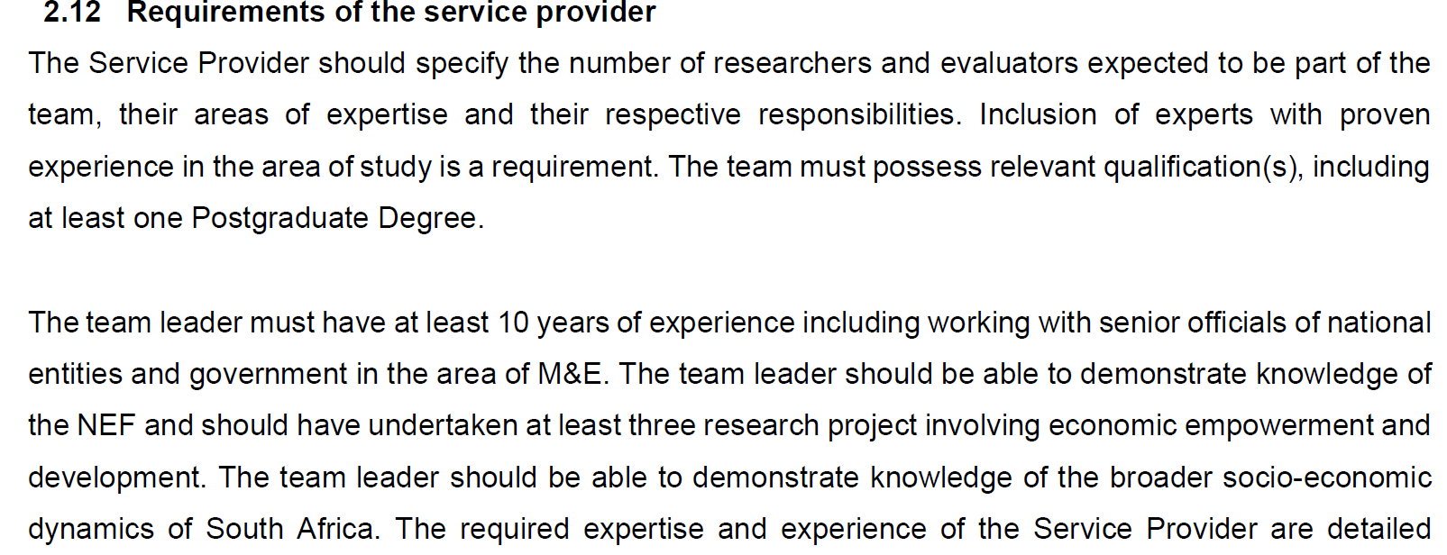
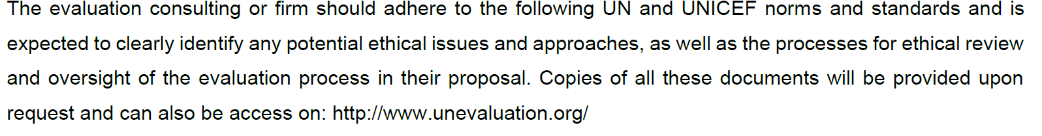
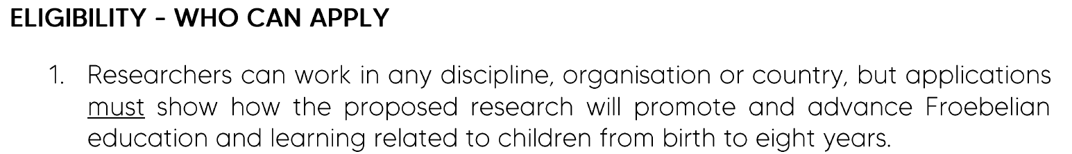
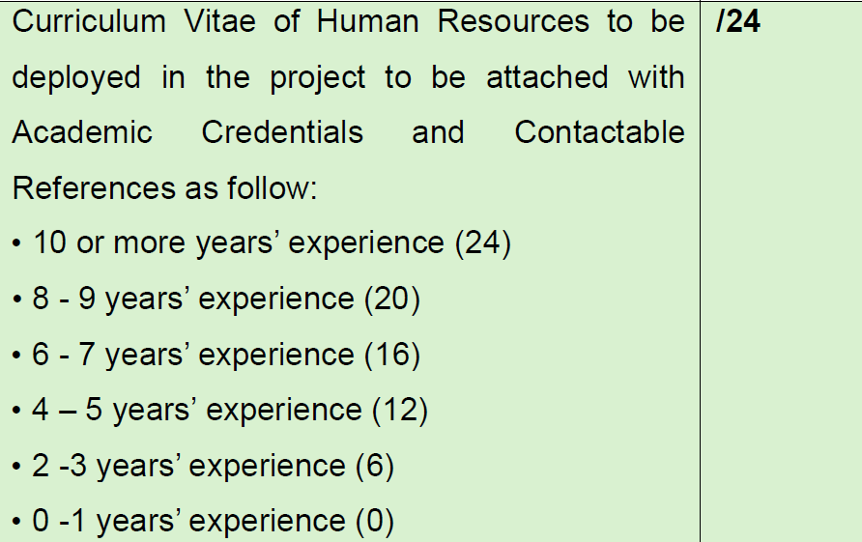
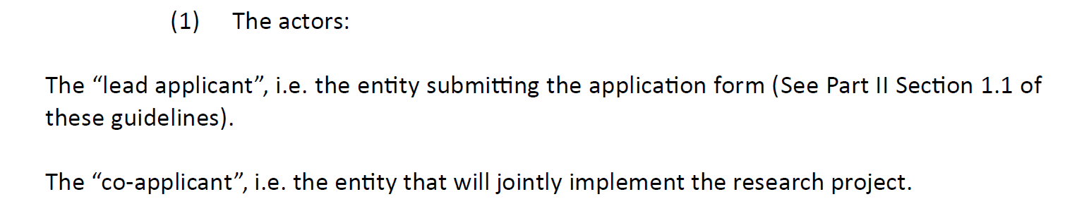
Research Team Capacity Requirements

Slide 66
Institutional Processes
Identification of a Funding opportunity
Dedicated grants office (universities), Business developer(s), Individual researchers
Reviews and Approvals
Budget Preparation – dedicated staff and approver
Proposal Reviews internal
Concept
Development
Submission
Research Team constituted and works on proposal
Submissions for approval follow formal institutional channels and institution
May include external partners
Allocation of responsibilities

Slide 67
Budgeting Development and Justification
What are key principles in developing budgets?
Please post your responses in the chat.

Slide 68
A research project without a sound budget is like a journey with no map—without it, you’re likely to lose your way, your resources, and perhaps even your destination.
“It always seems impossible until it’s done.” (Nelson Mandela)

Slide 69
Key Budgeting Principles for Grant Success?
Compliance with Funder Requirements – Review, review and review!!!!
Central to budget preparation is compliance with funder requirements for eligible and non-eligible costs
A compliant budget reduces the potential of rejection
Provide rationale for every budget item included
Some donors have specific budget templates or clear budget guidelines e.g. SA Government institutions include a “pricing schedule”
E.g, UKRI (UK) required the budgets to be priced in Euros at the current rate and not exceeding limits for different categories. An extensively developed and carefully crafted proposal valued at GBP 190 was rejected due to exceeding the budget allowed limit for UK researchers by a mere GBP 34
Never include donor-stipulated ineligible cost items in the budget
E.g. A budget excluded toll fees and fuel costs for a national fieldwork study, although vehicle hire was included. The client had to renegotiate the budget with the donor, which delayed the process by 3 months.
E.g, Alcohol was included in the dinner hosted for participants at a workshop.
Demonstrates Project Feasibility, Realism, and Justification
A university research proposal integrated its budget with project activities, clearly showing how resources would support expected outcomes. E.g. a line item for staff training highlighted the direct relationship to enhanced study implementation.
Ensure alignment of budget line items with activities
All activities in the proposal must be indicated in budget line items
Accuracy: Check and double-check your budget calculations and line items against the proposal

Slide 70
Key Budget Categories
Live Discussion
Indicate in the chat the categories you are familiar with

Slide 71
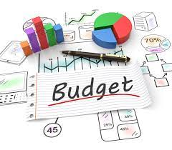
Key Budget Categories
Labour: Internal and External Personnel (salaries, consultants, fieldworkers, editors, administrative support)
Disbursements: Direct project costs (travel, subsistence, printing, equipment –laptops/tablets, subscriptions, IT connectivity, layout and printing)
Indirect costs: Institutional overheads
Donor ceilings – e.g. no more than 10 %
Value Added Tax
SA – 15% (only if not able to claim back)
Other costs – contingencies, Most donors won’t allow for this.
“Proposals may include a contingency of up to 7% of the total budget, provided that a clear rationale is presented outlining potential risks.” (European Union)

Slide 72
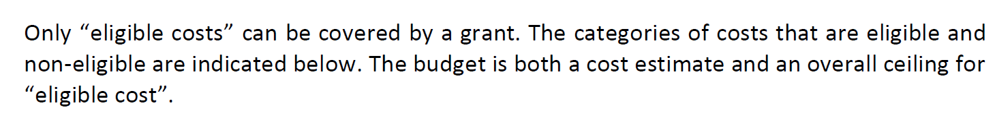
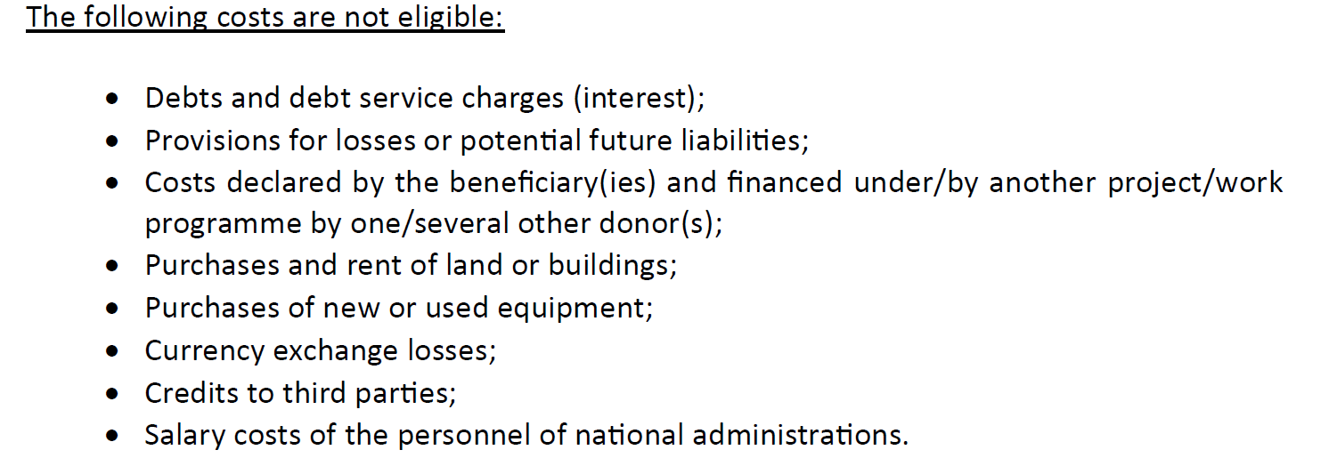
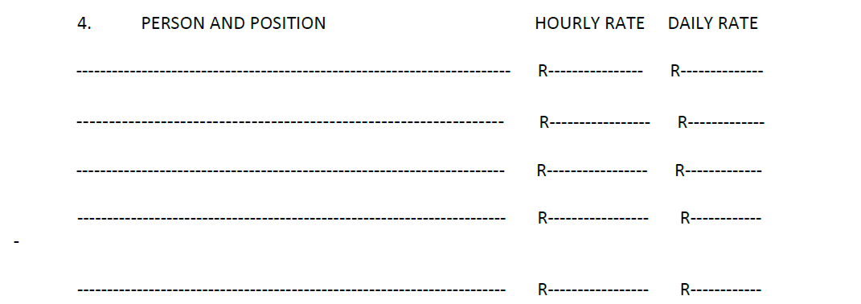
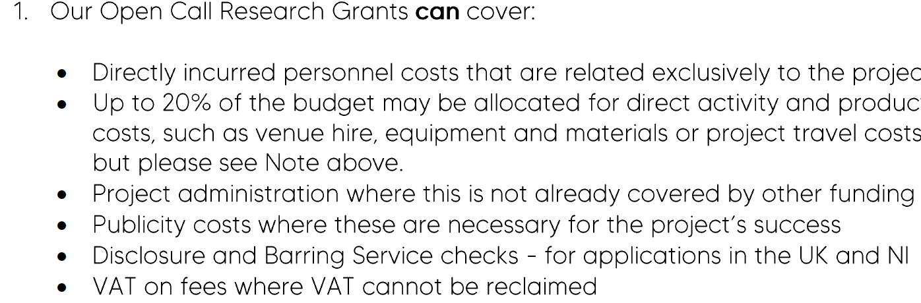
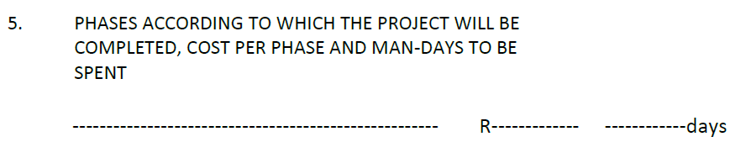
Examples of Donor Budget Requirements
Pricing Schedule

Slide 73







KEY BUDGETING PRINCIPLES FOR GRANT SUCCESS
Compliance with Funder Requirements
Review, review and review — a compliant budget is far less likely to be rejected.
REAL EXAMPLES — rejections & delays that were avoidable
Comply with funder rules on eligible vs non-eligible costs.
UKRI (UK) required budgets priced in Euros at current rates and capped per category. A carefully crafted proposal valued at GBP 190 was rejected for exceeding the UK limit by a mere GBP 34.
A compliant budget reduces the potential for rejection.
Provide a clear rationale for every budget item included.
A budget excluded toll fees and fuel for national fieldwork yet included vehicle hire. The client had to renegotiate with the donor — delaying the process by 3 months.
Follow donor templates & guidelines — e.g. SA Government’s “pricing schedule”.
Never include donor-stipulated ineligible cost items.
Ineligible Costs - Inclusion of post workshop, entertainment (alcohol costs, sightseeing etc.); claiming VAT which is recoverable.

Slide 74



KEY BUDGETING PRINCIPLES FOR GRANT SUCCESS
Feasibility, Alignment & Accuracy
Beyond compliance, a strong budget proves the project is realistic — and is checked line by line.
Demonstrates Project Feasibility, Realism & Justification
A university research proposal integrated its budget with project activities, clearly showing how resources would support expected outcomes — e.g. a line item for staff training highlighted its direct link to enhanced study implementation.
Align line items with activities
Accuracy
Every activity in the proposal must be reflected in the budget line items — no activity without a cost, no cost without an activity. The Spencer Foundation rejected a proposal as no costs for mileage.
Check and double-check your budget calculations and line items against the proposal. Small arithmetic slips undermine an otherwise strong bid. UKRI Budget calculations for the UK researcher exceeded the total allowed by a few extra GBP.

Slide 75
BUDGET TEMPLATE
Activity and Labour-Based Budgeting
Brief Demonstration of Budget Template

Slide 76
Explanatory Notes to Budget Line Items
Labour:
Adhere to institutional/donor stipulated charge-out rates for specific team members
Provide details of personnel time on study .e.g. Intern x 80 hours on literature review
Justify rates for consultants e.g could use DPSA guidelines for rates per qualification or experience
Editors – R350 per 1000 words x 16000 words
Disbursements:
Travel: Study requires travel to one site each per 9 provinces x 250km per site (use Dept of Transport mileage charge rates)
Subsistence: Use institutional rates per night for determining if they qualify for subsistence. Agreed on per diem rates (institutional regulations)
Equipment hire: get quotes for laptop/tablet hire with insurance cover
IT connectivity costs: 35 fieldworkers x 8 GB data per month x 3 months.
Incentives: Explain the need for incentives and the nature of the incentive e.g. Airtime voucher for connectivity, Shopping Voucher for food etc.

Slide 77

If grant is awarded manage the grant with care as per approved budget and donor guidelines

Slide 78
Budget Expenditure Non-Compliance-Consequences
Consequences of Non-Compliance: Potential Risks:
  Grants withdrawn, penalties levied, non-eligible expenditure or future funding jeopardised
The EU withheld the final 10% of the budget at study closure due to the inability to produce copies of boarding tickets for extensive flights taken. This had been explained in the briefing session
An international donor did not allow expenditure for flights which were paid for and not utilised due to no show or missed flights which had to be repurchased.
A research team was awarded a grant by a national funding body for a multi-year scientific study. The budget allocated specific amounts for personnel, travel, and equipment. However, the team transferred funds between categories without the donor’s approval, leading to a significant shortfall in the travel budget. Upon audit, the funding agency required justification, resulting in fines and a suspension of future grant applications.

Slide 79

7th Annual Emerging African Researcher Training Academy 2026
Proposal Packaging and Submissions
African Research Voices in the Age of Artificial Intelligence

Slide 80
7th Annual Emerging African Researcher Training Academy 2026
Ensure you fully understand the requirements for submission
Follow the submission guidelines
Check the terms of reference for guidelines
These vary depending on the donor and the type of opportunity
Adhere to the donor’s application forms/template, if available - Standard Bidding Documents - for government tenders
Briefing session attendance, if compulsory
Support documents - legal and financial documents
Reference letters, proof of similar work undertaken, copies of reports and publications.
Proposal supporting documents- e.g CVs and qualifications
African Research Voices in the Age of Artificial Intelligence

Slide 81

7th Annual Emerging African Researcher Training Academy 2026
Submission
Create checklist- track proposal development and submission
Clarify submission approach
Physical copies delivered
Online submission
Funder dedicated platform/system
Date and Time, address for physical submission
Failure to submit on time will disqualify your submission
Allow sufficient time to ensure that your submission reaches the donor timeously.
African Research Voices in the Age of Artificial Intelligence
Notes:
Checklist demonstration

Slide 82
7th Annual Emerging African Researcher Training Academy 2026
Example: "Proposals must be submitted in English by February 15, 2026 at 23:59 SAST via the online platform. We will hold an information session on January 28, 2026, at 3pm SAST/4pm EAT. Please register for the information session here and send any questions to us at # xxxx"
After Submission
Save a copy of the final submitted proposal.
Track the funder’s decision timeline.
If awarded, follow the next steps (e.g., contract signing, reporting requirements).
If rejected, request feedback and draw lessons for future submissions
African Research Voices in the Age of Artificial Intelligence

Slide 83
7th Annual Emerging African Researcher Training Academy 2026
Any questions?
African Research Voices in the Age of Artificial Intelligence

Slide 84
7th Annual Emerging African Researcher Training Academy 2026
CLOSING REMARKS
African Research Voices in the Age of Artificial Intelligence

