Slide 1

7th Annual Emerging African Researcher Training Academy 2026
MODULE 6
Finding a secondary research database for your study -
Data that matters!
Dr Glenn Tshweu
28 July 2026
11:00 – 13:00
gtshweu@hsrc.ac.za
African Research Voices in the Age of Artificial Intelligence

Slide 2
7th Annual Emerging African Researcher Training Academy 2026
Contents
What we do at the HSRC
The nature of the HSRCʼs data collection
Primary vs Secondary data
Example of a HSRC survey
Access to the HSRC’s data collection
Using data sets responsibly
African Research Voices in the Age of Artificial Intelligence

Slide 3
Question 1
What challenges might one encounter when collecting data for a research project?

Slide 4

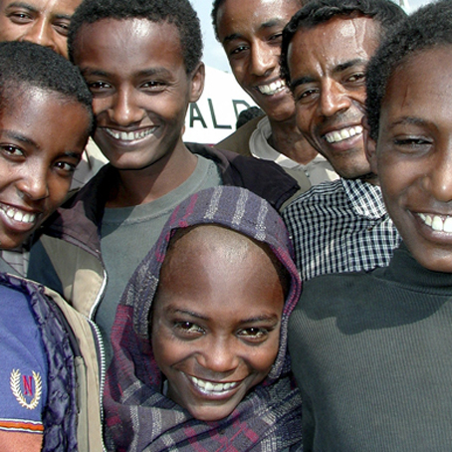
Human Sciences Research Council
The HSRC is a statutory research organisation that advances social sciences and humanities for public use.
Established in 1968, the HSRC generates evidence-based knowledge.
The largest social science research institute in Africa.

Slide 5
What we do
HSRC
Poverty
Education
Skills
Service Delivery
HIV/AIDS and STI
Crime
Youth and families
Health
Nutrition and food security
Innovation
±230 research projects per year

Slide 6
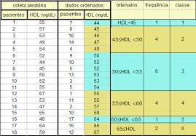
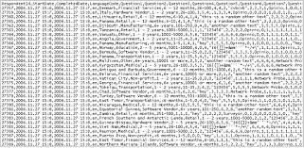
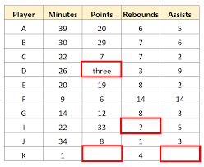
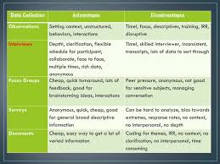

What are datasets?
Datasets are collections of raw data gathered during the research process.

Slide 7
Nature of the HSRC’s data collection
Variety of Content
Quantitative and qualitative data
Owned by HSRC or external organisations
Across the research process

Slide 8
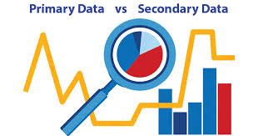
Primary vs Secondary Data
Secondary data analysis
  Use of data collected by someone else
  Data collection was for different purpose
  Researcher usually not involved in data collection
  Researcher not duplicating original study

Slide 9
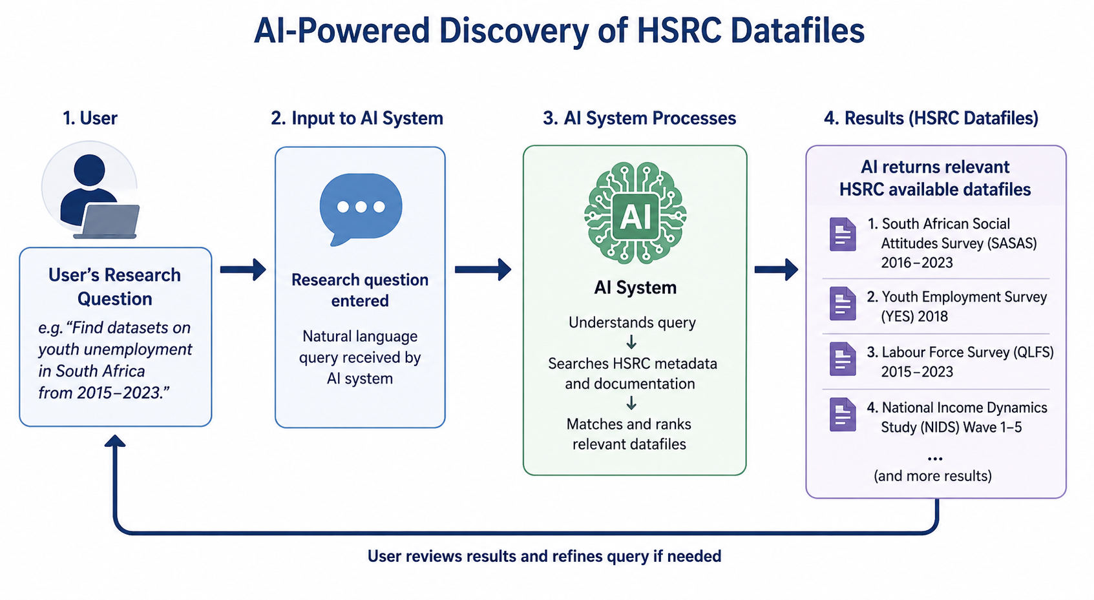
Using AI to discover HSRC data

Slide 10
HSRC large scale, repeated surveys
South African National HIV, Behaviour and Health Survey (SABSSM)
South African Social Attitudes Survey (SASAS)
Study on global AGEing and adult health (SAGE)
National Research and Experimental Development Survey (R&D)
South African National Health and Nutrition Examination Survey (SANHANES)
Trends in International Mathematics and Science Study (TIMSS)

Slide 11
South African Social Attitudes Survey (SASAS) - Profile
SASAS is intended to provide a unique long-term account of the social fabric of modern South Africa, and of how its changing political and institutional structures interact over time with changing social
attitudes and values.
History
  - First in 2003, thereafter repeat surveys annually
  Core modules include:
  - Health and Well-being
  - Education
  - Economy and Employment
  - Social issues
  - Governance and Public Policy

Slide 12
Use of Research Data
Primary data use
Data
curation
Secondary data use

Slide 13
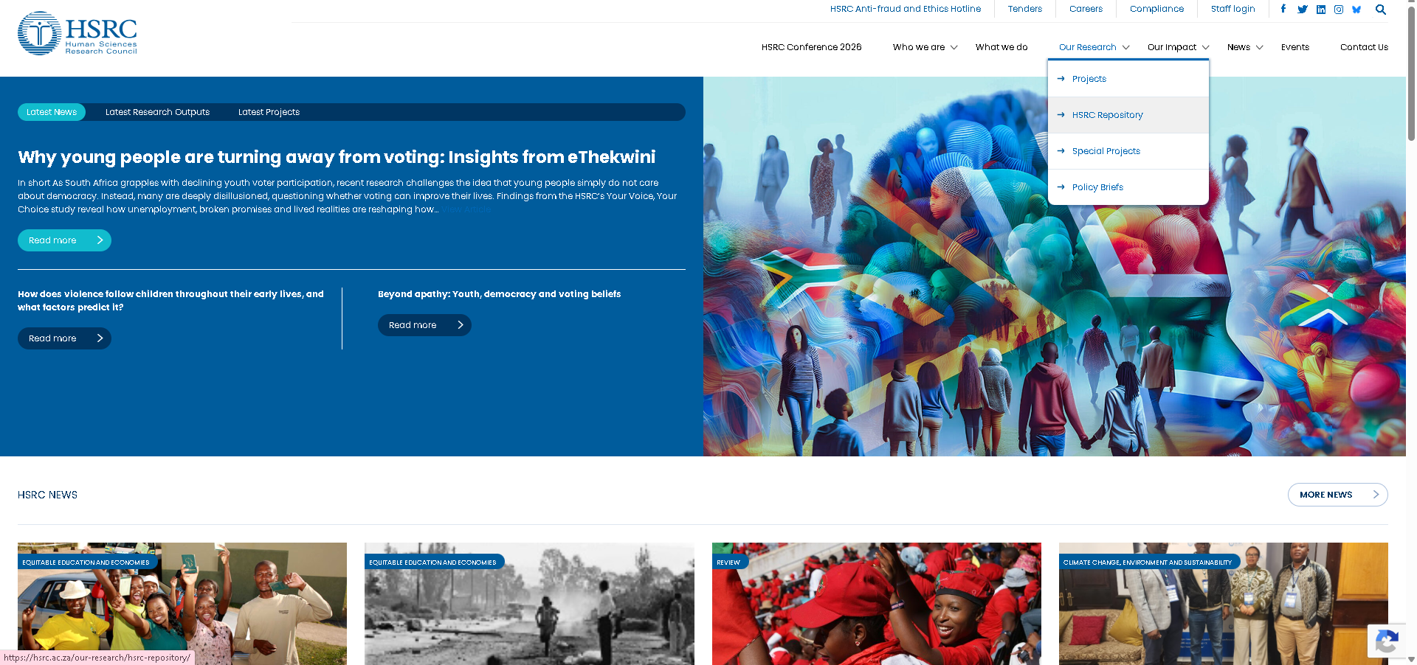
Data Sharing
http://www.hsrc.ac.za

Slide 14
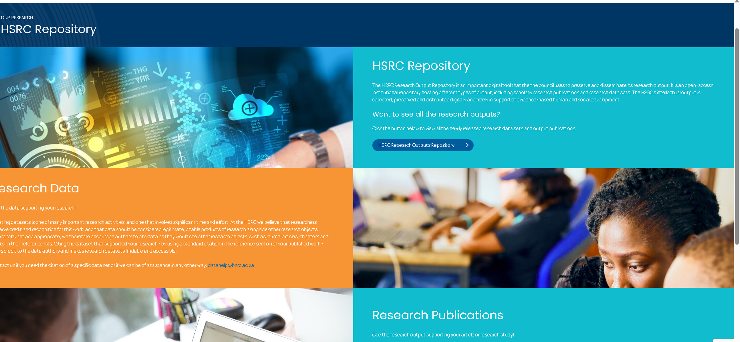
Viewing Research Data

Slide 15
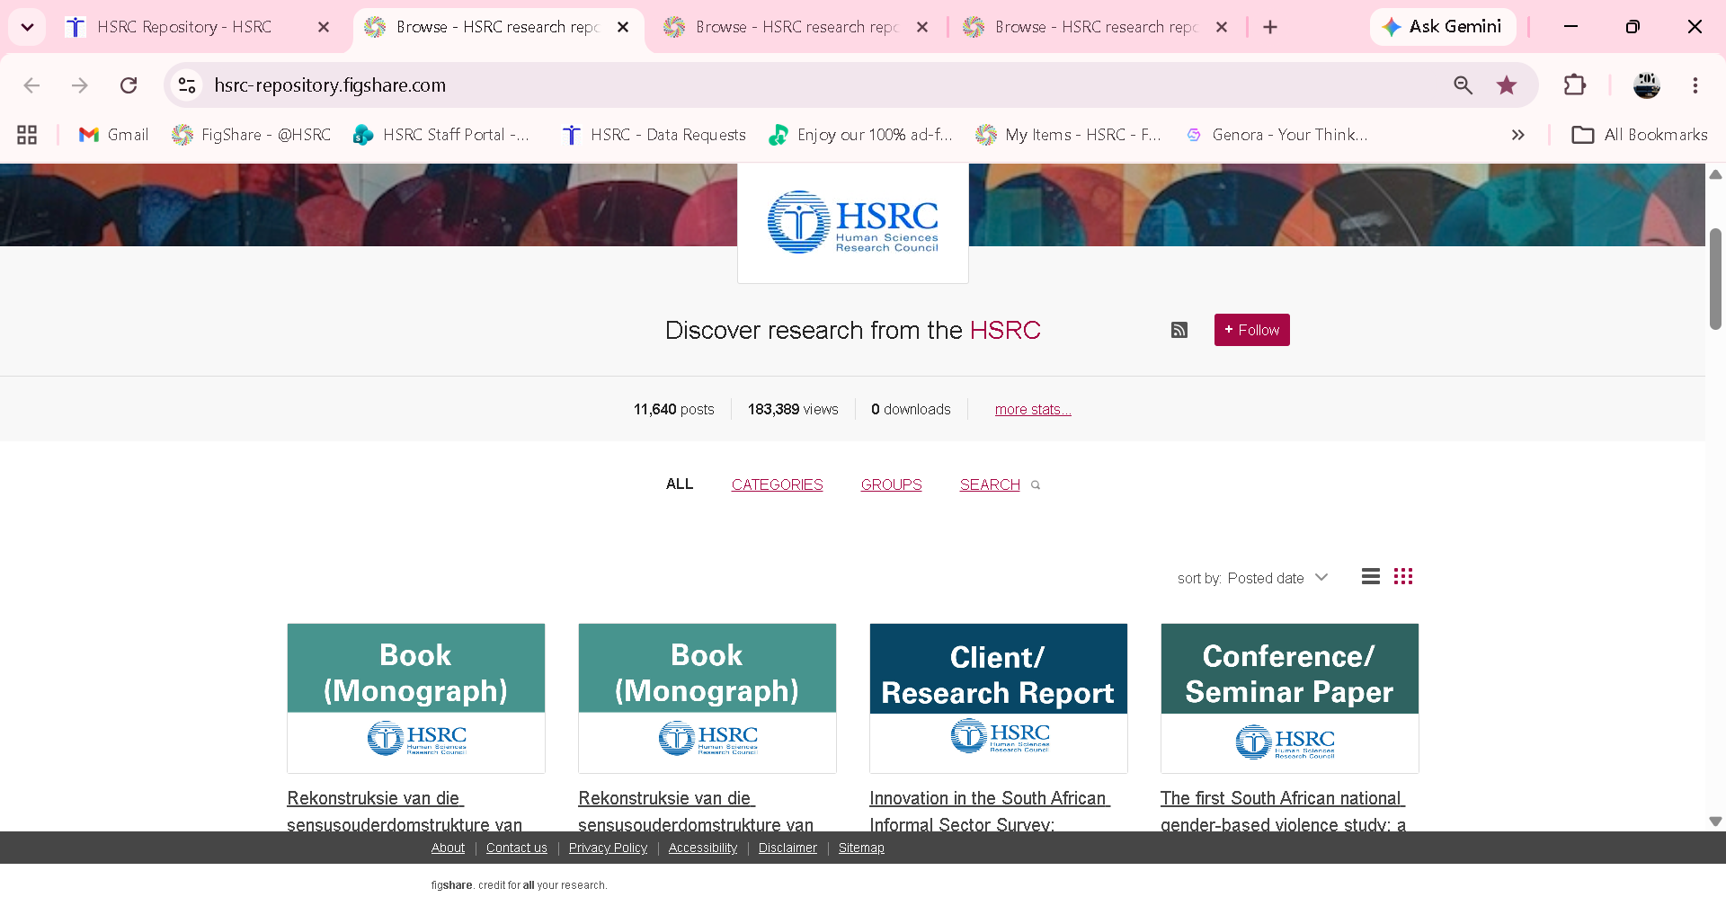
Viewing Research Data

Slide 16
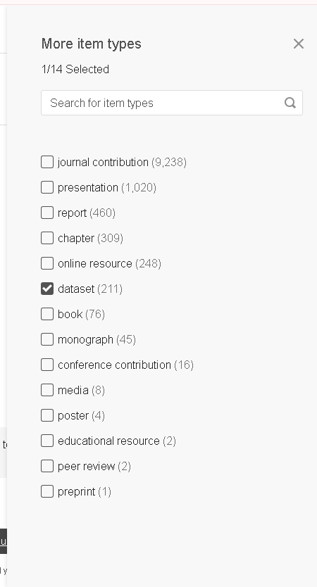
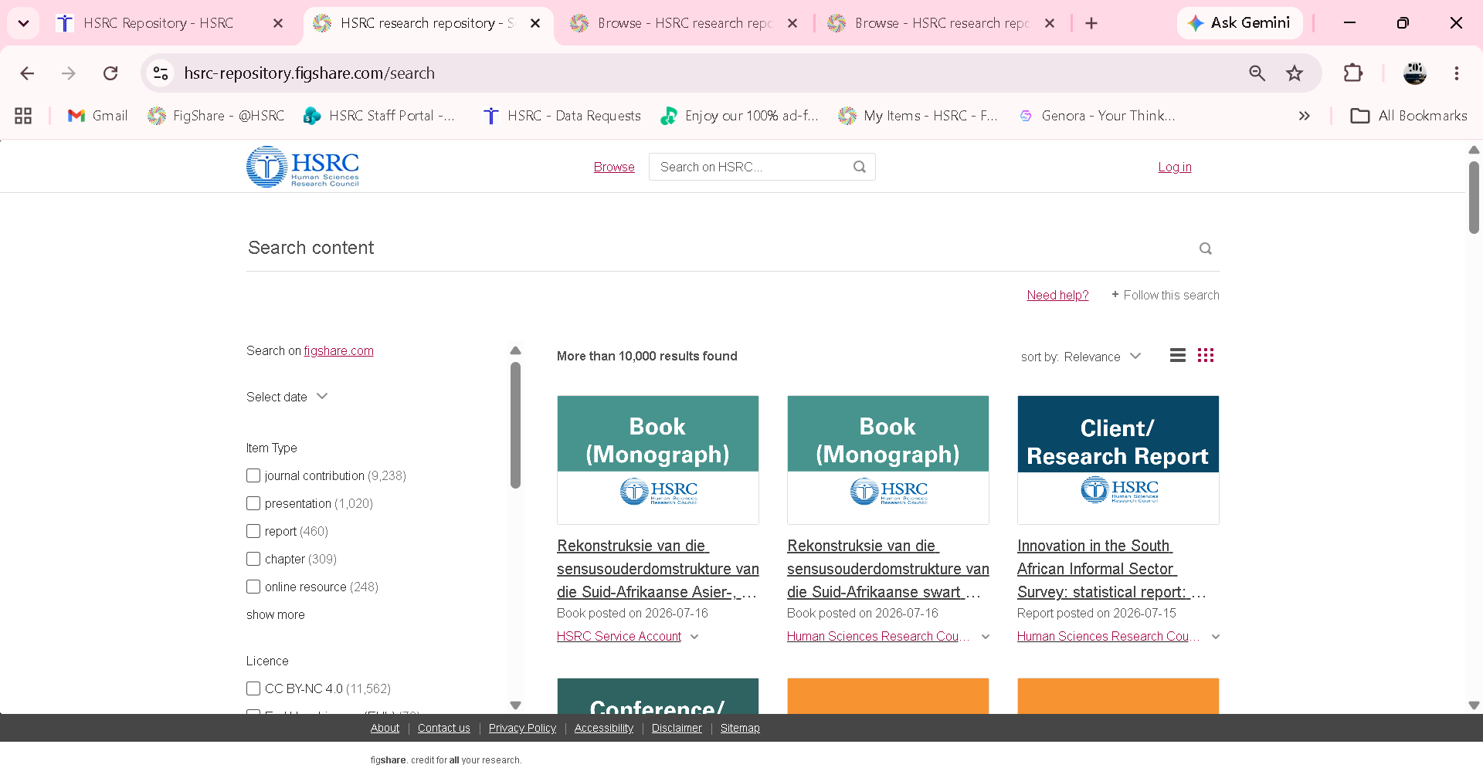
Viewing Research Data

Slide 17
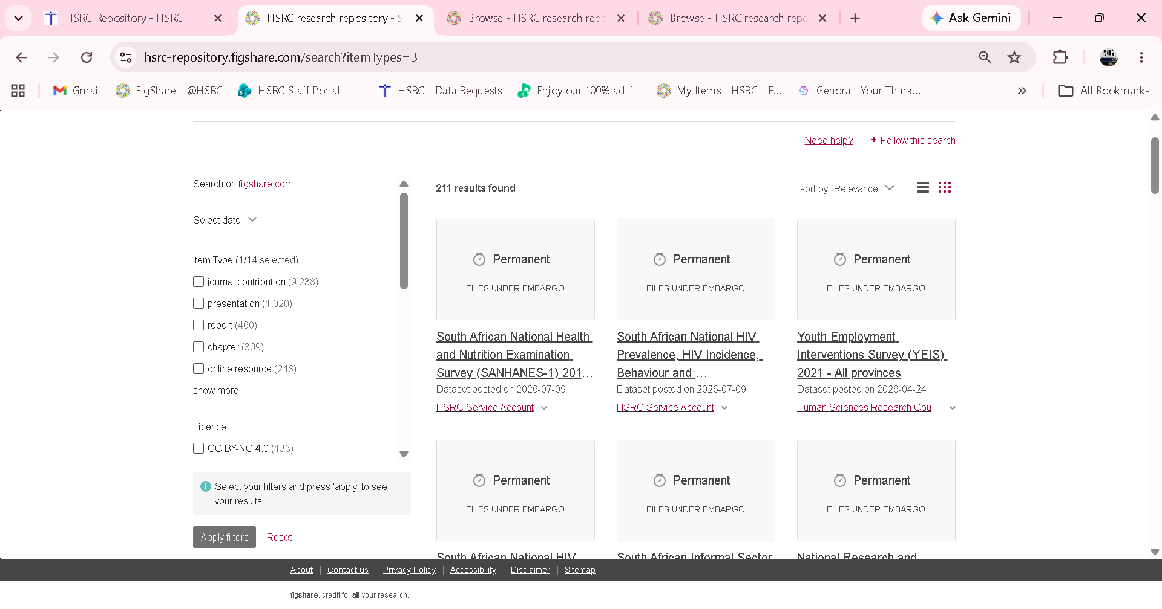
Viewing Research Data

Slide 18
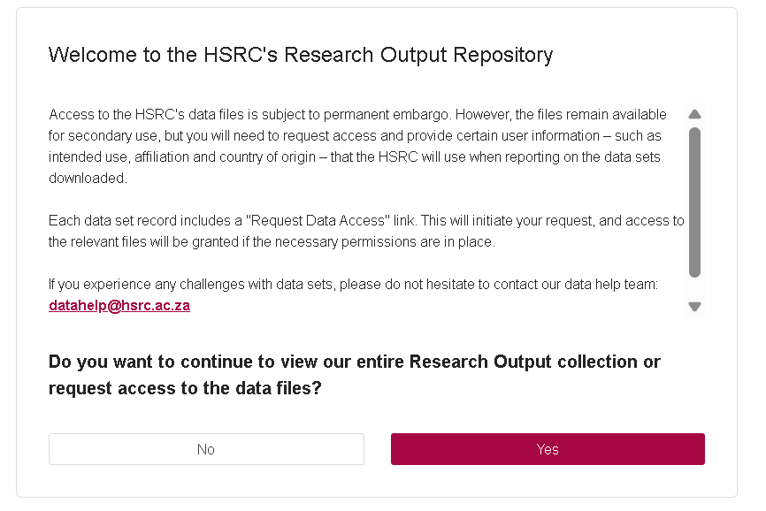
Viewing Research Data

Slide 19
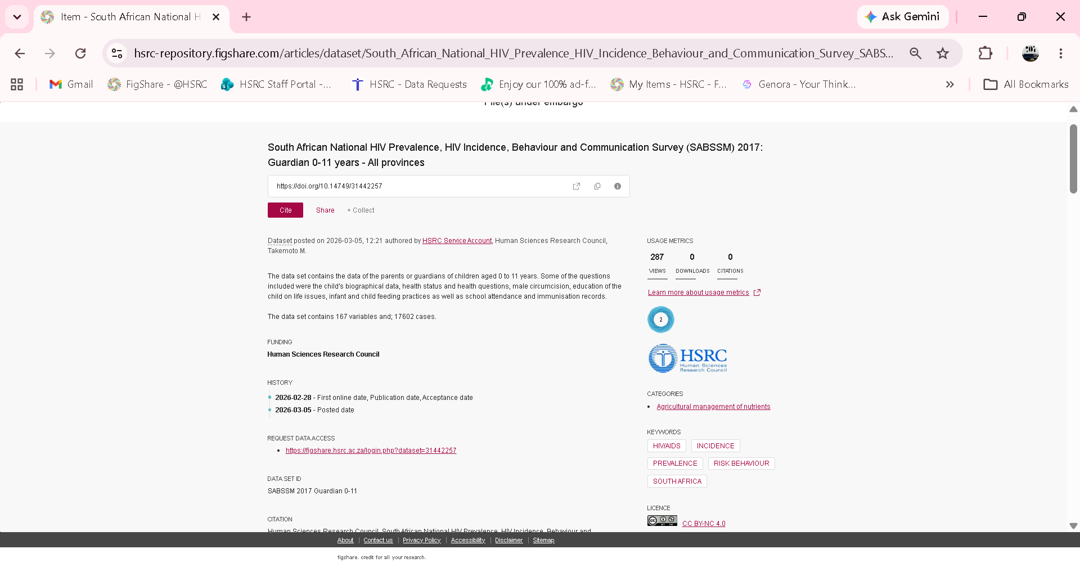
Viewing Research Data

Slide 20
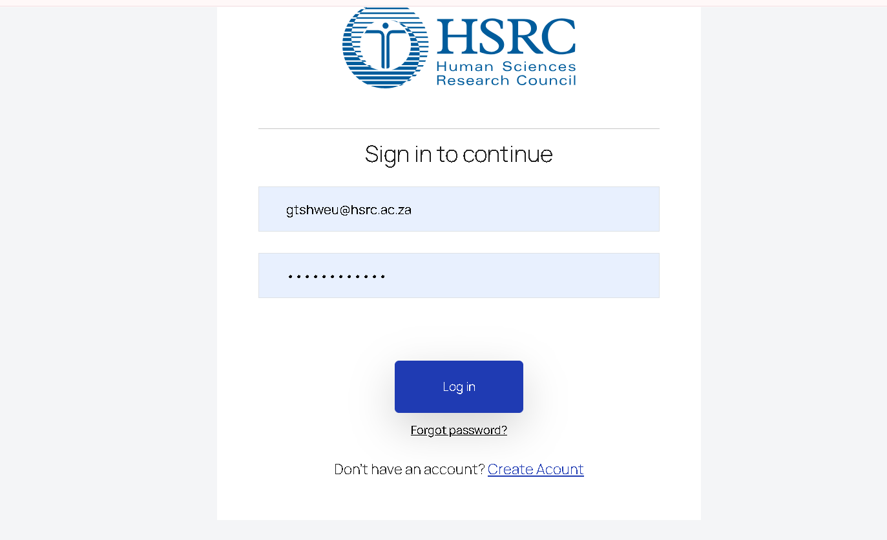
Viewing Research Data

Slide 21
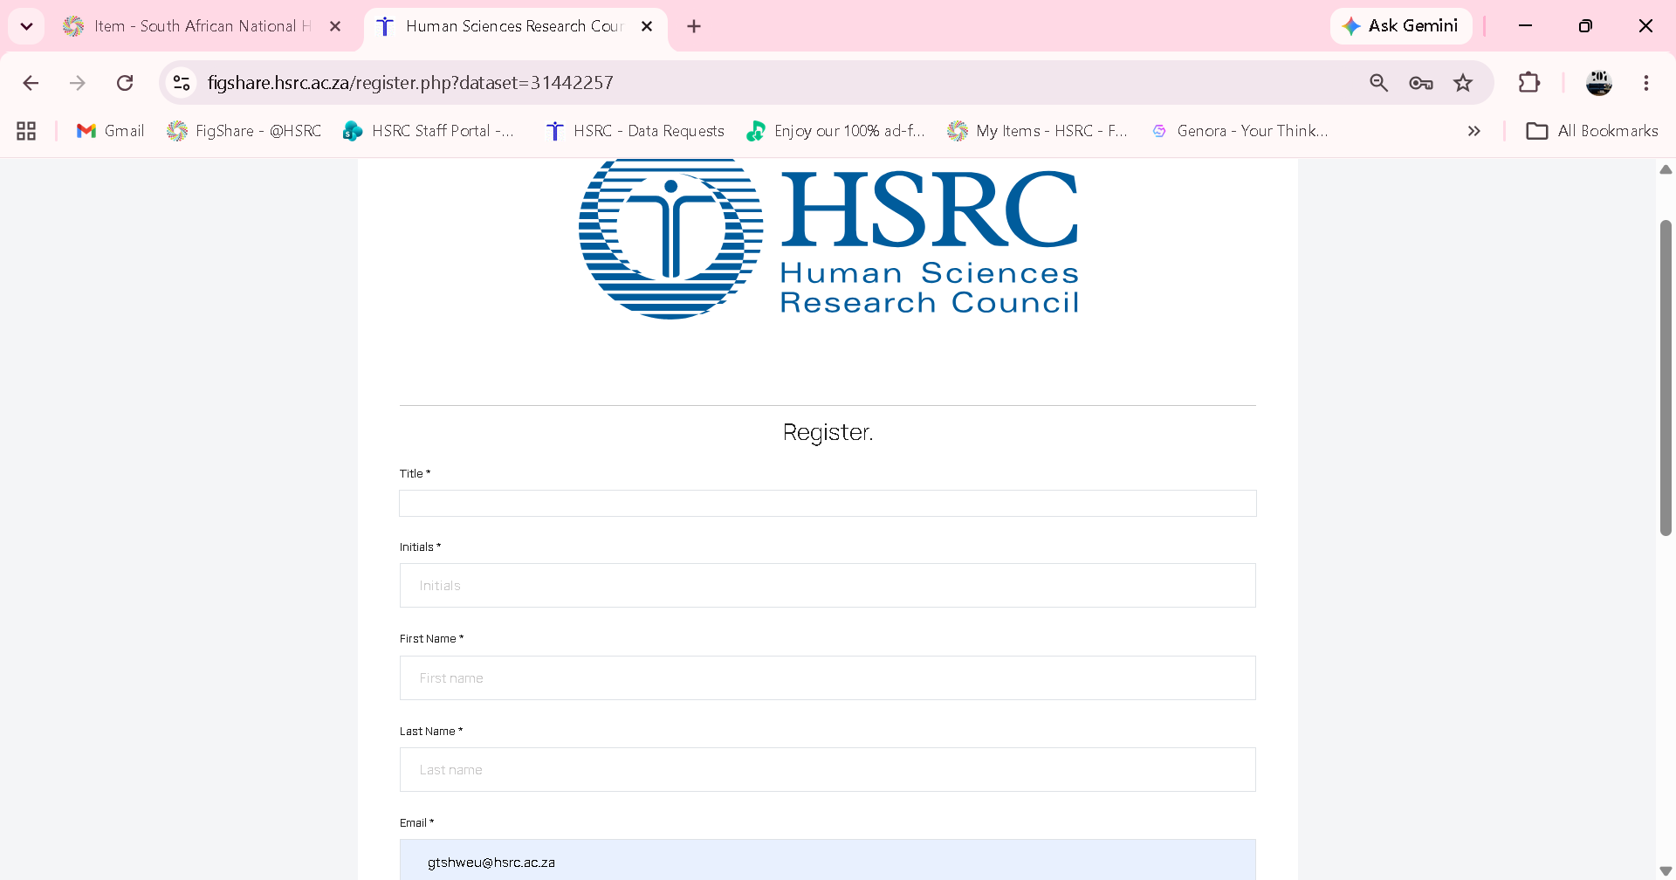
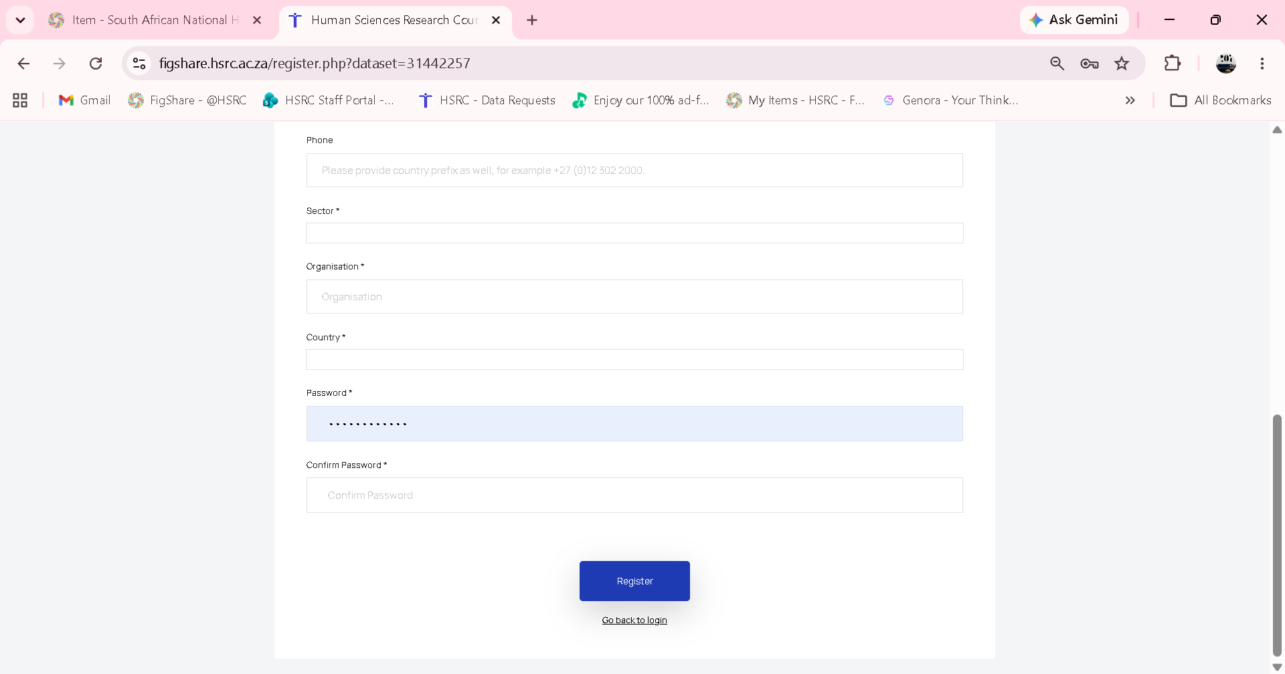
Viewing Research Data

Slide 22
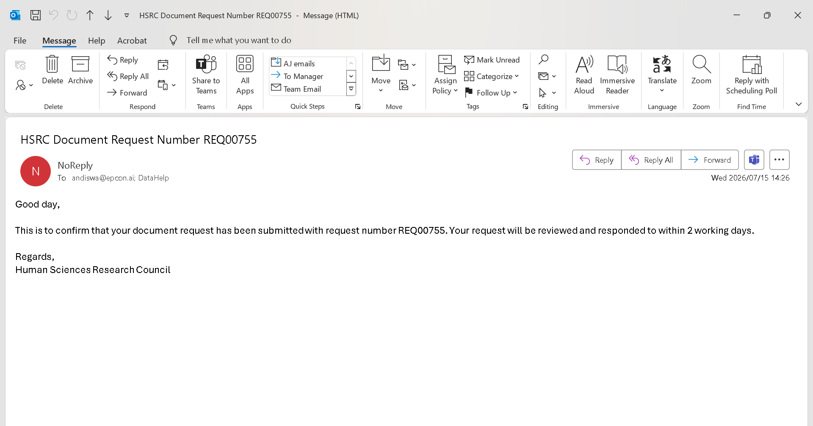
Viewing Research Data

Slide 23
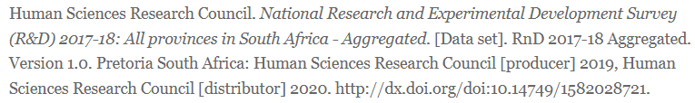
Use Secondary Data Responsibly – cite the data
Data Producers
Attribution and credit
Creates a bibliographic trail
Data Users
Finding data sets
Persistence of data sets
Everyone
Transparency
Reproducibility
Reuse
Impact

Slide 24
7th Annual Emerging African Researcher Training Academy 2026
Thank you
gtshweu@hsrc.ac.za
datahelp@hsrc.ac.za
African Research Voices in the Age of Artificial Intelligence
Notes:
Here’s my email address and the DataHelp email address, please contact us if you have any questions regarding HSRC research outputs.

