Slide 1

7th Annual Emerging African Researcher Training Academy 2026
Foundations of Quantitative Research: Session 2
Vandudzai Mbanda
29 July 2026
09:00 to 13:00
VMbanda@hsrc.ac.za
African Research Voices in the Age of Artificial Intelligence

Slide 2
Lesson plan outline
Research design
Sampling
Questionnaire design

Slide 3
7th Annual Emerging African Researcher Training Academy 2026
Quantitative Research Design
African Research Voices in the Age of Artificial Intelligence

Slide 4
Research design and the research process
A research design: critical component of research process
Blueprint for conducting a study
Allows drawing of meaningful conclusions from research - to contribute to the body of knowledge a field
Why is a well-constructed research design fundamental
Essential to ensure research objectives are met
Validity, reliability, and generalizability of research findings
Allows drawing of meaningful conclusions from research - to contribute to the body of knowledge a field

Slide 5
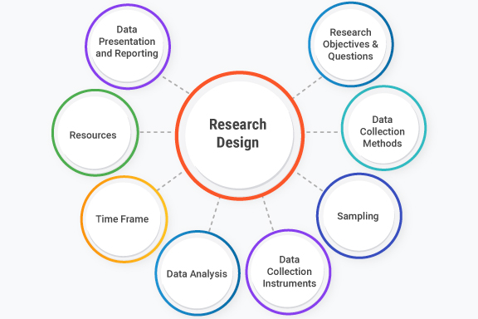
Research design
Key elements of research design include

Slide 6
Quantitative research designs
Foundational master blueprint in quantitative research
Quantitative research describes and explains phenomena by collecting & analysing numerical data
The choice of research design depends on the nature of the research and the goals of the study
A research design: critical component of research process
Quantitative research describes and explains phenomena by collecting & analysing numerical data
The choice of research design depends on the nature of the research and the goals of the study

Slide 7
Overview of major designs
Non-experimental
Observation Only: Data is observed/measured without manipulating or control
Descriptive: Describing traits
Correlational: Focuses on finding statistical associations between variables
Experimental
Cause & Effect: Data is analysed to test causality
Control: Involves manipulation of a variable and/or groups to isolate causal effects

Slide 8
Activity: Quantitative research designs
Experimental, quasi-experimental, correlational, or descriptive?

Slide 9
Which design should I use for my research?
Ultimately one should be guided by the purpose of their research
  What is research question one needs to answer and what design can most effectively assist in answering that question?
To describe or identify trends without identifying a causal effect - a non-experimental design
  Important: is the sample representative of the group for which answer to a question are sought?
  Can experience challenges with collecting data from the same units over time
  To identify an effect - an experimental or quasi-experimental design
  A pure experimental design would be best BUT consider ethics concerns, costs and complexities of administering the experiment
  A quasi-experimental design could get around these concerns, may need to be creative with existing data or collect limited data in a strategic way

Slide 10
7th Annual Emerging African Researcher Training Academy 2026
Sampling in Quantitative Research
African Research Voices in the Age of Artificial Intelligence

Slide 11
Sampling in Quantitative Research
Sampling techniques: Probability and non-probability​
Quantitative research often focuses on being able to make generalizations about groups larger than study samples
It tends to rely on probability sampling techniques
  There are instances when it relies on nonprobability samples
    Exploratory and evaluation research
Probability sampling techniques aim to identify a representative sample from which to collect data
  i.e., a sample that resembles the population from which it is drawn in all aspects important for the research being conducted
All elements in target population have equal chance of being selected for inclusion in a study
  random selection

Slide 12
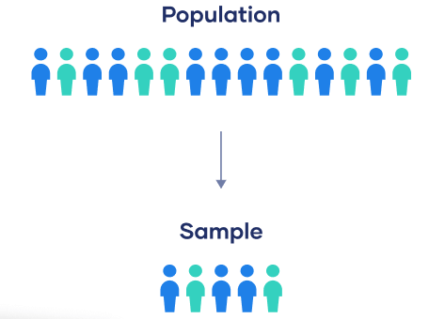
Sampling terminology
Population vs sample
  Population: group to draw conclusions about
  Sample: the specific group of individuals to collect data from
Sampling frame
Sampling techniques

Slide 13
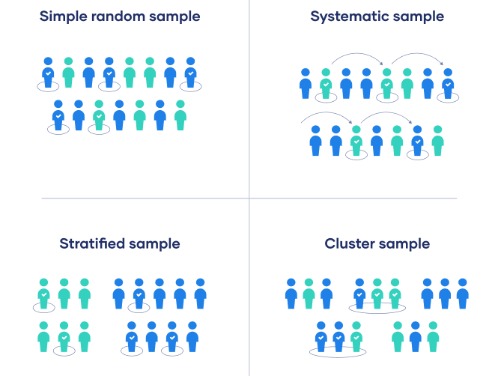
Sampling methods

Slide 14
Sampling methods
Strengths and weaknesses of sampling techniques:pling
  Simple random sampling
  Systematic sampling
  Stratified sampling
  Cluster sampling

Slide 15
7th Annual Emerging African Researcher Training Academy 2026
Questionnaire design
African Research Voices in the Age of Artificial Intelligence

Slide 16
Questionnaire design
Widely used quantitative research data collection
Aims of the aims of the questionnaire
Selecting the question styles
Designing the questions
Structuring the questionnaire
Piloting the questionnaire
Revising the questionnaire
Administering the questionnaire.

Slide 17
Questionnaire design
How have others measured the concepts you want to measure? Make use of lit review, other questionnaires to guide how you approach yours
How you will administer the survey may affect the way you approach your design
Who is the target audience? This may also affect how you approach the design
Keep it as short as possible – can be difficult to collect the data you need in the most “painless” way
Think about the order and flow of your questionnaire

Slide 18
Questionnaire design
Make use of filtering and branching – only ask what you need to who you need that information from
Types of questions:
Open-ended vs close-ended: respondents more likely to skip open-ended questions
Rating scales: five to seven point scales, should be unambiguous
Categorical questions: think about order, biases

Slide 19
Questionnaire design
The ideal question accomplishes three goals (Harvard, 2007):
  It measures the underlying concept it is intended to
  It doesn’t measure other concepts
  It means the same thing to all respondents
Best practice
  Keep sentences short and simple
  Avoid vague language
  Avoid technical language and jargon (language not appropriate for the audience)
  Avoid leading and emotive language
  Be specific and provide reference points for clarity of what you mean
  Anticipate all options, allow “other – please specify” for possibilities you may not have covered in multiple choice questions

Slide 20
Primary data collection – online tools
Online data collection apps provide new research possibilities
  Increasingly becoming integral to secure and reliable
  Efficient and dependable mobile survey apps offline
  Secure data entry
  Faster data analysis and visualization
Vital issues to consider with online data collection apps:
  Ethical considerations and technical dilemmas
  Easy to find, accessible, reusable

Slide 21
Activity 2: breakaway session
Agree on research that you might want to conduct as a group and answer the following questions:
  What type of research design would you use?
    Indicate if you will make use of primary or secondary data
  Design a questionnaire with a max of 6 questions to get the information you require.
    For each question, what types of variables are you interested in measuring?
    How will you measure these?

Slide 22
7th Annual Emerging African Researcher Training Academy 2026
Thank you
Any questions?
African Research Voices in the Age of Artificial Intelligence

