Slide 1

7th Annual Emerging African Researcher Training Academy 2026
Foundations of Quantitative Research
Session 1.1
Dr Saahier Parker
29 July 2026
African Research Voices in the Age of Artificial Intelligence

Slide 2

Learning Objectives
At the end of this session, you will be able to:
Explain what quantitative research is
Describe the purpose of statistics
Differentiate between quantitative and qualitative research
Understand the research process
Identify populations, samples and variables
Recognise common forms of quantitative data
Explain why statistics matters in research

Slide 3

Using Numbers to Answer Research Questions
Building Evidence through Data
We ALL already use evidence and inference in our daily life.
We use basic inference; we pattern-match, we average our expenses; predict who will win the World Cup; we weigh anecdotal evidence.
Statistics are not math - forensic evidence that separates a real scientific discovery from a lucky guess
"I'm wrong all the time. It's how I get to 'right'.

Slide 4
Why Do Statistics Matter?
How do researchers know whether something is true?
          Does social media affect mental health?
          Does science engagement increase public trust?
          Does education improve employment?
          Does vaccination reduce disease?
The Danger:
Our intuitions are terrible scientists - statistics helps us answer questions objectively.
Think of quantitative research methods as the tools to protect you from research bias
  Raw Data is like eyewitnesses - full of bias and error.
  Descriptive Statistics - gives you the interrogation summary. (Mean / SD)
  Inferential Statistics - Are the observed effects random chance? (P Values)
  Confidence Intervals - show our precision in measurement (Error, Reliability)

Slide 5

Statistics in Everyday Life
Examples of common everyday statistics
How many of these use statistics? (use the chat)
Everyday statistics are just numbers we summarise, compare, and question.
Election polls | Sampling, Descriptive statistics
Weather forecasts | Probability Modelling
Medical research | Inferential Statistics, Hypothesis Testing
University rankings | Percentiles and Ranking
Inflation rates | Index Numbers and Aggregation
Crime statistics | Descriptive and Geospatial statistics
Sports analytics | Regression modelling
Credit scores | Logistic regression / machine learning

Slide 6
What is Quantitative Research?
Definition:
Quantitative research is the systematic process of collecting and analysing numerical data to identify patterns, test hypotheses, and establish cause-and-effect relationships.
Primarily answers questions like how much, how many, and how often, relying on statistical analysis to generalise findings to a broader population
Characteristics – numerical, structured, objective, replicable, analytical
Transforms abstract ideas into measurable numbers, to test our assumptions with precision

Slide 7
Quantitative vs Qualitative Research
Characteristic | Qualitative Research | Quantitative Research
Purpose | Explore, understand, generate new ideas or theories | Describe, compare, explain, and test hypotheses
Type of data | Words, text, images, audio, observations | Numbers, counts, measurements, scales, percentages
Sample size | Small (typically 5–30 participants) | Large (statistically determined via power analysis)
Analysis | Thematic analysis, coding, narrative interpretation | Descriptive stats (mean, SD) and inferential stats (t-tests, ANOVA, regression)
Strengths | Rich depth, context, flexibility, captures nuance | Generalisable, objective, replicable, tests causality
Weaknesses | Subjective, hard to generalise, time-intensive analysis | Lacks deep context, rigid structure, may miss unexpected findings
Both approaches have their strengths and limitations and each is able to answer different types of real-world questions

Slide 8
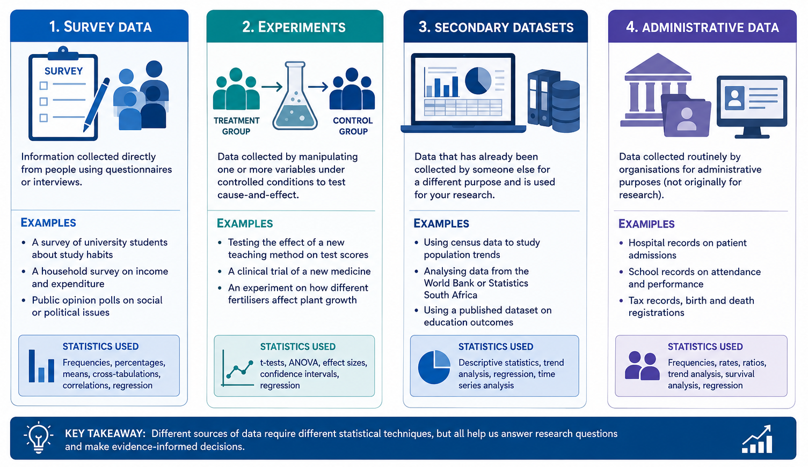
Types of Datasets

Slide 9
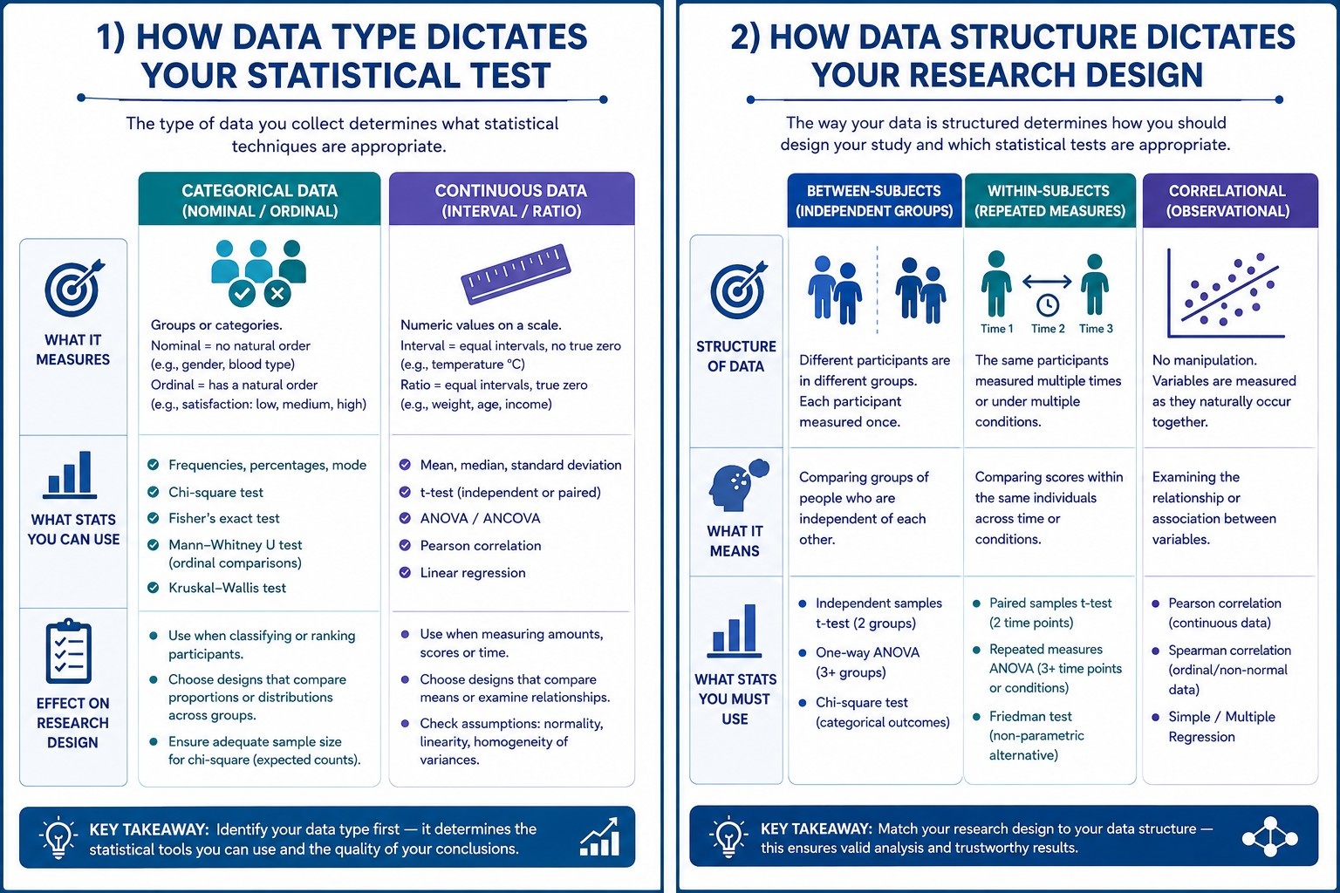
Types of Data (cont 1)

Slide 10
Data Structure and Research Design

Slide 11
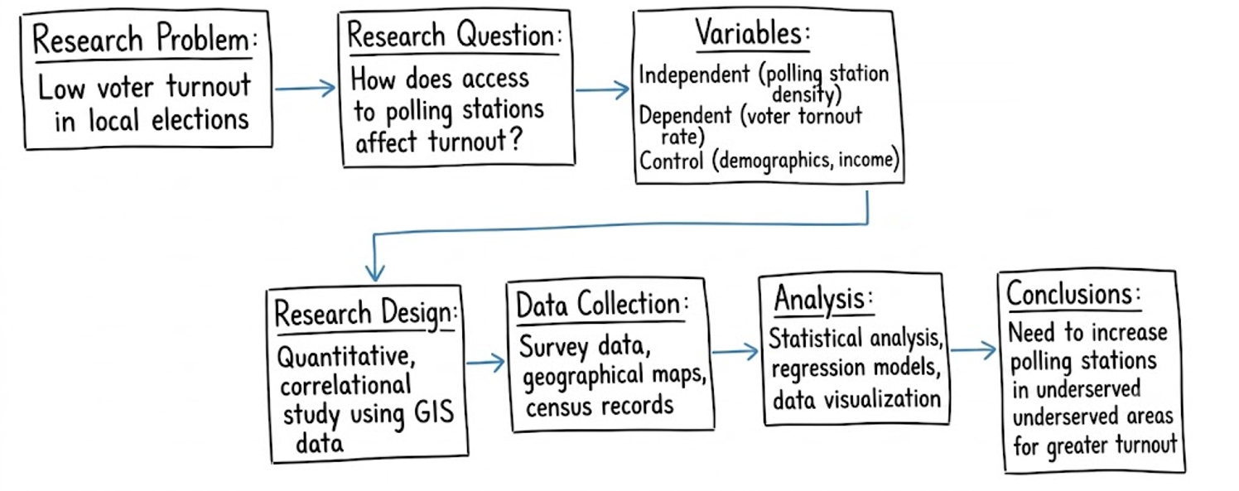
The Research Process
Start with a clear question - What are you measuring
Choose your research design carefully
Collect your data and run the analytics
Interpret the results to create plain language findings

Slide 12
Research Questions and Hypotheses
A RESEARCH QUESTION is an open-ended inquiry guiding your study.
  Defines the specific focus or problem you want to investigate. It is framed as a question "What is the effect of X on Y?”
  How does daily screen time affect the sleep quality of university students?
A RESEARCH HYPOTHESIS is a specific, testable prediction answering that question
  A testable statement predicting an outcome before you collect data. It follows an "IF this, THEN that..." format.
  Students who limit their daily screen time to under two hours will report significantly better sleep quality than those with higher screen time.

Slide 13

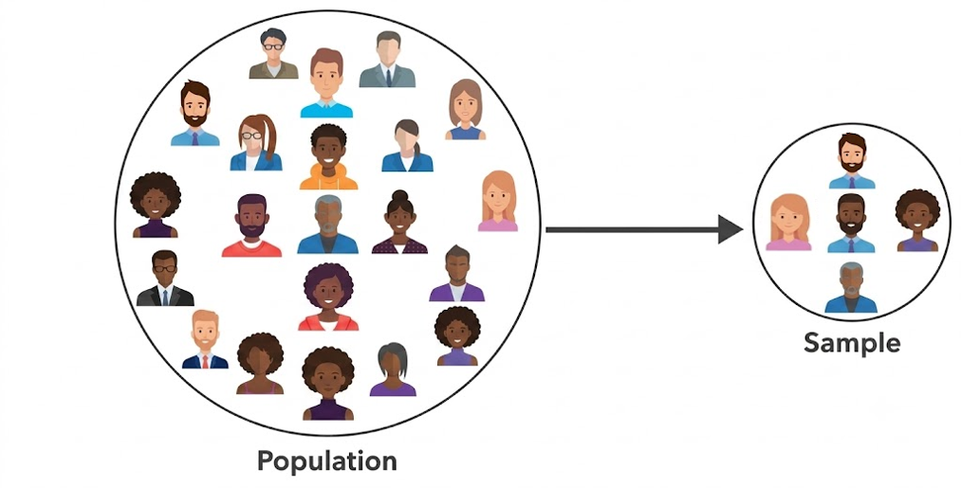
Population and Sample
A POPULATION is the entire, comprehensive group you want to study (e.g., all adults in Cape Town).
A SAMPLE is the specific, smaller subset chosen from that group (People with blue cars in Cape Town).

Slide 14
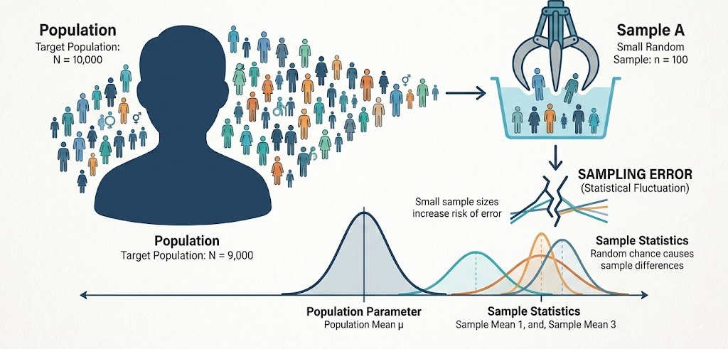
Sampling Error

Slide 15
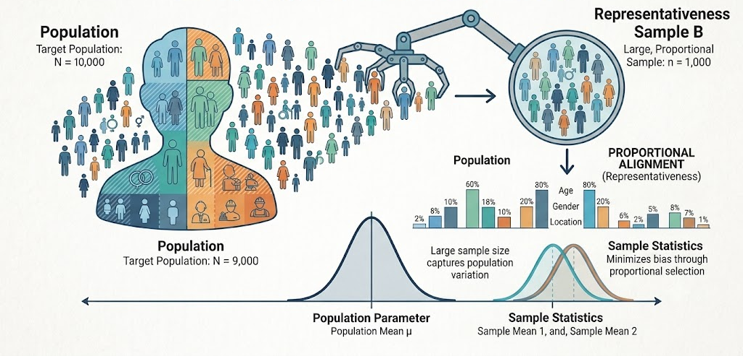
Sampling Representativeness

Slide 16
Variables
A variable is a characteristic, number, or quantity that can be measured, counted, or categorised.
Value changes across different people, objects, or events being studied (e.g., age, income, or gender)
Defining variables is the foundation of any statistical analysis because it determines how data is collected, measured, and interpreted.
Age | 18; 19; 20; 21;22 OR 16 – 24; 25-34; 35-44
Income | Low; Medium; High, Prefer Not To Say
Gender | Male; Female; Non-Binary, N/A
Race | Black; Coloured; Indian; White; Other, N/A
Life / Job Satisfaction | Low; Medium; High OR Numeric Scale
Trust in Science | Low Trust; Medium Trust; High Trust
Smoking status | Current Smoker; Former Smoker; Non-Smoker

Slide 17
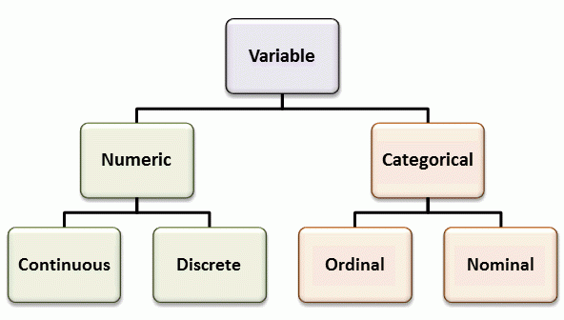
Types of Variables
Independent Variable: The presumed cause or predictor (change).
Dependent Variable: The outcome being measured.
Control Variable: Factors kept constant (experimental designs).
Continuous – measured on a scale (Height / Weight)
Discrete – Countable whole numbers (cars / books)
Ordinal – Ranked in order (Educational level)
Nominal – No order (Blood Type)
Notes:
Continuous: Measured on a scale with high precision, allowing for infinite fractions or decimals (e.g., height, weight, or temperature)
Discrete: Countable whole numbers (e.g., number of children in a family, or cars in a parking lot).
Ordinal: Categories that can be ranked or ordered (e.g., pain scale 1-10, or education level)
Nominal: Categories with no inherent order (e.g., eye color, blood type, or zip code).

Slide 18
Descriptive vs Inferential Statistics
Descriptive statistics summarise and describe the dataset.
Inferential statistics use a smaller sample to draw conclusions, test hypotheses, and make predictions about a population.
 | DESCRIPTIVE | INFERENTIAL
DATA | Population or full sample | Sample / Sub-samples
STATISTICS | Totals; Sums; Mean; Standard deviation; Averages | Correlation; Regression; t-test; ANOVA; Chi-square
KEY QUESTIONS | What does the data tell us? | What can we infer about the population?
CERTAINTY | No certainty – just patterns | Calculated probabilities / uncertainties
EXAMPLE | Calculating the average test score for a specific class of students | Surveying 1 000 000 voters to predict the outcome of a national election.

Slide 19
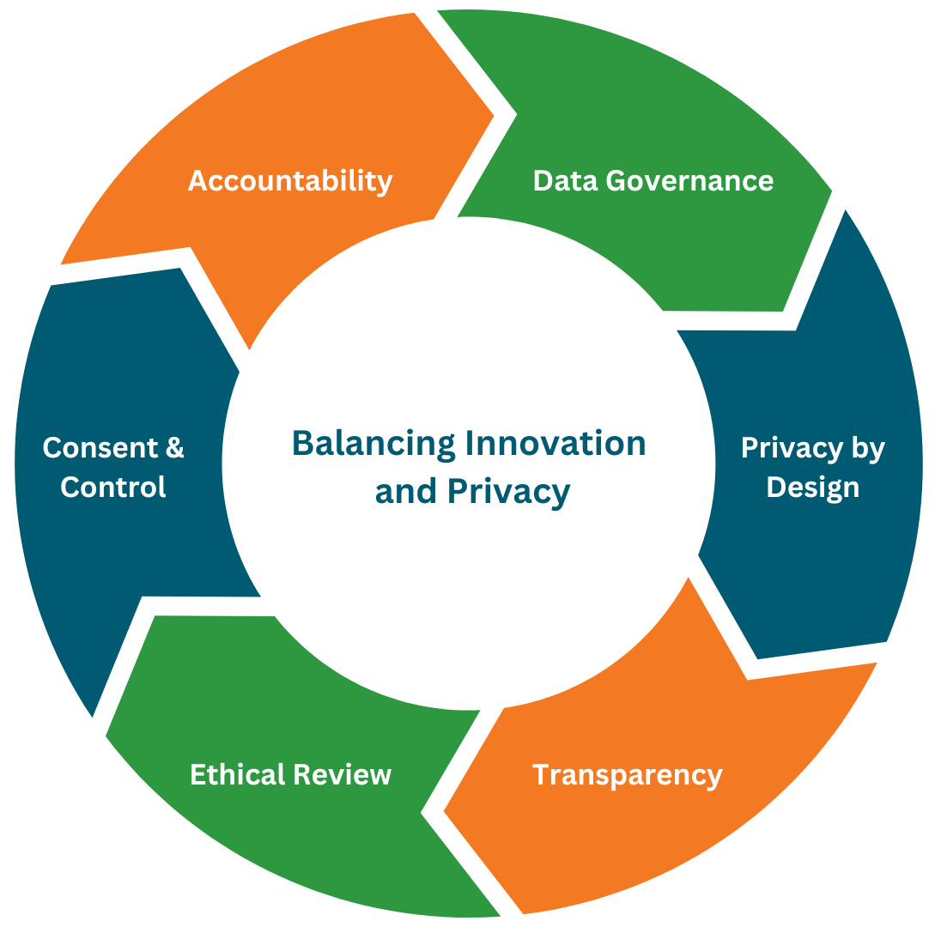
Ethical Considerations
Ethical considerations protects the researcher and ensures the integrity, equity, and the societal responsibility of research.
Key pillars include:
  REC Review
  Voluntary informed consent
  Protecting respondent privacy
  Data Governance
  Preventing algorithmic sample bias
  Maintaining transparency
  Feedback
Ethical
Considerations

Slide 20
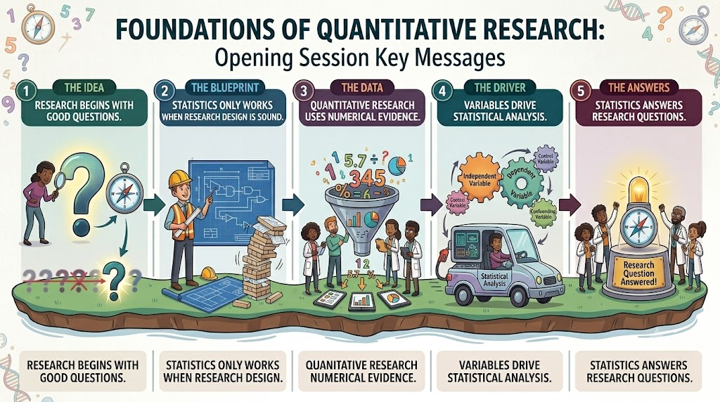
Session 1.1 Key Messages

Slide 21
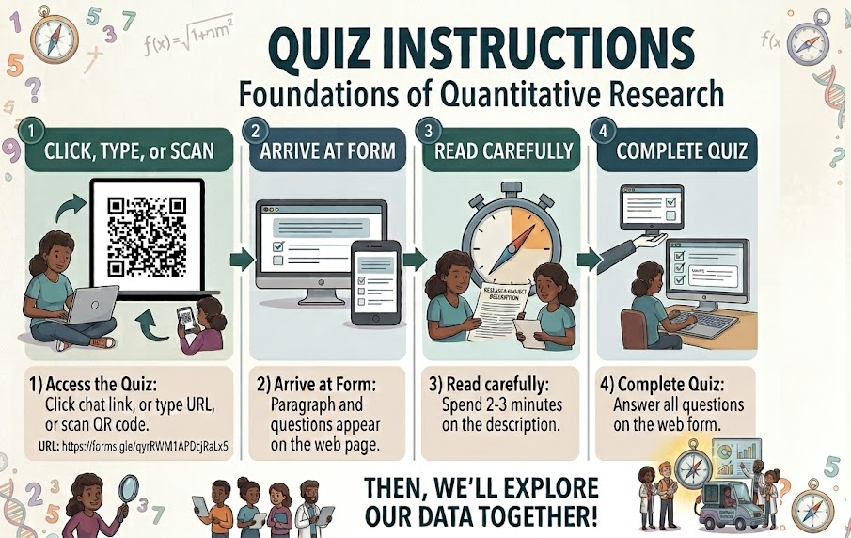
Session 1 – Fun Activity
https://forms.gle/qyrRWM1APDcjRaLx5

Slide 22
7th Annual Emerging African Researcher Training Academy 2026
Foundations of Quantitative Research
Session 1.2
Measurement, Validity and Reliability
Dr Saahier Parker
29 July 2026
African Research Voices in the Age of Artificial Intelligence

Slide 23
Learning Objectives
At the end of this session, you will be able to:
Define variables
Distinguish between independent and dependent variables
Explain different measurement scales
Explain validity
Explain reliability
Understand why measurement quality matters

Slide 24
Why Measurement Matters
"If you cannot measure it appropriately, you cannot analyse it correctly.“
No statistical test can correct a poorly worded question, a biased scale, or an inaccurate instrument. Statistics cannot fix bad data
Measurement determines your statistical options – do it wrong, and you lock yourself out of the right analysis
If your measurement tool lack precision, your conclusions are meaningless - Validity is the foundation of credibility
Reliability ensures your findings are repeatable – Noise destroys replicability

Slide 25
Concepts vs. Variables
Concepts like trust, stress, or motivation exist in theory; Variables are their measurable counterparts: a trust score, a stress scale, a motivation index.
Define how you will measure your concept -"Income“ is abstract, but monthly income in South African Rands is a variable.
The concept is your research interest; the variable is your dataset's reality
How you define the variable shapes your conclusions - Measuring motivation as a single Yes/No question vs. a validated multi-item index will yield completely different data.
Your results are only as good as your variable definitions

Slide 26
Levels of Measurement Matter
Levels of measurement dictates your statistical options, visualisations and statistical possibilities for analysis (see below)
Nominal data cannot be averaged. Ordinal data cannot use parametric tests. Continuous data unlocks powerful tools
You wouldn't use a pie chart for income, or a scatterplot for gender. Level of measurement influences how you can meaningfully visualise data – very important in Multilingual worlds
Level of measurement doesn't just affect your analysis – it defines what conclusions you are even allowed to draw.
Level of Measurement | Description | Visualisations | Statistics
Nominal | Categories with no order (e.g., Gender, Ethnicity, Yes/No) | Bar chart, Pie chart | Frequencies, Proportions, Mode, Chi-square
Ordinal | Categories with a clear order (e.g., Education level, Likert scale) | Bar chart (ordered), Stacked bar | Median, Percentiles, Spearman correlation, Mann-Whitney
Interval / Ratio | Numeric with meaningful differences (e.g., Age, Income, Test scores) | Histogram, Boxplot, Scatterplot | Mean, SD, Pearson correlation, t-tests, ANOVA, Regression

Slide 27
Validity
Am I actually measuring what I think I am?
Measuring “Intelligence” by “the number of books a participant read this year”
Face and Content validity build your foundation, while Construct validity is your theoretical proof.
Criterion validity connects research to reality - showing your instrument does something useful – showing stress scales correlate to blood pressure readings
Type of Validity | What it means | Useful for
Face Validity | Does the instrument look like it measures what it should? | Informal check - useful for pilot testing.
Content Validity | Does the instrument cover all relevant aspects of the concept? | Ensuring comprehensive coverage of the construct – essential for knowledge tests or complex concepts.
Construct Validity | Does the instrument actually measure the theoretical construct it intends to? | The gold standard – crucial for abstract concepts like intelligence or job satisfaction.
Criterion Validity | Does the instrument predict or correlate with an external, concrete outcome? | Applied and diagnostic settings – Can an item predict real-world outcome? Job turnover

Slide 28
Reliability
Reliability – The consistency of a measurement. A reliable instrument produces the same result when the underlying thing being measured hasn't changed. Eg: Bathroom scale OR a Thermometer.
Reliability separates signal from noise; sets a ceiling on validity; amplifies statistical power.
If your data comes from a single survey, check Internal Consistency. If you measure people twice, check Test-Retest. If multiple people score the same data, check Inter-Rater reliability.
Type of Reliability | What it measures | Example
Internal Consistency | Whether all items on a multi-item scale measure the same underlying construct | A 10-item anxiety scale. Cronbach's alpha – a high value (e.g., 0.85) 10 items are measuring anxiety.
Test-Retest | Stability of scores over time | The same cognitive ability test to the same group of adults, two weeks apart. High correlation (r > 0.80) proves the test is stable.
Inter-Rater | Agreement between different observers or coders assessing the same thing | Two doctors independently rate the same set of X-rays for severity. High Kappa statistic shows the measurement isn't dependent

Slide 29
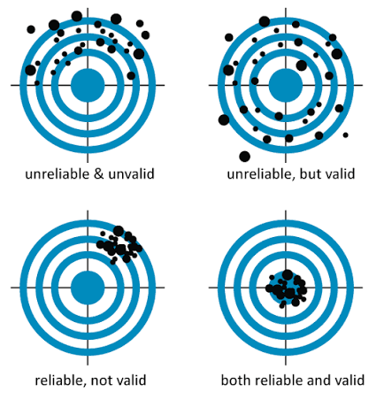
Validity vs Reliability
Reliability is necessary, but not sufficient - Validity is impossible without reliability!
Reliability gets you consistency. Validity gets you precision. You need both to do good research
Scenario | Reliable? | Valid? | What it means
A bathroom scale always reads exactly 2kg too heavy | ✅ Yes | ❌ No | Consistent but wrong – participants are misclassified
A new IQ test gives completely different scores when taken twice | ❌ No | ❌ No | Useless – cannot interpret any single score
A well-validated depression scale with Cronbach's alpha = 0.92 | ✅ Yes | ✅ Yes | Trustworthy measurement – proceed to analysis

Slide 30
Common Measurement Errors
Response Bias- Participants agree with everything OR all Select Option C in MCQ
Recall Bias- participants may not recall events accurately
Item non-response- Skip questions, end surveys, or longitudinal studies
Data Handling Errors- Typos, mis-coded categories, incomplete captures
Error Type | How to minimize
Response Bias | Use balanced scales (reverse-coded items)
Social desirability | Ensure anonymity, use indirect questioning
Interviewer bias | Standardise script, interviewers training
Recall bias | Use objective records or shorten recall period
Missing Data | Design shorter surveys, send reminders
Coding Errors | Double-entry validation, data cleaning checks

Slide 31
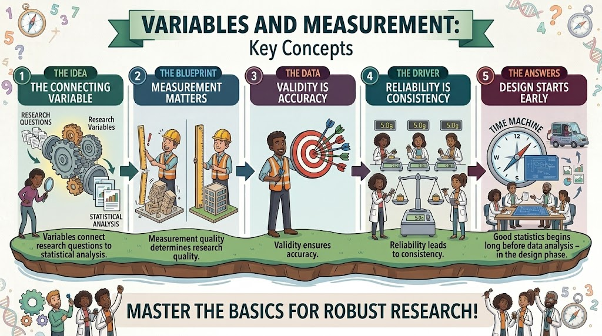
Session 1.2 Key messages

Slide 32
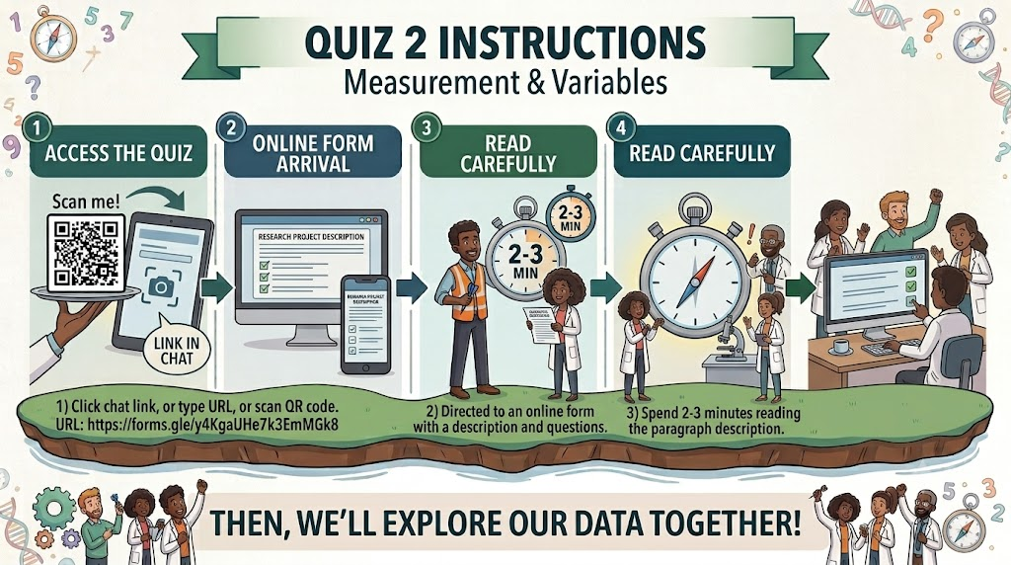

Session 1.2 – Fun Activity
https://forms.gle/y4KgaUHe7k3EmMGk8

Slide 33
7th Annual Emerging African Researcher Training Academy 2026
Thank you
Any questions?
African Research Voices in the Age of Artificial Intelligence

