Slide 1

7th Annual Emerging African Researcher Training Academy 2026
Research Fundamentals
Components and approaches
Presenter: Dr Wilfred Lunga
Date: 27 July 2026
Time: 12:30 – 13:30 WLunga@hsrc.ac.za
African Research Voices in the Age of Artificial Intelligence

Slide 2
7th Annual Emerging African Researcher Training Academy 2026
Contents
Slide 1: Session Objectives
Slide 2: Introduction Activity
Slide 3: Research Components
Slide 4: Research Philosophy
Slide5: Research Strategy
Slide6: Choice of methods
Slide7: Research methods
Slide8: Time Horizons
Slide9: Approach to theory
Slide10: Activity
Slide11: Understanding the research process
Slide12: Data collection and analysis
Slide13: Research techniques
Slide14: Choice of research methods
Slide15: Do the research pieces fit together?
Slide16: My reflections
Slide17: Applying basic AI tools in research
Slide18: Summary
African Research Voices in the Age of Artificial Intelligence

Slide 3
Session Objectives
Understand key components of the research process
Select appropriate research designs
Align research questions, methods, and outputs
Apply basic AI tools in research

Slide 4

Introduction activity
What is research?
What are the key components of the research process? (List as many as you can)
What, in your view, is the most challenging part of the research process?

Slide 5
7th Annual Emerging African Researcher Training Academy 2026
Research Components
African Research Voices in the Age of Artificial Intelligence

Slide 6
Research Components
Philosophy
Approach
Strategy
Methods
Time horizon
Other elements

Slide 7
Research Philosophy
Crux of the research process- influences the methods to be adopted, etc.
• Clarifies principles about the worldview, studied in terms of epistemology
• Epistemology as defining acceptable knowledge and acquisition methods
Two main paradigms:
  • Positivism: Testable questions, subject-independent knowledge.
  • Interpretivism: Individual perception shapes reality
Approach differences:
  • Positivism: Scientific, quantitative testing
  • Interpretivism: Qualitative, subjective analysis
Reflection point: What about you- which paradigm aligns with your research?

Slide 8
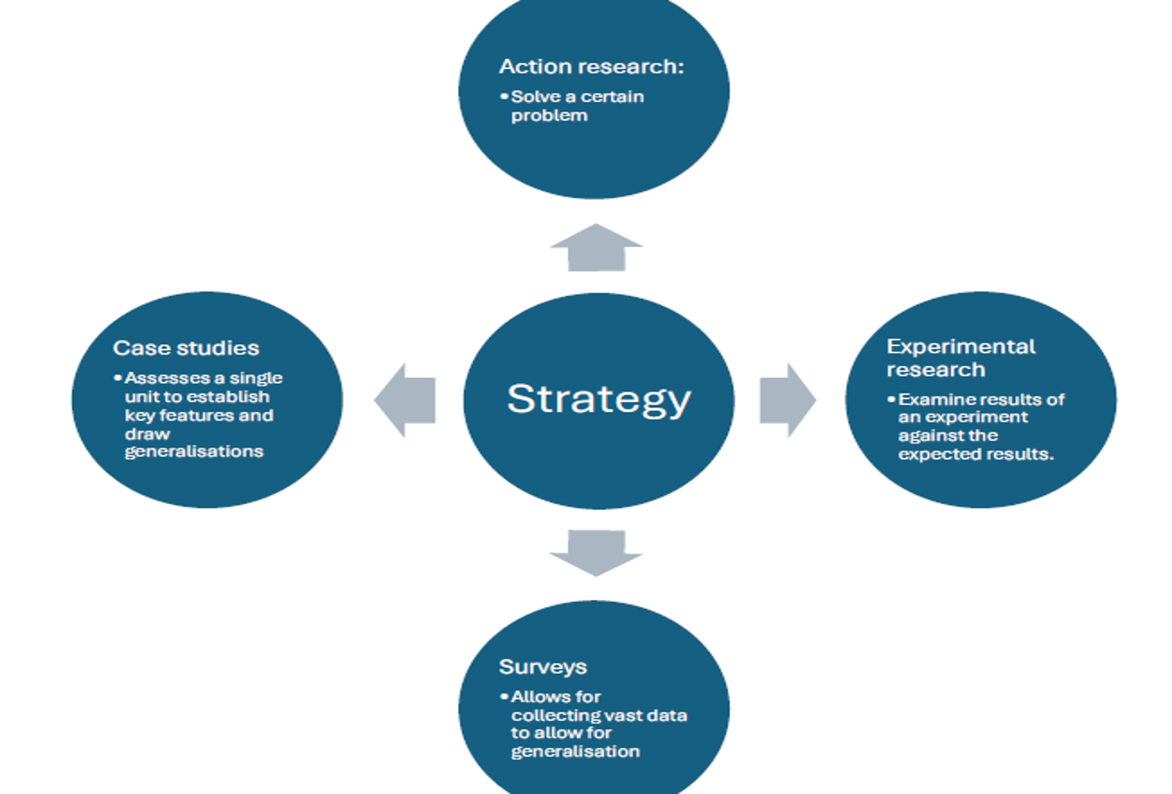
Research strategy

Slide 9
7th Annual Emerging African Researcher Training Academy 2026
Research Methods
Qualitative
Quantitative
Mixed methods
African Research Voices in the Age of Artificial Intelligence

Slide 10
Choice of methods
Three possible choices
1. Mono method- one type of information is gathered.
Therefore, only one method is used. E.g. either
qualitative or quantitative.
2. Mixed method- two or more methods of research
used. E.g. quantitative combined with qualitative.
3. Multi-method- wider selection of methods used.
Research divided into segments, each producing a
specific data set.

Slide 11
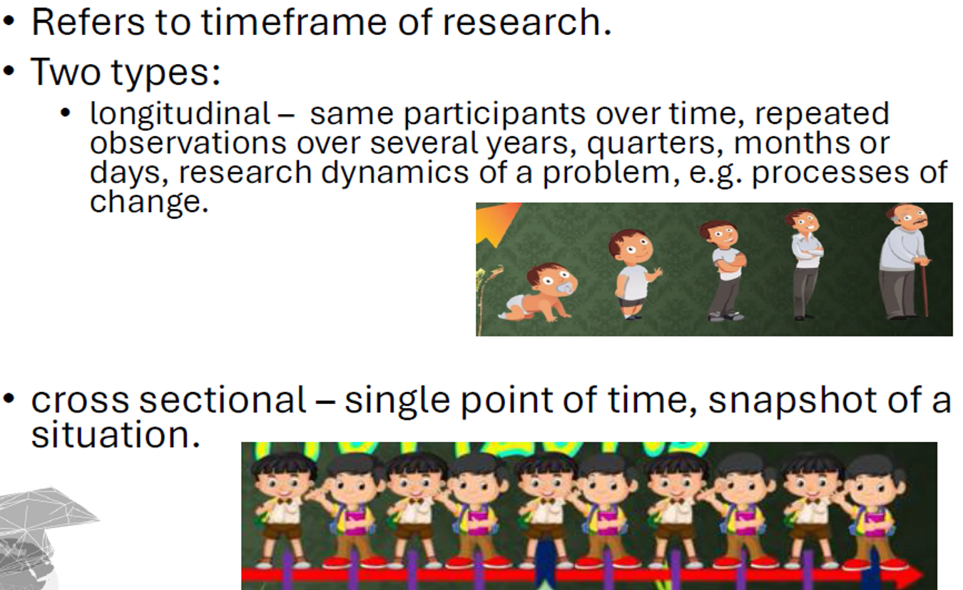
Time horizons

Slide 12
Approach to Theory
Deductive
Inductive

Slide 13
Activity
Pair the following into components, tools, methods, research strategy, and other elements using a table
• Survey
• Interviews
• Inductive
• Case study
• Quantitative
• Positivism
• Sampling
• Deductive
• Positivism
• Qualitative
• Experiment
• Questionnaire
• Dissemination
• Literature review
• Ethics

Slide 14
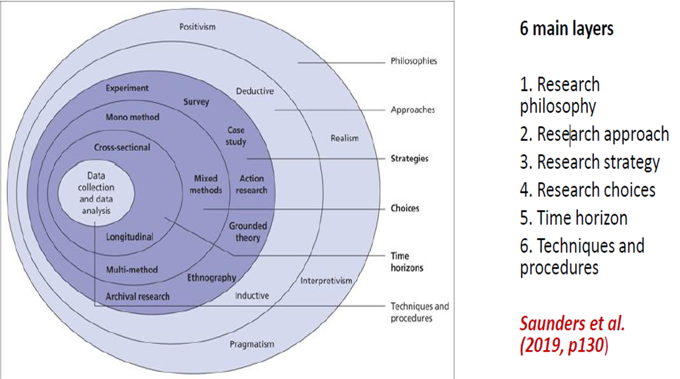
Understanding the research process

Slide 15
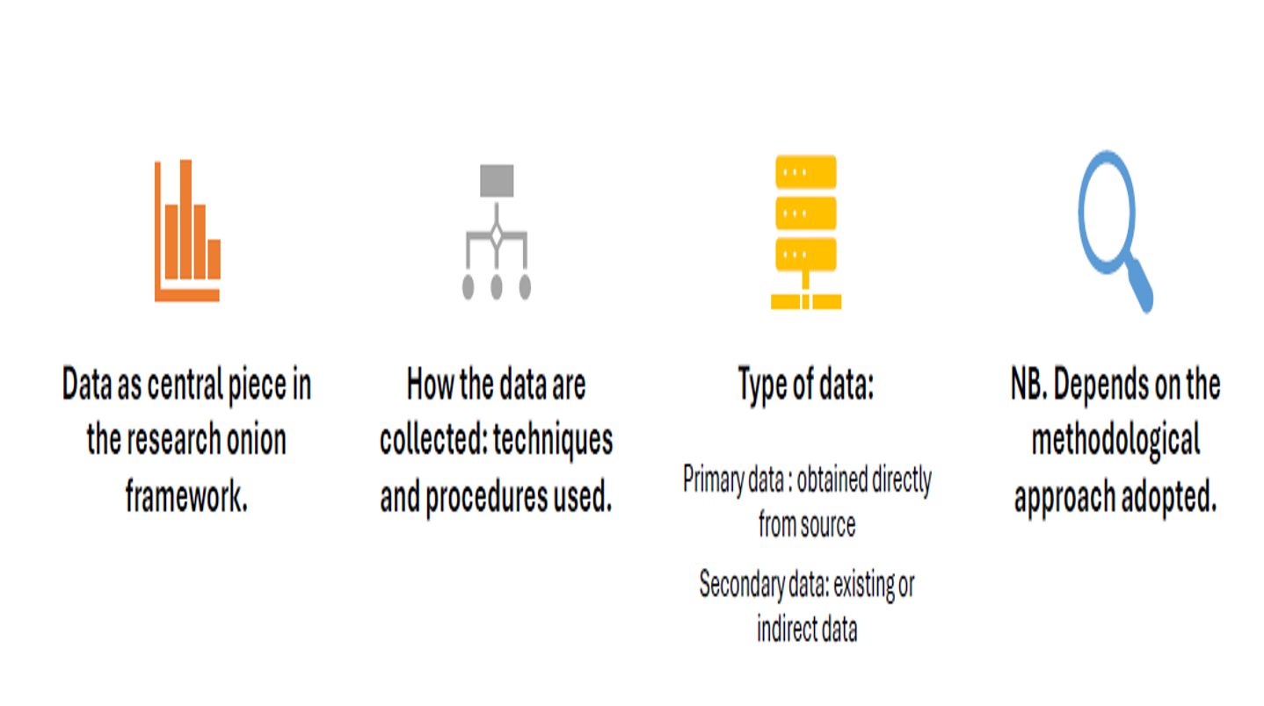
Data collection and analysis

Slide 16

Research techniques

Slide 17
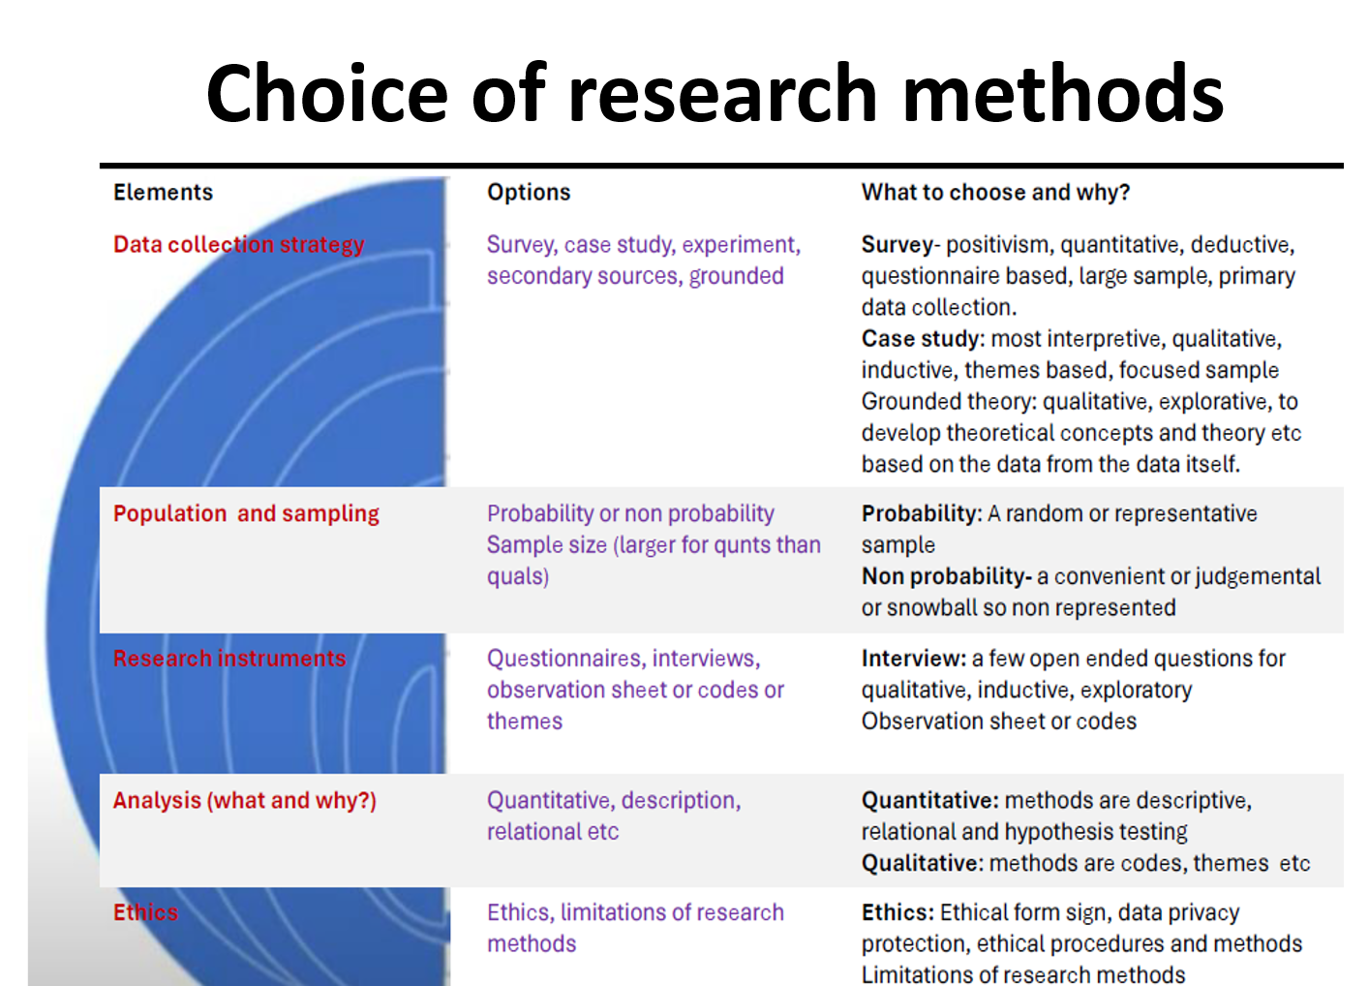
Choice of research methods

Slide 18
Do the research pieces fit together?
This dissertation is based on a premise that very little is actually known about why formal organizational change programmes have such a high rate of failure. The aim of the research is therefore an in-depth exploration of the possible reasons for such failure. In particular, the study will look at the interpretations of failure by senior managers. 200 questionnaires have been sent to senior managers around the UK to test the relationship between the common causes of failure and their effects. The responses were analysed statistically using SPSS. The key finding is that resistance to change is the most common cause of failure of formal organizational change programmes, which supports previous studies.
Reflect on what this extract tells you regarding alignment between research philosophy, approach to theory, methods…

Slide 19
My reflection
This dissertation is based on the premise that very little (1) is actually known about why (2) formal organisational change programmes have such a high rate of failure.
The aim of the research is therefore an in-depth exploration (3) of the possible reasons for such failure. In particular, the study will look at the interpretations (4) of failure by senior managers. 200 questionnaires (5) have been sent to senior managers around UK to test the relationship(6) between the common causes of failure and their effects.
The responses were analysed statistically using SPSS (7). The key finding is that resistance to change is the most common cause of failure of formal organisational change programmes, which (9)supports previous studies.

Slide 20
Applying basic AI tools in research
Smart Literature Discovery & Organization
General AI Chatbots (ChatGPT, Gemini, Perplexity
Research-Focused AI (Elicit, ResearchRabbit, Connected Papers)
Data Analysis & Visualization (Without Being a Statistician)
AI-Powered Data Assistants (Julius AI, Vizly, OpenAI Code Interpreter)
Structuring & Scaffolding the Research Process
Project Mentors (Custom GPTs, Lovable, Notion AI)

Slide 21
Summary
How- are you going to conduct research?
How will you collect data and conduct the analysis?
Why- the chosen plan is best suited for the study, a justification is required.

Slide 22
7th Annual Emerging African Researcher Training Academy 2026
Thank you
Any questions?
African Research Voices in the Age of Artificial Intelligence

