Slide 1

7th Annual Emerging African Researcher Training Academy 2026
Conducting Systematic and Evidence Reviews
Presenters: Mbuzeleni Hlongwa (HSRC), Trisha Ramraj (SAMRC)
Date: 28 July 2026
Time: 14:00 – 16:00
African Research Voices in the Age of Artificial Intelligence

Slide 2
Session Learning objectives
At the end of this module, you should:
Understand the purpose and value of systematic and evidence reviews in research
Distinguish between different types of reviews (e.g., systematic, scoping, narrative, evidence).
Follow the key steps in planning and conducting a systematic/evidence review
Use tools like the PRISMA flowchart for reporting.
Identify appropriate databases and develop search strategies.
Identify key steps for synthesizing evidence
Identify artificial intelligence tools to explore for evidence synthesis

Slide 3
Session Outline
One and Two
One: Introduction & Objectives: Quick overview of the session
Two: Overview of Review Types: Systematic vs. scoping vs. narrative vs. evidence reviews
Three and Four
Three: Planning a Systematic/Evidence Review: Formulating a clear research question
Four: Search Strategy & Database Use : Identifying appropriate databases (PubMed, Scopus, Google Scholar, etc.) Using Boolean operators and keywords
Five, Six and Seven
Five: Screening & Data Extraction: Title/abstract and full-text screening, Tools: Covidence, Rayyan, Excel
Six: Synthesising and Reporting: Descriptive vs. meta-analysis synthesis (briefly), Reporting guidelines: PRISMA
Artificial Intelligence: Using artificial intelligence for evidence synthesis

Slide 4
What is Evidence Synthesis?
Definition:
  A process of systematically collecting, evaluating and combining information from multiple studies to answer a specific question
    Systematic and evidence reviews are crucial for high-quality research
    They help consolidate, appraise, and synthesise findings from existing studies (Moher et al., 2009; Gough et al., 2017).
    Involves predefined methods to identify, assess, and summarise research findings for stronger conclusions
    Unlike traditional literature reviews, they use rigorous methods to reduce bias and improve reliability

Slide 5
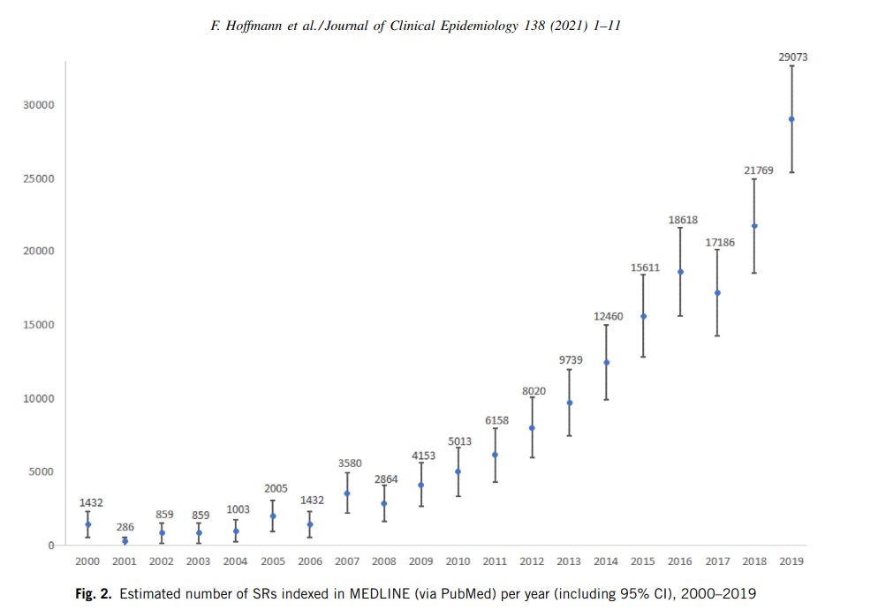
Number of systematic reviews published each year

Slide 6
Overview of review types

Slide 7
Overview of Review Types
Review Type | Purpose | Characteristics | When to Use
Narrative Review (literature review) | To provide a thematic summary and interpretation of existing literature | Often selective, not necessarily systematic, used for theoretical discussions. | For background/contextual information in essays, dissertations, or theoretical papers.
Scoping Review | To map existing literature on a broad topic or emerging area | Broad in scope, includes various study types, does not assess quality in detail. | When exploring what is known, identifying gaps, or informing future research questions.
Rapid Review | Mainly focus on new or emerging research topics (e.g. COVID-19) | Fewer database sources are searched (e.g. PubMed). May include only one reviewer in each stage. | Used when time is limited
Systematic Review (meta-analysis, meta-synthesis) | To answer a specific, focused research question | Comprehensive search, critical appraisal, transparent and replicable methods. May include meta-analysis. | When a rigorous evidence synthesis is needed to guide policy, clinical practice, or research.
Umbrella Review (review of systematic review) | Summarizes findings from multiple systematic reviews to provide a high-level overview of evidence on a topic | High-level synthesis. Evaluates consistency and strength of findings across reviews. | When a high-level summary is needed to compare findings from systematic reviews and inform broad decision-making.
Living Systematic Review | Continuously updated systematic review as new evidence becomes | Ideal for fast-evolving fields (e.g., COVID-19) | When new evidence is emerging rapidly and may change conclusions (e.g., COVID-19)

Slide 8
Differences between scoping & systematic review
Feature | Scoping Review | Systematic Review
Purpose | Broadly explores a topic | Answers a specific research question
Question type | Open-ended | Focused, specific
Search Strategy | Comprehensive | Comprehensive
Study Selection | Includes all relevant literature | Strict inclusion/exclusion criteria
Quality Appraisal | Optional | Mandatory
Data Synthesis | Descriptive/narrative | Quantitative (meta-analysis) or qualitative (meta-synthesis)
Outcome | Identifies gaps, themes, trends | Provides evidence-based conclusions
NB:
Use a scoping review when you need to map the literature, identify gaps, and clarify concepts.
Use a systematic review when you want to synthesize high-quality evidence to answer a focused question.

Slide 9
What type of review is right for you?
Use these tools to decide if you should complete a systematic review or another form of evidence synthesis:
A typology of reviews: an analysis of 14 review types and associated methodologies (Grant and Booth, 2009).
Systematic Review Decision Tree: Which type of Review is Right for You? (Cornell University, DeMello, 2019)
Systematic review or scoping review? Guidance for authors when choosing between a systematic or scoping review approach (Munn et al, 2018)
Right Review: https://whatreviewisrightforyou.knowledgetranslation.net/

Slide 10
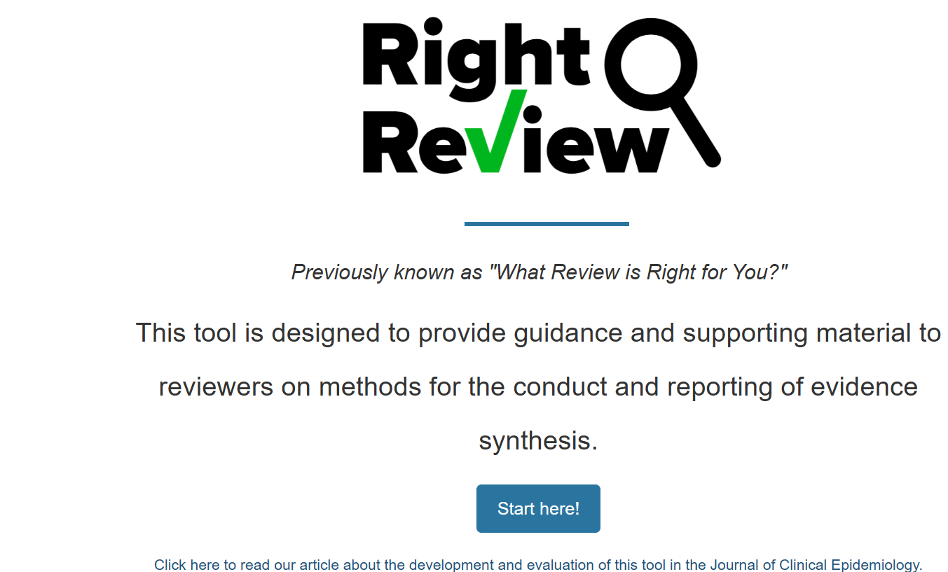
What type of review is right for you?
https://whatreviewisrightforyou.knowledgetranslation.net/

Slide 11
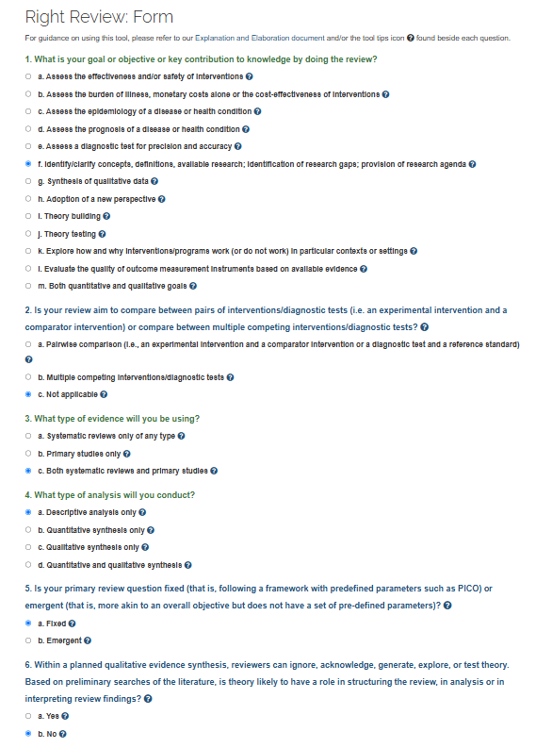
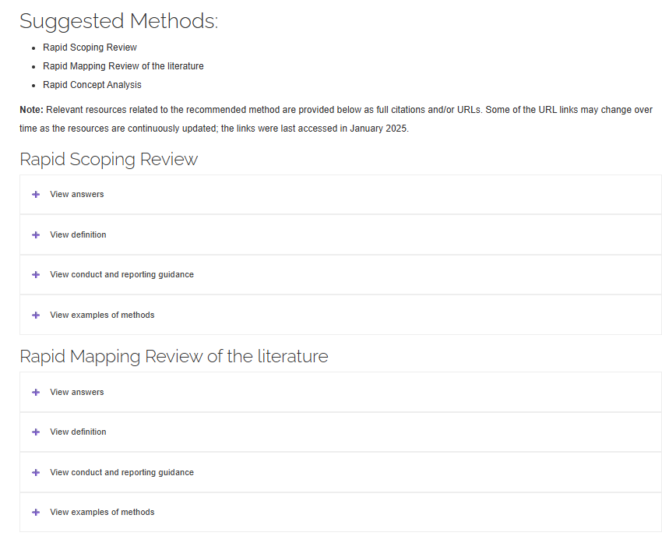
What type of review is right for you?
Right Review: Form (9 questions). For guidance on using this tool, please refer to the Explanation and Elaboration document and/or the tool tips icon found beside each question.
https://whatreviewisrightforyou.knowledgetranslation.net/

Slide 12
Stages of the Review
Defining the research question
Searching the databases
Screening
Data extraction
Data Synthesis/ presentation of findings
Report writing and dissemination

Slide 13
7th Annual Emerging African Researcher Training Academy 2026
Conceptualizing the right research question for a review
African Research Voices in the Age of Artificial Intelligence

Slide 14
Why is the research question important?
A well-defined question guides the entire review process (search strategy, study selection, data extraction).
It ensures the review addresses a meaningful gap in the literature
It helps in identifying key concepts and structuring the scope of the study.

Slide 15
Differences between scoping & systematic review questions (i)
Feature | Scoping Review | Systematic Review
Purpose | Broad exploration of literature | Specific and focused
Question type | Open-ended | Precise and narrow
Example | What is known about barriers to HIV PrEP uptake among men in sub-Saharan Africa? | What is the effectiveness of PrEP interventions in preventing HIV among men in sub-Saharan Africa?

Slide 16
Differences between scoping & systematic review questions (ii)
Examples:
Scoping Review:
  What is known about digital interventions for HIV self-testing in Africa?
  What factors influence PrEP adherence among adolescent boys and young men?
Systematic Review:
  Does mobile health messaging improve PrEP adherence?
  What is the effectiveness of HIV self-testing in increasing ART initiation?

Slide 17
Frameworks for developing a review question (i)
The PICO framework is the most commonly used model for structuring questions because it captures each key element required for a focused question
 | Focus | Questions to ask
P | Population, Patient or Problem | How would I describe a group of patients similar to mine?
I | Intervention, Exposure | Which main intervention, or exposure am I considering?
C | Comparison or Intervention (if appropriate) | What is the main alternative to compare with the intervention?
O | Outcome you would like to measure or achieve | What can I hope to accomplish, measure, improve, or affect?
S | Study design | What study designs will help answer the research question?

Slide 18
Frameworks for developing a review question (ii)
To ensure clarity and comprehensiveness, frameworks help structure the research question.
PCC (Population, Concept, Context) is the recommended approach for scoping reviews.
  Population – Who or what is the focus? (e.g., adolescents, healthcare workers, men at high risk of HIV).
  Concept – What is being studied? (e.g., interventions, experiences, barriers, facilitators).
  Context – Where or in what setting? (e.g., South Africa, low-resource settings, healthcare facilities).
Example:
"What are the barriers and facilitators to PrEP uptake (Concept) among adolescent boys and young men (Population) in sub-Saharan Africa (Context)?"

Slide 19
Other frameworks (i)
SPIDER (for Qualitative & Mixed-Methods Research)
  Sample - Who is involved?
  Phenomenon of Interest - What is being explored?
  Design - Type of study (e.g., interviews, focus groups).
  Evaluation - Outcomes or themes explored
  Research type - Qualitative or mixed methods.
PEO (For Qualitative Reviews)
  Population - Who is the target group?
  Exposure - What experiences or interventions are being studied?
  Outcome - What is being measured?

Slide 20
Other frameworks (ii)
SPICE (for health and social research questions)
  Setting - Where?
  Perspective - For whom? (Population or stakeholders)
  Intervention - What? (Service, policy, or practice)
  Comparison - Compared to what?
  Evaluation - What result or outcome is being measured?
ECLIPSE (for health policy/service evaluation)
  Expectation - What do you want to learn or improve?
  Client group - Who is the service for?
  Location - Where is the service located?
  Impact - What change or outcome is expected?
  Professionals - Who is involved in delivering the service?
  Service - What is the service or intervention?

Slide 21
Other frameworks (ii)
SPICE (for health and social research questions)
  Setting - Where?
  Perspective - For whom? (Population or stakeholders)
  Intervention - What? (Service, policy, or practice)
  Comparison - Compared to what?
  Evaluation - What result or outcome is being measured?
ECLIPSE (for health policy/service evaluation)
  Expectation - What do you want to learn or improve?
  Client group - Who is the service for?
  Location - Where is the service located?
  Impact - What change or outcome is expected?
  Professionals - Who is involved in delivering the service?
  Service - What is the service or intervention?

Slide 22
7th Annual Emerging African Researcher Training Academy 2026
Search strategy and database use – Hands on practical
African Research Voices in the Age of Artificial Intelligence

Slide 23




Search strategy and Database Use
Multiple databases are essential for comprehensive search, they can include the following:
Biomedical
Multidisciplinary
PubMed/MEDLINE, Embase, CINAHL.
Scopus, Web of Science, Google Scholar.
Specialized
Regional
OpenGrey, BASE, Indigenous databases.
Global South and non-English sources.

Slide 24
Search strategy and Database Use
Advanced search strategies enhance precision in literature retrieval. Mastering Boolean logic is essential for effective database querying. This process improves relevance and reduces retrieval bias
Tips for Refining Search
Apply quotation marks for exact phrases (e.g., "mental health")
Use truncation symbols (e.g., child) to capture word variants (child, children, childhood)
Filter by date range, study type, or language to increase relevance
Explore controlled vocabularies like MeSH (PubMed) or Emtree (Embase)
Test and revise your search string based on initial results
Search multiple databases to compare coverage and minimize bias
Use Boolean Logic
AND: Narrows (intersection)
NEAR/n: Proximity searching
NOT: Excludes (subtraction)
ADJ/n: Adjacent terms

Slide 25
Search strategy and Database Use: using AI
AI can be a valuable assistant when developing a search strategy for a scoping review, but it should support—not replace—researcher expertise. The researcher remains responsible for ensuring that the search is comprehensive, transparent, and reproducible.
The table below illustrates practical ways AI can be used throughout the search strategy development process.
Stage | How AI Can Help | Researcher's Role
Define the research question | Refine a broad topic into a clear research question using frameworks such as PCC (Population, Concept, Context). | Ensure the question aligns with the review objectives.
Identify key concepts | Extract the main concepts from the research question. | Confirm that all relevant concepts are included.
Generate keywords | Suggest synonyms, abbreviations, spelling variations, and related terminology. | Verify relevance and remove inappropriate terms.
Identify controlled vocabulary | Suggest MeSH terms (PubMed), Emtree terms (Embase), and other subject headings. | Confirm terms within each database.
Build Boolean search strings | Combine keywords using AND, OR, and NOT. | Check the logic and completeness of the search.
Adapt searches for different databases | Rewrite searches for PubMed, Scopus, Web of Science, CINAHL, etc. | Test and refine syntax for each database.
Improve sensitivity | Suggest additional synonyms or broader concepts to retrieve more studies. | Balance comprehensiveness with precision.
Improve specificity | Recommend additional limits or concepts to reduce irrelevant results. | Decide whether narrowing the search is appropriate.
Translate searches | Convert a search strategy from one database format to another. | Validate the translated search.
Documentation | Draft search methods and search strategy tables for reporting. | Ensure reporting complies with PRISMA-ScR or JBI guidance.

Slide 26
Search strategy and Database Use: using AI - example
Research question
What digital health interventions improve HIV prevention among adolescents in sub-Saharan Africa?
 | Population | Concept | Context
AI identifies the PCC | Adolescents, young people, youth, young adults | Digital health, mHealth, eHealth, mobile apps, SMS, telemedicine, WhatsApp | Sub-Saharan Africa, South Africa, Kenya, Uganda, Nigeria, Zimbabwe
AI suggests synonyms | adolescent* , youth young people, young adult*, teenager* | digital health, mHealth, eHealth, mobile health, smartphone, SMS, mobile application* telemedicine, WhatsApp | sub-Saharan Africa, Africa South of the Sahara, South Africa, Kenya, Uganda, Nigeria Zimbabwe
AI builds a draft search | (adolescent* OR youth OR "young people" OR "young adult*") AND ("digital health" OR mHealth OR eHealth OR smartphone OR SMS OR telemedicine OR WhatsApp) AND (HIV OR AIDS) AND ("sub-Saharan Africa" OR "Africa South of the Sahara" OR "South Africa" OR Kenya OR Uganda OR Nigeria)

Slide 27
Search strategy and Database Use: using AI - example
AI tools that can assist
Tool | Use
ChatGPT | Brainstorm research questions, identify keywords, generate Boolean searches, adapt search strategies, and explain methodology.
PubMed MeSH Database | Identify controlled vocabulary (not AI, but essential).
Elicit | Find relevant papers, extract key concepts, and identify related terms.
Semantic Scholar | Discover related studies and citation networks.
Scopus AI (where available) | Explore topics and identify key terminology from the literature.
Consensus | Summarize evidence and identify commonly used terminology.

Slide 28
7th Annual Emerging African Researcher Training Academy 2026
AI for Systematic Review Recommended Tools
African Research Voices in the Age of Artificial Intelligence

Slide 29
Tool | Primary Function | AI Capabilities | Ideal Use Case | Advantages | Limitations
Research Gold | End-to-end systematic review platform | Active-learning screening, AI relevance ranking, AI-assisted inclusion/exclusion suggestions with explanations, duplicate detection, recall estimation | Researchers wanting an integrated workflow from screening to PRISMA reporting | Browser-based, supports two-reviewer reconciliation, structured extraction templates, risk of bias modules (paid tiers), PRISMA support | Advanced features (full-text screening, RoB, GRADE, audit trails) require paid plans; AI suggestions still require human confirmation.
Covidence AI | Systematic review management | Learns from reviewer decisions to prioritize likely relevant studies and assist title/abstract screening | Cochrane reviews, systematic reviews with multiple reviewers | Intuitive workflow, EndNote integration, supports screening, full-text review, data extraction and PRISMA reporting | Subscription required; AI is mainly focused on screening rather than literature discovery.
Rayyan | Citation screening | Machine learning predicts inclusion decisions based on previous reviewer choices, highlights keywords, identifies duplicates | Independent title/abstract screening and collaboration | Free basic version, blinded screening, easy collaboration, widely used for systematic and scoping reviews | Does not support comprehensive data extraction or meta-analysis; AI recommendations improve as reviewers provide more decisions.
DistillerSR | Enterprise review management | AI-assisted screening, workflow automation, AI-assisted data extraction, prioritization of citations | Large systematic reviews, HTAs, regulatory reviews | Highly customizable workflows, audit trails, quality management, enterprise compliance | High cost and steeper learning curve; best suited to institutional review teams.
Elicit | AI research assistant | Semantic search, evidence summarization, extraction of study characteristics, answers research questions using published literature | Topic exploration, rapid evidence summaries, scoping searches | Quickly identifies relevant papers and summarizes findings, useful for developing research questions | Not designed for PRISMA-compliant systematic reviews because it is not intended to perform exhaustive literature retrieval. Outputs require verification.
RobotReviewer / EPPI-Reviewer | Risk of bias assessment | Machine learning identifies text relevant to risk-of-bias domains | Risk of bias assessment after study selection | Reduces time required for quality appraisal, particularly in academic reviews | Supports rather than replaces reviewer judgment; human validation remains essential.

Slide 30
7th Annual Emerging African Researcher Training Academy 2026
Screening and Data Extraction in Rayyan – Hands-on practical
African Research Voices in the Age of Artificial Intelligence

Slide 31
Rayyan for Evidence Synthesis
What is Rayyan?
Web-based and mobile application
Designed specifically for systematic, scoping reviews and other types of evidence synthesis
Helps researchers screen studies quickly and efficiently
  Rayyan simplifies one of the most time-consuming stages of evidence synthesis - screening stages
  Access from anywhere, no download/installation
  Free and paid – free tier is robust enough for most projects
  It enables independent screening by multiple reviewers while reducing bias and improving collaboration
  Can provide your PRISMA diagram for reporting (paid subscription)

Slide 32
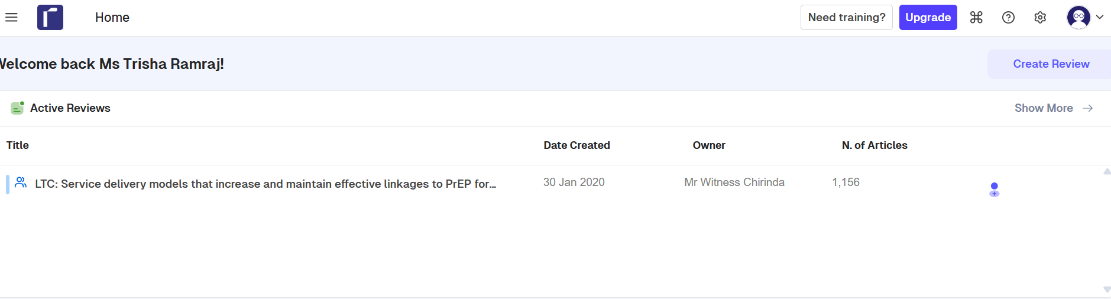
Creating a Rayyan Account
Go to https://new.rayyan.ai/
Create an account

Slide 33
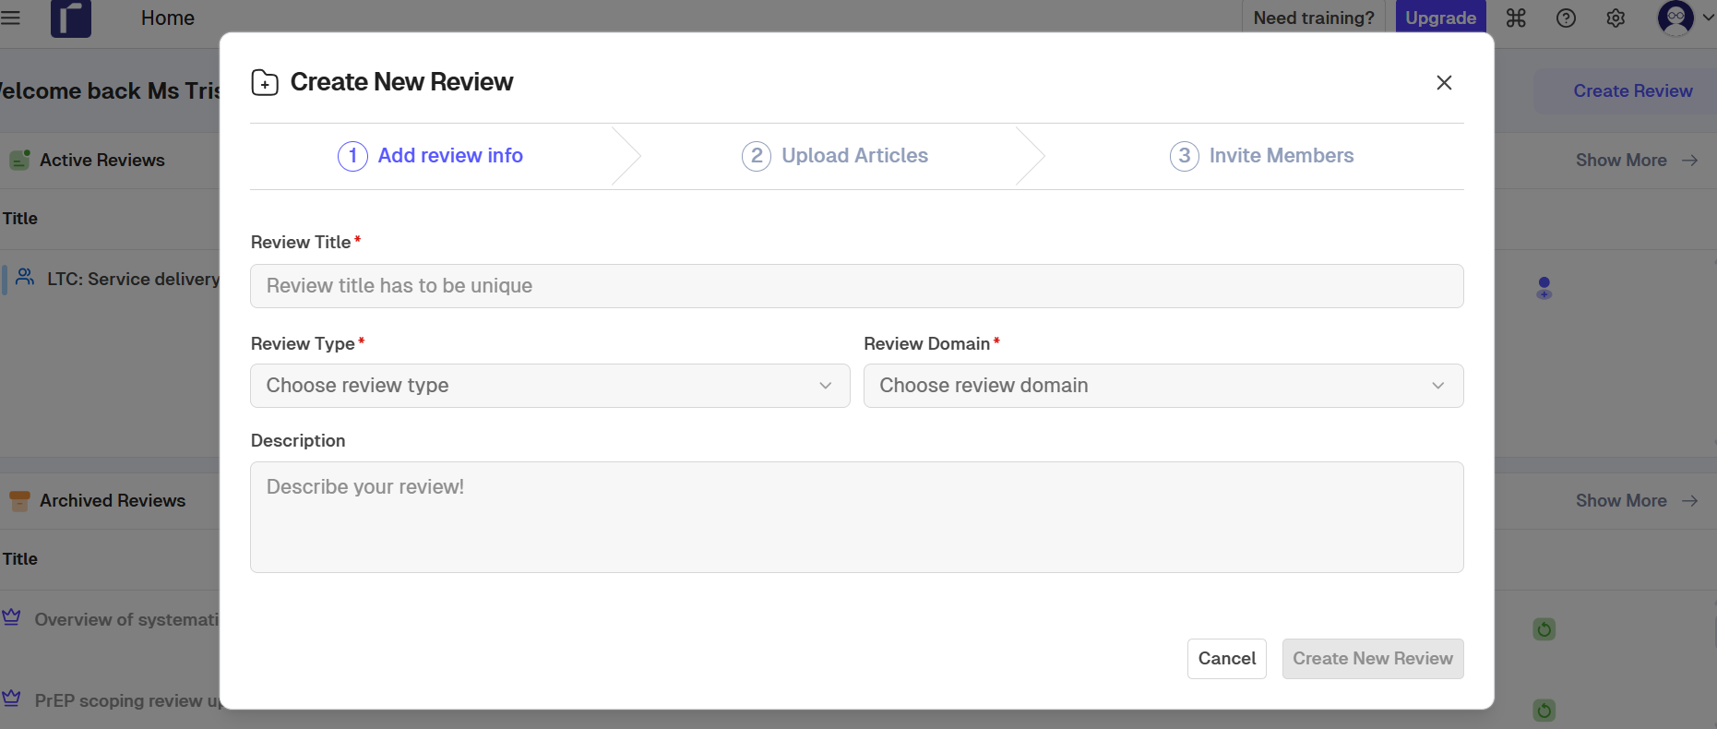
Creating a Project

Slide 34
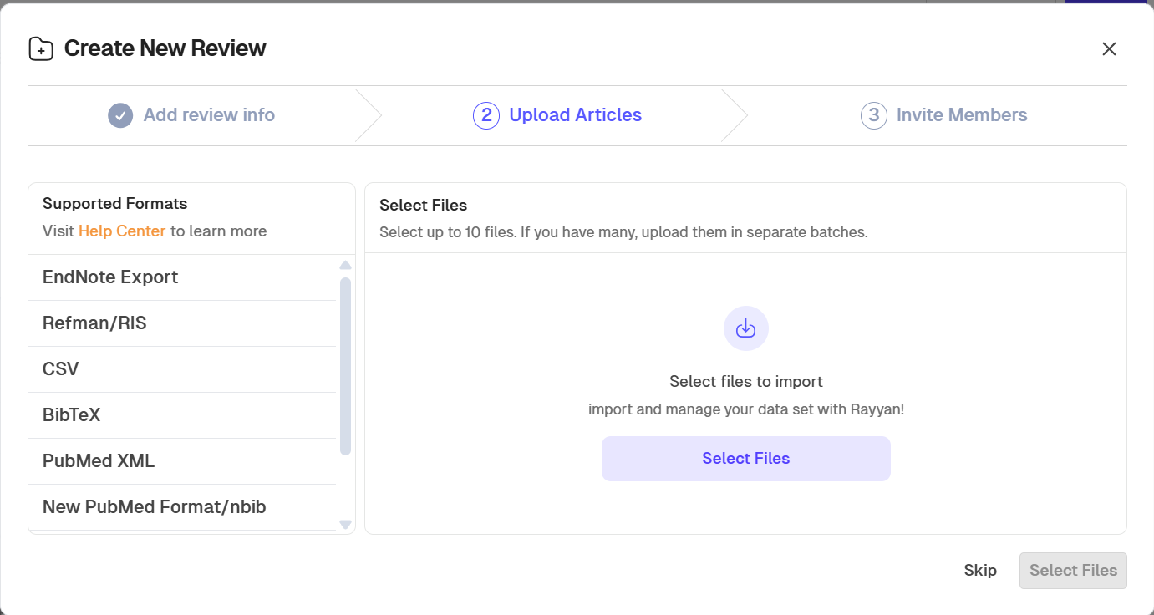
Creating a Project

Slide 35
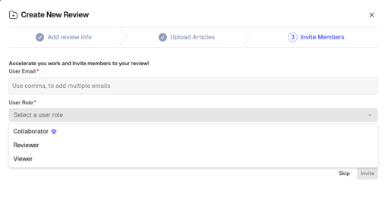
Adding collaborators
After uploading articles (or skipping), you will be prompted to invite members.
Enter email addresses
Assign a role
Collaborator: Co-lead researcher or review manager responsible for administering the review, importing citations, managing team members, resolving conflicts, and exporting results.
Reviewer: Independent screener who reviews titles/abstracts and full texts, records include/exclude decisions, and participates in blinded screening.
Viewer: Read-only access. Suitable for supervisors, students observing the review process, or stakeholders who need to monitor progress without making decisions.

Slide 36
Adding collaborators
Feature/Permission | Collaborator | Reviewer | Viewer
View all references | ✅ | ✅ | ✅
Screen titles and abstracts | ✅ | ✅ | ❌
Make inclusion/exclusion decisions | ✅ | ✅ | ❌
Add labels and exclusion reasons | ✅ | ✅ | ❌
Add notes/comments | ✅ | ✅ | View only
Resolve conflicts | ✅ (if permitted by owner) | ❌ | ❌
View other reviewers' decisions during blinded screening | Only after unblinding | Only after unblinding | N/A
Invite or remove team members | ✅ (if granted by owner) | ❌ | ❌
Modify review settings | ✅ (if granted by owner) | ❌ | ❌
Upload/import references | ✅ | ❌ | ❌
Export references | ✅ | Usually no | ❌
Delete references | ✅ | ❌ | ❌
Create or edit filters, labels, and groups | ✅ | Limited | ❌
Participate in blind screening | ✅ | ✅ | ❌
Access project statistics | ✅ | Limited | View only

Slide 37
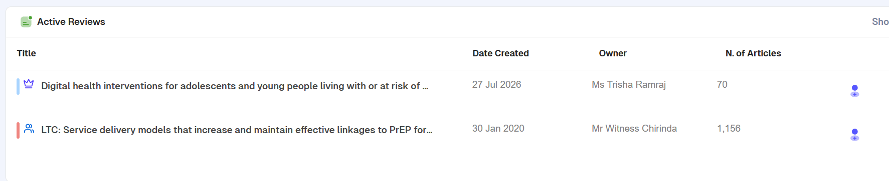
Opening and working on a project
Click a project name on home screen
Overview tab will show basic information: review information, data summary (number of articles, duplicates), review members, screening information (screening criteria – add inclusion/exclusion criteria for reviewers, track progress).

Slide 38
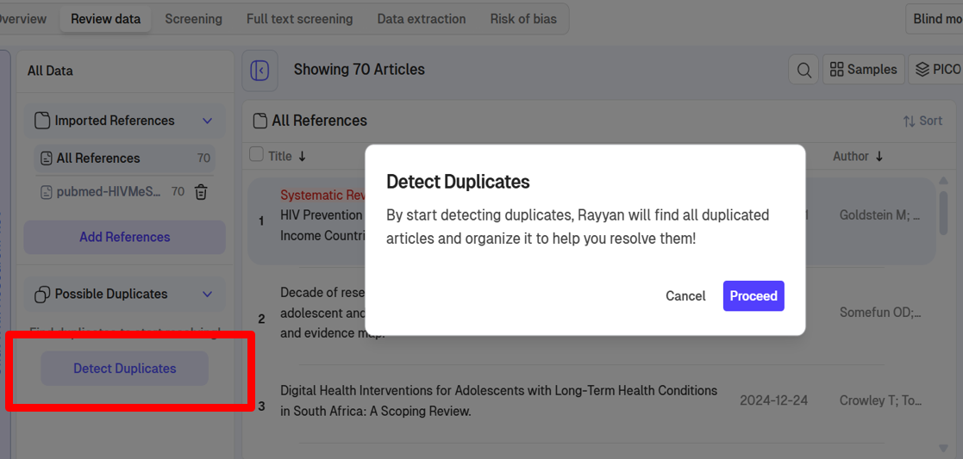
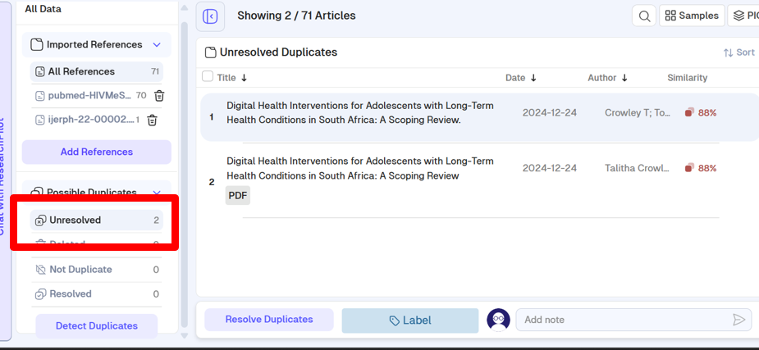
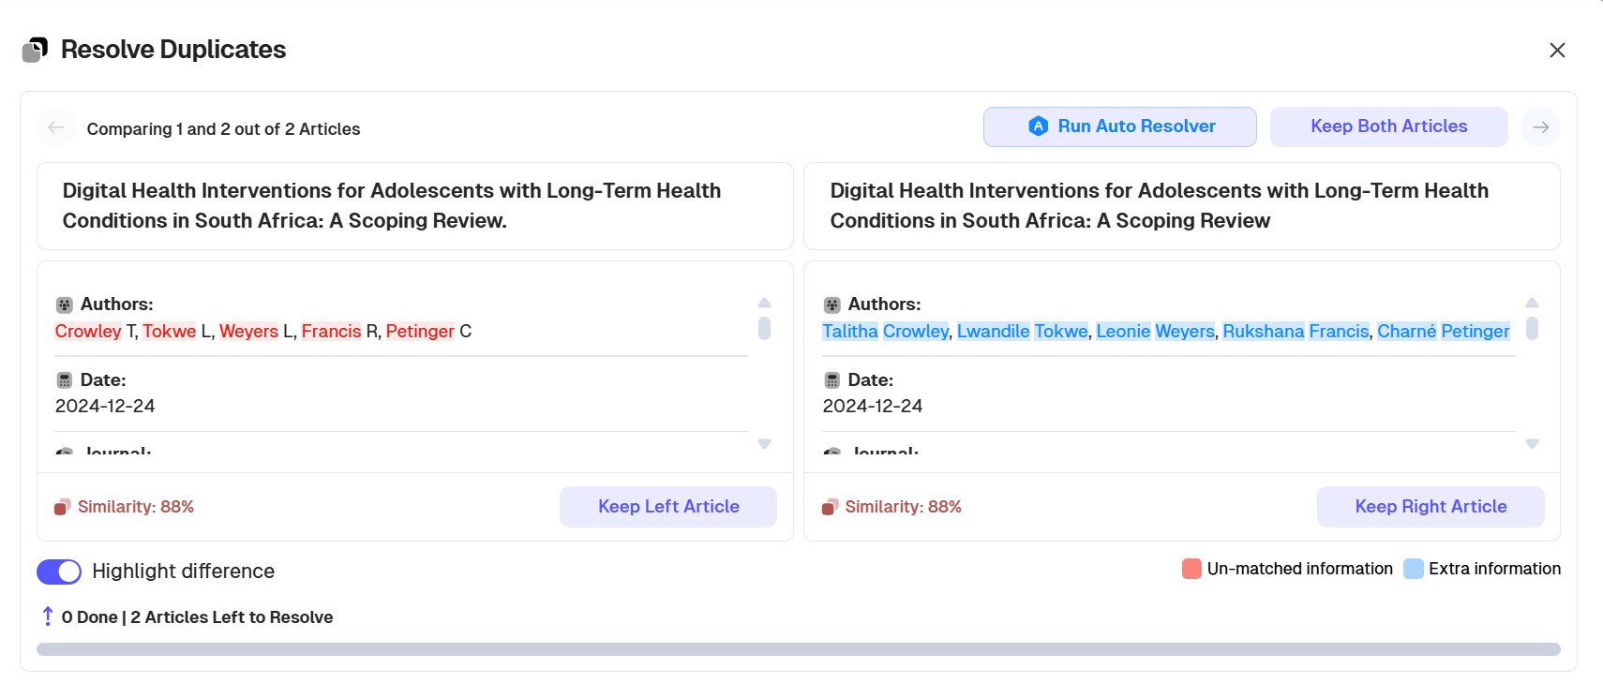
De- duplication
Searches from multiple databases often result in duplicate records
Rayyan can help identify possible duplicates.- you have the final judgment call.
Click on ‘Review Data’ tab.
Click ‘Detect Duplicates’
Click ‘Unresolved’ to see duplicates.
Check titles, authors, dates, similarity %
Click ‘Resolve duplicates’ and click relevant button to keep one or both articles

Slide 39
Screening
What is screening?
At least 2 reviewers (>2 preferred to reduce bias)
Independently read all research results
Apply the study’s defined inclusion/exclusion criteria
Make decisions regarding which results should be included in the study
Usually happens in 2 stages
Title and abstract only
Full text articles
Most applications like Rayyan offer a ‘blinding’ feature so that reviewer decisions are not biased/influenced by seeing other reviewers' decisions.

Slide 40
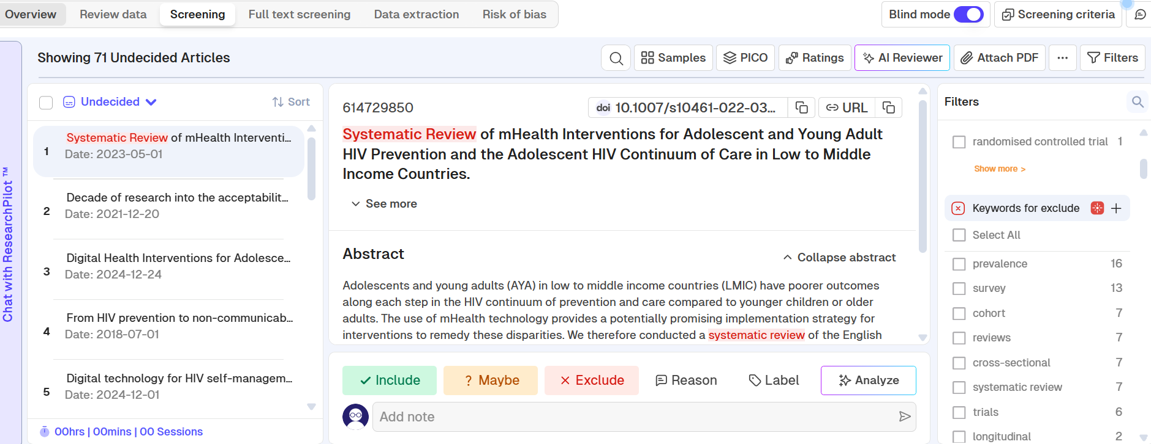
Screening
Click on ‘Screening’ tab.
Ensure Blind Mode is On
All articles listed on left pane
Individual articles listed in the middle
Filters for keywords, highlights etc are on right pane. You can choose to switch these off.

Slide 41
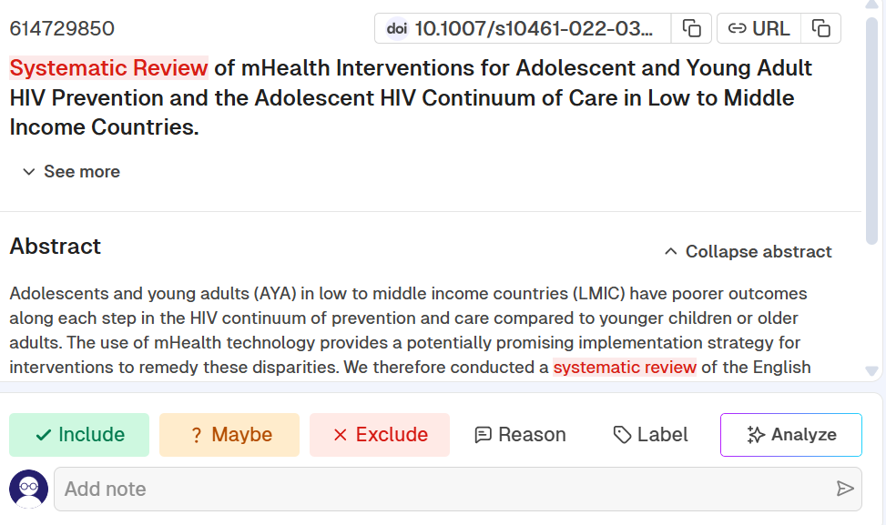
Screening
Click on each citation.
Read title and abstract
Apply inclusion and exclusion criteria of study.
Mark as Include, Maybe or Exclude

Slide 42
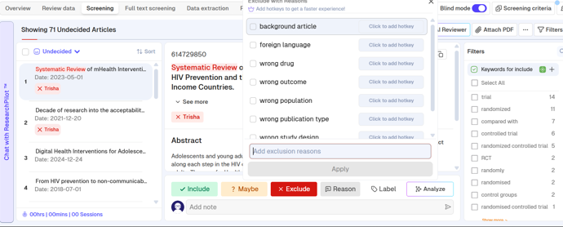
Screening
Can add a reason for exclusion for standardisation and PRISM
Add notes for example if you selected maybe and want to add your reason.

Slide 43
Screening
Once all reviewers have completed the process:
Turn Blind off on ‘Screening Tab’ to see each reviewers decision
Filter citation to display conflicts
Discuss conflicts comparing decisions, exclusion reasons, labels, notes
When a consensus is reached, each reviewer changes decision as needed.
‘Undecided’ option must be = 0
Filter ‘Maybe’ and resolve or wait till full text round

Slide 44
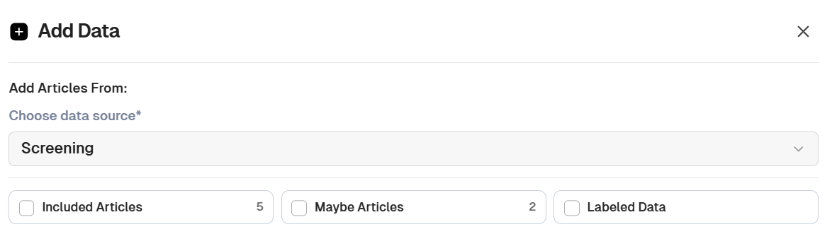
Full text
Click the ‘Full text screening’ tab.
Click Add data
Select the records from the title and abstract screening round which should be pulled through to the full-text screening:
- Included articles, possible ‘Maybe’s’ and ‘Labels’

Slide 45
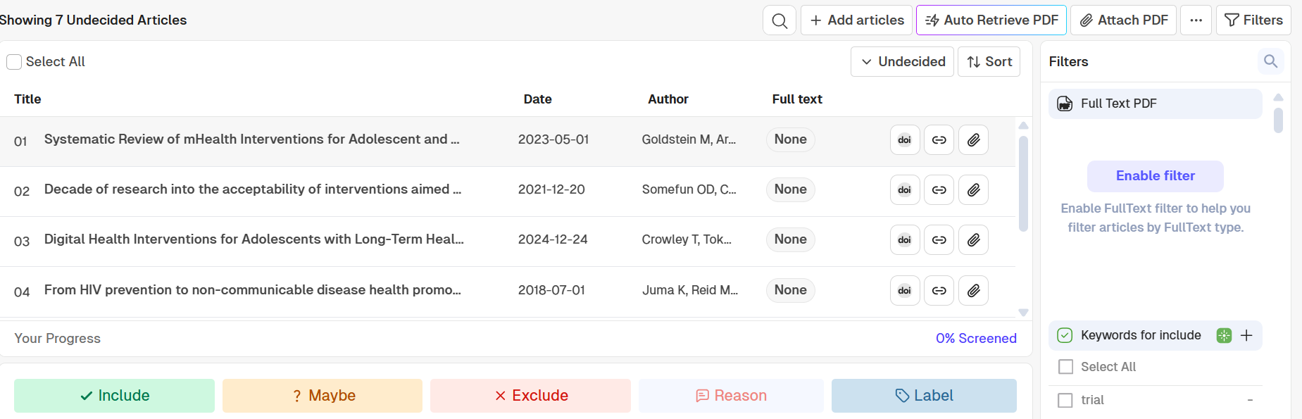
Full text
Use the Add article option to upload full text PDFs allowing you to remain in Rayyan when screening
Use the URL option to open articles
Option to auto-retrieve PDF
Repeat the process for BLIND ON screening
Reviewers should use the full text article to make include/exclude decision.
Repeat steps for resolving conflicts
Final citation set for analysis is ready

Slide 46
Other features on Rayyan: AI
Make at least 50 decisions in your dataset including at least 5 include and 5 exclude decisions.
AI engine will calculate the likelihood of each article to be included in your literature review (5 stars most likely).
Re-sort citations by rating to make decisions.
Compute ratings at any time, more decisions should lead to more accurate ratings.
Provides additional information to assist you to make decisions more efficiently – BUT do not trust all AI recommendations with human review.

Slide 47
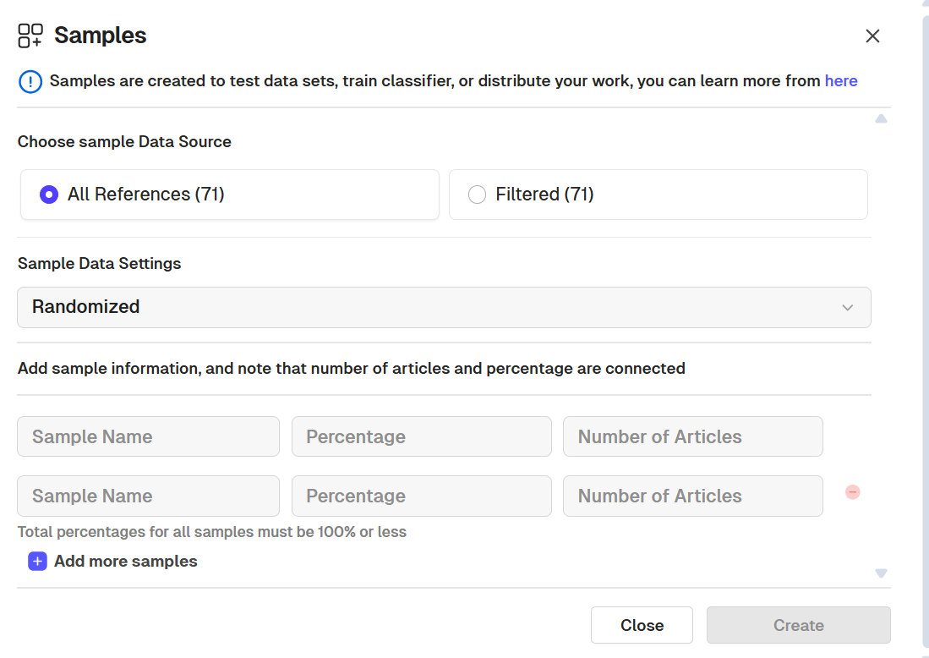
Other features on Rayyan: Creating samples
Used during screening to divide screening amongst a large team of reviewers by random distribution.
Use after screening: Divide workload of qualitative analysis, data extraction and coding.
Create sample either from all references or a subset.

Slide 48
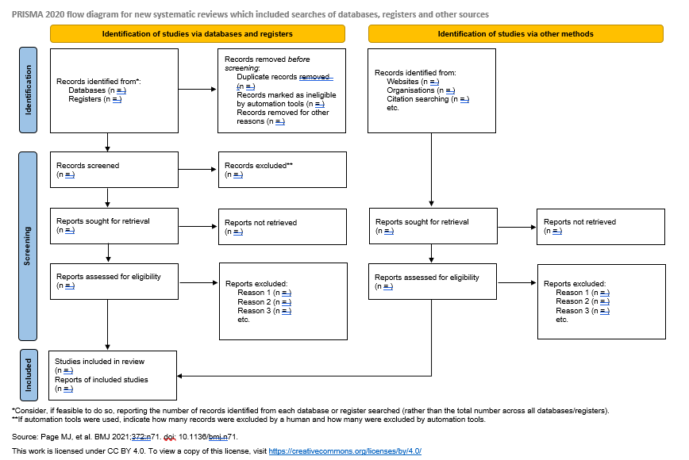
PRISMA Flow Diagram
The Preferred Reporting Items for Systematic Reviews and Meta-Analyses (PRISMA) diagram is used to document the number of studies screened and included.

Slide 49
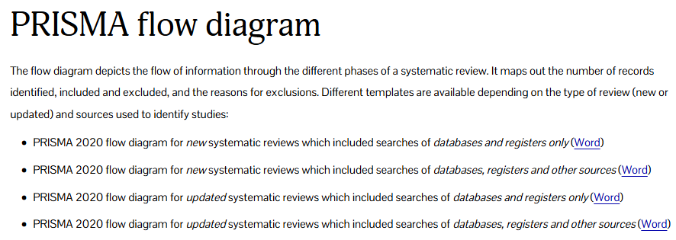
PRISMA Flow Diagram
https://www.prisma-statement.org/
Flow diagrams can also be generated using a Shiny App available at https://www.eshackathon.org/software/PRISMA2020.html

Slide 50
7th Annual Emerging African Researcher Training Academy 2026
Synthesizing and reporting
African Research Voices in the Age of Artificial Intelligence

Slide 51
What is Data Synthesis in a review?
Data synthesis is the process of summarising, organising, and presenting evidence from the included studies
Unlike systematic reviews, scoping reviews do not assess effectiveness or conduct meta-analysis but rather map key concepts, themes, and gaps in the literature

Slide 52
Steps in Data Synthesis
Data Extraction
  Extract relevant data from studies using a standardized form
  Include study characteristics, populations, interventions, and key findings.
Organising the Data
  Group studies by key characteristics (e.g., country, population, intervention type).
  Use tables and charts for structured organisation.
Identifying Themes & Patterns
  Look for repeating themes, gaps, and trends across studies.
  Categorize findings into meaningful groups (e.g., facilitators vs. barriers)
Sumarising & reporting findings
  Use narrative synthesis, tables, and figures to present results
  Clearly outline what is known, gaps in the literature, and areas for future research

Slide 53
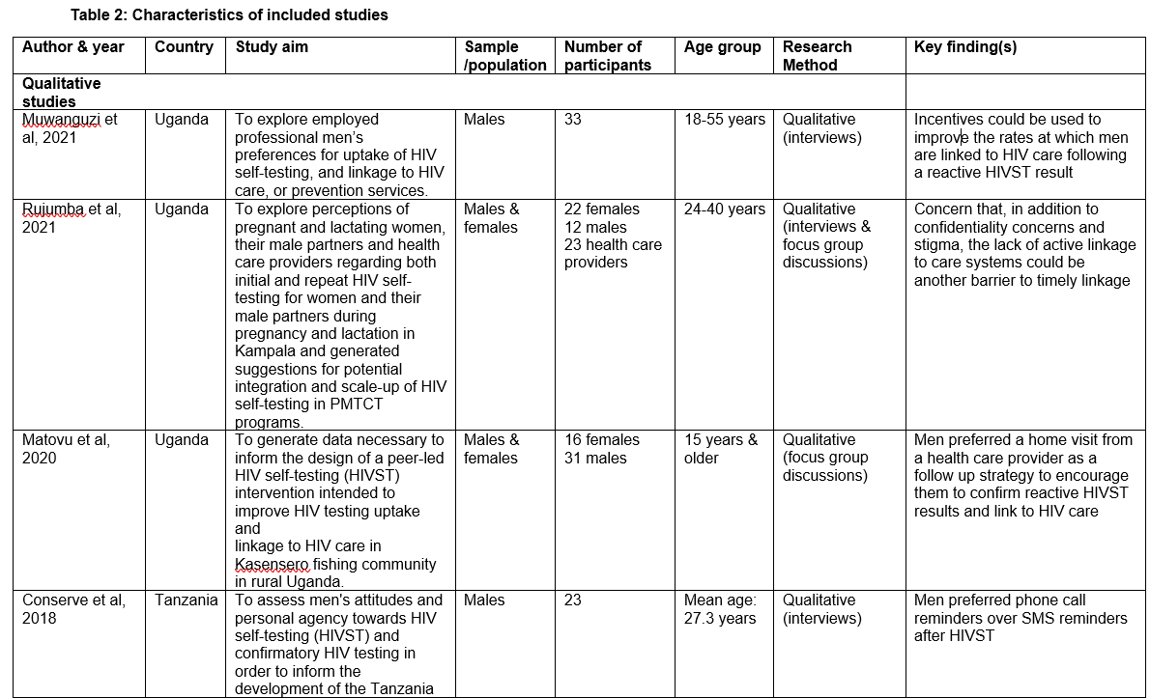
Example of Descriptive Table
Present the characteristics of your included studies in text and using a table

Slide 54
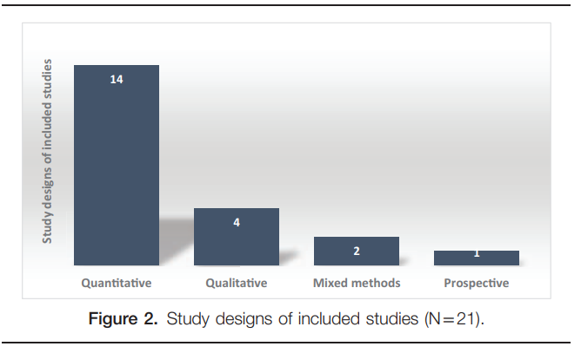
Example of a Graphic Form
You can present some of the characteristics in a graphic form
E.g.

Slide 55
Arguments in favour of using artificial intelligence in evidence synthesis
AI can increase efficiency
  Systematic reviews often involve screening thousands of titles and abstracts
  Faster completion of evidence syntheses, reducing weeks or months of manual work
AI can support better decision-making
When combined with expert review, AI can help researchers:
  Identify important evidence more quickly
  Detect patterns across studies
  Produce timely evidence for clinicians and policymakers

Slide 56
Arguments against using artificial intelligence in evidence synthesis (i)
AI can hallucinate
  AI may invent studies, citations, or findings that do not exist.
  It may confidently present inaccurate information.
  Evidence synthesis requires factual accuracy and traceability
Lack of transparency
  Many AI models do not clearly explain how they reached a decision
  Systematic reviews require every inclusion and exclusion decision to be reproducible and auditable.
  Can another researcher reproduce an AI's reasoning?
Over-Reliance on AI can reduce critical thinking
Researchers may:
  Become less engaged with the evidence
  Accept AI outputs without verification
  Overlook methodological flaws

Slide 57
Benefits of conducting reviews
Access to free data: e.g. PubMed, EBSCOhost, etc.
Does not require primary data collection
High-Quality Evidence: Generates robust evidence that can inform policy, shape practice, and improve health outcomes
Promotes Research Integrity - demands transparency
Enhances knowledge on chosen research topic
Fosters inclusive education - enables collaboration and building networks
No Ethics Approval required, unless you’re doing it for degree purposes
Highly publishable in high-ranking journals

Slide 58
Challenges related to conducting reviews
Progress can take a long time if done manually
Collaboration is essential: success often depends on effective teamwork and clear communication among collaborators
Needs at least two or more authors to ensure methodological rigor & reduce bias
Demands accountability from all team members
Project success depends on careful planning and meeting strict timelines
Requires strict record keeping for transparency, reproducibility, and publication standards

Slide 59
Reading list
Sackett DL, Strauss SE, Richardson WS, et al. Evidence-based medicine: how to practice and teach EBM. London: Churchill-Livingstone, 2000.
Steves R, Hootman JM. Evidence-based medicine: what is it and how does it apply to athletic training? J Athl Train 2004;39:83–7.
Masic, I., Miokovic, M., & Muhamedagic, B. (2008). Evidence based medicine-new approaches and challenges. Acta Informatica Medica, 16(4), 219.
Akobeng AK. Principles of evidence based medicine. Archives of disease in childhood. 2005 Aug 1;90(8):837-40.
Guyatt, G. H., Oxman, A. D., Schünemann, H. J., Tugwell, P., & Knottnerus, A. (2011). GRADE guidelines: a new series of articles in the Journal of Clinical Epidemiology. Journal of clinical epidemiology, 64(4), 380-382.
Mixed method quality appraisal tool. http://mixedmethodsappraisaltoolpublic.pbworks.com/w/file/fetch/84371689/MMAT%202011%20criteria%20and%20tutorial%202011-06-29updated2014.08.21.pdf
Tricco, A. C., Lillie, E., Zarin, W., O'Brien, K. K., Colquhoun, H., Levac, D., ... & Straus, S. E. (2018). PRISMA extension for scoping reviews (PRISMA-ScR): checklist and explanation. Annals of internal medicine, 169(7), 467-473. ▪ Arksey, H., & O'Malley, L. (2005). Scoping studies: towards a methodological framework. International journal of social research methodology, 8(1), 19-32.
Aromataris E, Munn Z. Chapter 1: JBI Systematic Reviews. In: Aromataris E, Munn Z (Editors). JBI Manual for Evidence Synthesis. JBI, 2020. Available from https://synthesismanual.jbi.global.. https://doi.org/10.46658/JBIMES-20-02

Slide 60
7th Annual Emerging African Researcher Training Academy 2026
Thank you
Any questions?
African Research Voices in the Age of Artificial Intelligence

