Slide 1

Module 12. Quantitative Research Using STATA
Presenter/s: Dr Ben Roberts, Dr Steven Gordon & Ms Muneza Munyatore
Date: 29 July 2026
Time 14.00-16.00
Presenter email addresses:
broberts@hsrc.ac.za
sgordon@hsrc.ac.za
mmunyatore@hsrc.ac.za
7th Annual Emerging African Researcher Training Academy 2026
African Research Voices in the Age of Artificial Intelligence

Slide 2
Lesson plan outline
Aweh, Let's Get Started! Welcome, introductions and orientation [10 mins]
Before you hit the N1...Getting started with STATA [20 mins]
Take a lekker look around: Exploring your data [25 mins]
Who’s in the Taxi Together? Investigating relationships between variables [25 mins]
Putting the dombolos in the stew: From relationships to modelling [20 mins]
H(AI)bo!: STATA and AI-assisted quantitative research [10 mins]
Home Time… But Keep the Fire Burning. Reflection, evaluation and next steps [10 mins]

Slide 3
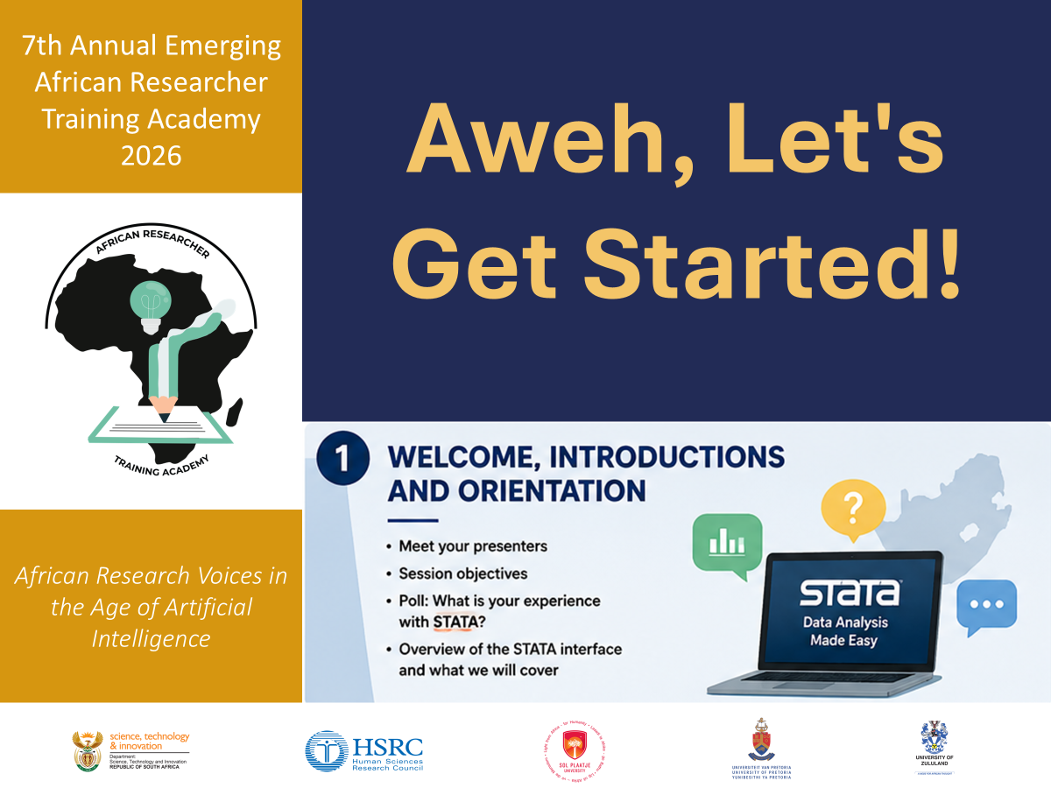
7th Annual Emerging African Researcher Training Academy 2026
NEXT SECTION SLIDE
African Research Voices in the Age of Artificial Intelligence

Slide 4
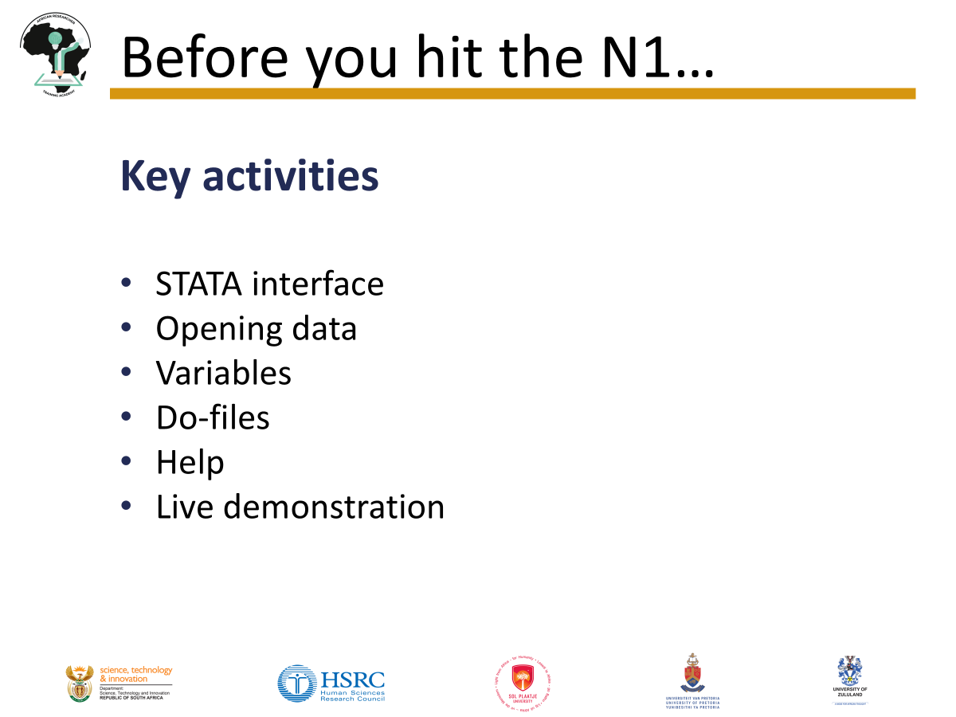
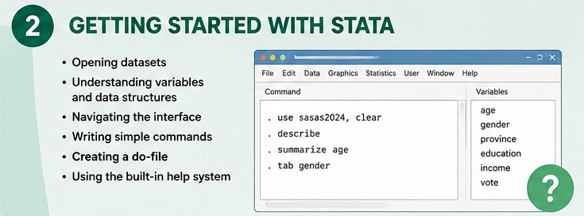
7th Annual Emerging African Researcher Training Academy 2026
Before you hit the N1...
African Research Voices in the Age of Artificial Intelligence

Slide 5
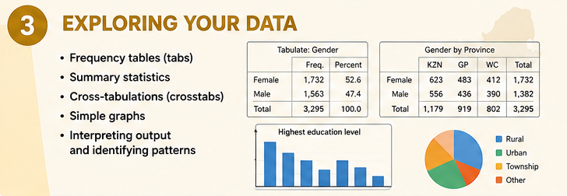
7th Annual Emerging African Researcher Training Academy 2026
Take a lekker look around
African Research Voices in the Age of Artificial Intelligence

Slide 6
Take a lekker look around
Key activities
STATA interface
Frequency tables (tab)
Summary statistics (summarize)
Crosstabs (tab ..., row col)
Interpreting output
Practical exercise
Discussion

Slide 7
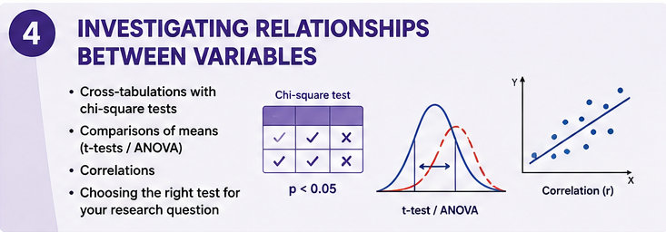
7th Annual Emerging African Researcher Training Academy 2026
Who’s in the Taxi Together?
African Research Voices in the Age of Artificial Intelligence

Slide 8
Who’s in the taxi together?
Key activities
Research questions
Choosing the correct statistical test
Chi-square
t-test
ANOVA
Correlation
Practical example

Slide 9
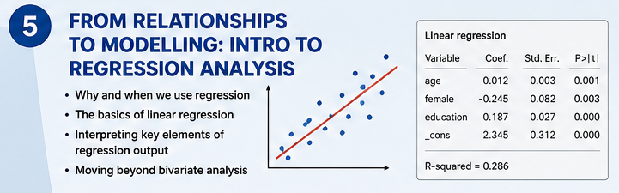
7th Annual Emerging African Researcher Training Academy 2026
Putting the dombolos in the stew
African Research Voices in the Age of Artificial Intelligence

Slide 10
Putting the dombolos in the stew
A gentle introduction to regression analysis
Key activities
Why regression?
Regression concept
Reading regression output
Transition to more advanced courses

Slide 11
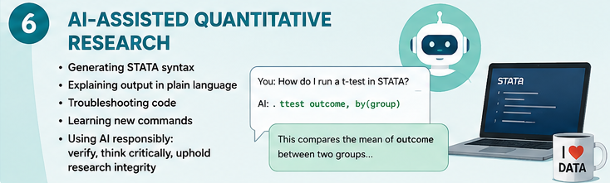
7th Annual Emerging African Researcher Training Academy 2026
H(AI)bo! STATA and AI-assisted analysis
African Research Voices in the Age of Artificial Intelligence

Slide 12
H(AI)bo!...STATA and AI usage
Key activities
AI demonstration
Good prompts
Common mistakes
Responsible AI

Slide 13

7th Annual Emerging African Researcher Training Academy 2026
Home time… but keep the fire burning
African Research Voices in the Age of Artificial Intelligence

Slide 14
Home time…but keep the home fires burning
Key activities
Knowledge check
Resources
Thank you / Q&A

Slide 15

7th Annual Emerging African Researcher Training Academy 2026
Thank you
Any questions?
African Research Voices in the Age of Artificial Intelligence

