Slide 1

7th Annual Emerging African Researcher Training Academy 2026
LITERATURE SEARCH, REFERENCING AND FINDING SECONDARY DATA
Shingirirai Muzondo
28 July 2026
11h00-13h00
smuzondo@hsrc.ac.za
African Research Voices in the Age of Artificial Intelligence

Slide 2
Contents
Stages in the information searching process
Decide which database to use
Core principles of searching
Searching techniques
Evaluation of information resources
Open access
Questions & Live Demonstration
7th Annual Emerging African Researcher Training Academy 2026
African Research Voices in the Age of Artificial Intelligence

Slide 3
Lesson plan outline
At the end of this module, you should:
Understand the literature searching process
Identify stages in the information-seeking process
Identify relevant databases and therefore relevant information
Evaluate information and information resources

Slide 4
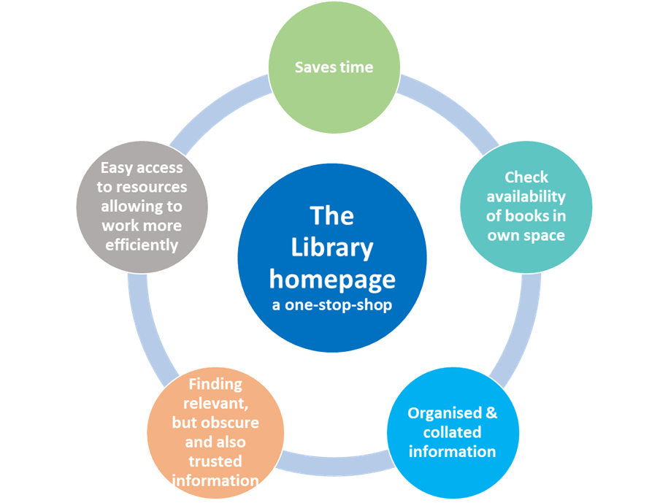
Stages in the Information Searching Process
Analysis of the research topic
Decide which database to use
Searching techniques
Open Access
Artificial Intelligence (AI) Benefits
AI can brainstorm keywords, find synonyms,
or help structure highly effective
search queries for traditional databases
Artificial Intelligence (AI) Risks
AI can confidently generate false
information or fabricate sources that
do not exist

Slide 5

Decide which Database to Use
Types of Material
Articles: EBSCO, ProQuest (AI), Scopus (AI), SA ePublications
Publisher databases (Sage, Springer, Oxford, Wiley, Elsevier, Taylor & Francis etc.
Books: Library Catalogue, WorldCat
Statistics: Regional Explorer (ReX)
Legislation: Sabinet's Netlaw, LexisNexis (policy documents)
Research Reports: World Bank, OECD iLibrary, IMF Library
Tools
Bibliographic management: Mendeley, EndNote, Zotero
Funding / Expertise/Collaborators: Research Africa

Slide 6
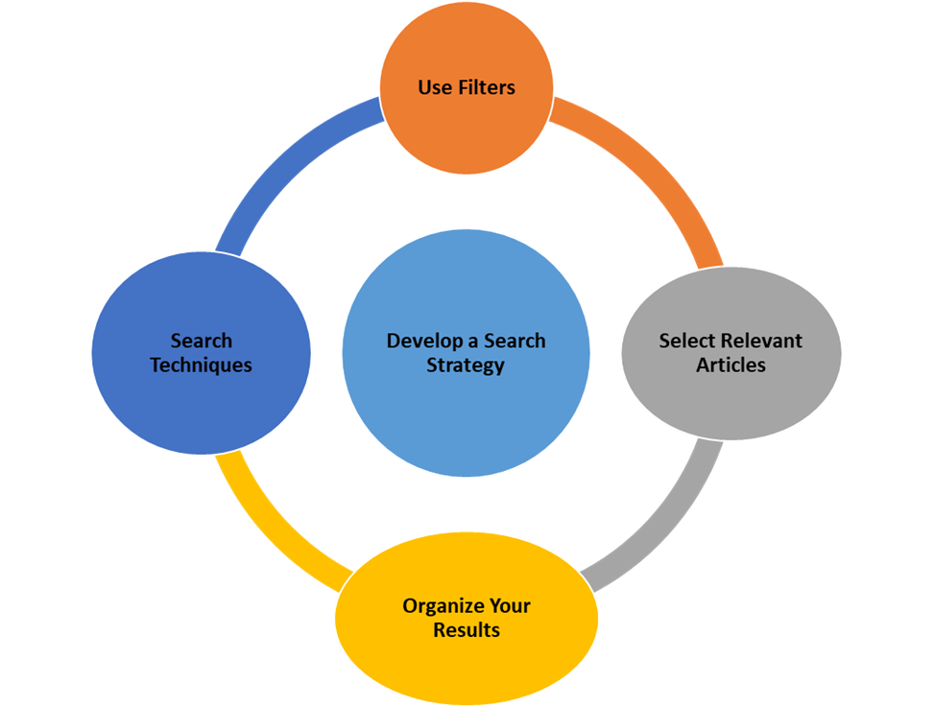
Core Principles of Searching
While AI is a valuable tool for discovery, its ranking algorithms and natural language processing can sometimes overlook important studies. Utilising search techniques like Boolean operators (AND, OR, NOT) allows for precise and reproducible searches, particularly in systematic literature reviews. These techniques give users complete control over how keywords and concepts intersect, resulting in transparent and measurable outcomes. UNISA and UP Library (2026)

Slide 7
Searching Techniques
Natural language searching
A Search like Google – it uses all the words you type, and use the Boolean operator “AND to search across the board – This returns thousands of hits
Boolean searching
Broaden or narrow your search by combining words or phrases using the Boolean operators: AND OR and NOT
Parentheses
Use parentheses to clarify relationships between search terms
Example: (television or mass media)
Truncation and Wildcards
A symbol at the end of a word stem provides for all variants on the word stem. The most commonly used symbol is the asterisk (*)
Example: educat* will retrieve educate, educating education, educator…etc.
A symbol within a word provides for all possible variants inside a word or word stem. A commonly used symbol for internal truncation is: ?
Example: wom?n will retrieve woman and women

Slide 8
Searching Techniques
Limit the result in terms of:
Academic / Peer Reviewed / Grey Literature
Period, Full Text, Language, Geographical Area, Keywords, Subject etc.
Develop a search strategy:
Example: “I urgently need the best articles on Poverty Health Inequality Unemployment and Health Outcomes. I need to look at this from a biobehavioural perspective”
Poverty AND health AND biobehaviour*
Inequality AND health AND biobehaviour*
Unemployment AND health AND biobehaviour*
I am writing a paper on the prevalence of self-reported cataract and associated risk factors. Please search for the most recent papers (less than 10 years old)
Cataract” AND elderly OR aged OR “older adult*”
“self-reported cataract*”
Cataract” AND prevalence AND impact
Cataract” AND “disease burden”

Slide 9
Evaluation of Information Resources
Authority
What is the source of the information – is it a trusted scholarly, peer-reviewed publication?
What is your method of access – Did you access this resource through a controlled gateway such as a database?
Is the author an expert or an authority? Is his affiliation available? What else has he/she published on your topic?
Is the author referenced or cited by other authors in the field?
Objectivity
Is the author or sponsor advocating particular viewpoints or causes? Are any biases or assumptions noted?
Does the publication appear to be marketing services or products?
Was the research sponsored in any way?

Slide 10
Evaluation of Information Resources
Accuracy and currency
Is the date of the publication evident? Are the dates of datasets within the source evident?
Are the sources factual, and is the data clearly listed to enable verification?
Relevance and audience
Does this source give some relevant data, information or useful background for your research question?
Who is the intended audience? Is the information written for consumers, employees, investors, students, researchers, specialists or experts? Is the level of content appropriate for your research
Artificial Intelligence (AI)
You must evaluate AI output for accuracy by cross-referencing claims against trusted databases and primary sources
Check citations, trace claims, assess for bias.
Identify the organisation or developer behind the AI tool and look for transparency in their algorithms

Slide 11
Open Access
Increasing the visibility of your research
Extreme costs of packaged journal subscriptions
Drive to make publicly funded information freely available
The HSRC a front-runner!
All Research Outputs are available free of charge to the outside world, except for confidential papers.
Online available since 2000.
Some books published by the HSRC Press are available for download free of charge (embargo applies for recently published books)
Transformative Agreements (Taylor & Francis + Springer)

Slide 12

7th Annual Emerging African Researcher Training Academy 2026
Any Questions?
Live Demonstration
(Databases + Referencing with Mendeley)
African Research Voices in the Age of Artificial Intelligence

